Slide 1

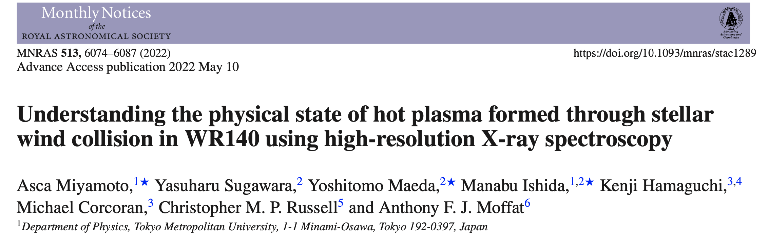
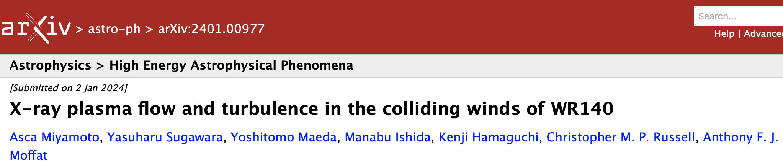
Understanding the physical state of hot plasma formed through stellar wind collision in WR140 using high-resolution X-ray spectroscopy
Tokyo Metropolitan University
Miyamoto, Asca
accepted
Notes:
Today, I’ll talk about the physical state of hot plasma formed by stellar wind collision in WR140. I’m aska from tokyo metropolitan university in japan. My talk is based on these papers. These are my collaborators.

Slide 2




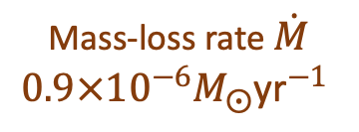

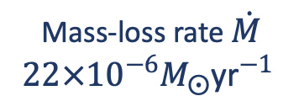


Introduction： Wolf-Rayet(WR) 140
Shock cone : emitting X-rays
O star
(O5.5fc)
WR star
(WC7pd)
$$2R_{⨀}$$
$$26R_{⨀}$$
Terminal velocity
of stellar wind
$$2860 {\text{km} \text{s}}^{−1}$$
$$16M_{⨀}$$
$$41M_{⨀}$$
Terminal velocity
of stellar wind
$$3100 {\text{km} \text{s}}^{−1}$$
Mass-loss rate $\dot{M}$
$$22×{10}^{−6}M_{⨀}{\text{yr}}^{−1}$$
Mass-loss rate $\dot{M}$
$$0.9×{10}^{−6}M_{⨀}{\text{yr}}^{−1}$$
The shock cone is open to the O star
Monnier+2011, Sugawara+2015
Notes:
Wolf-Rayet 140, my target, is a binary of a WR star and an O star, orbiting each other with a period of about 8 years.
Both stars expel high-velocity supersonic stellar winds, have high Mass-loss rates, and their collision forms a shock cone that heats and compresses a hot plasma which emits X-rays. Because the WR star's wind is more intense, the shock cone is open to the O star.

Slide 3
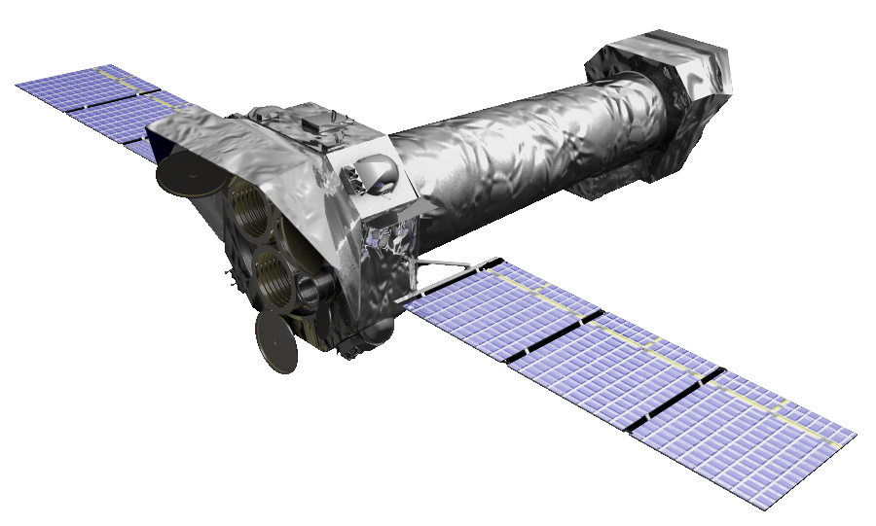
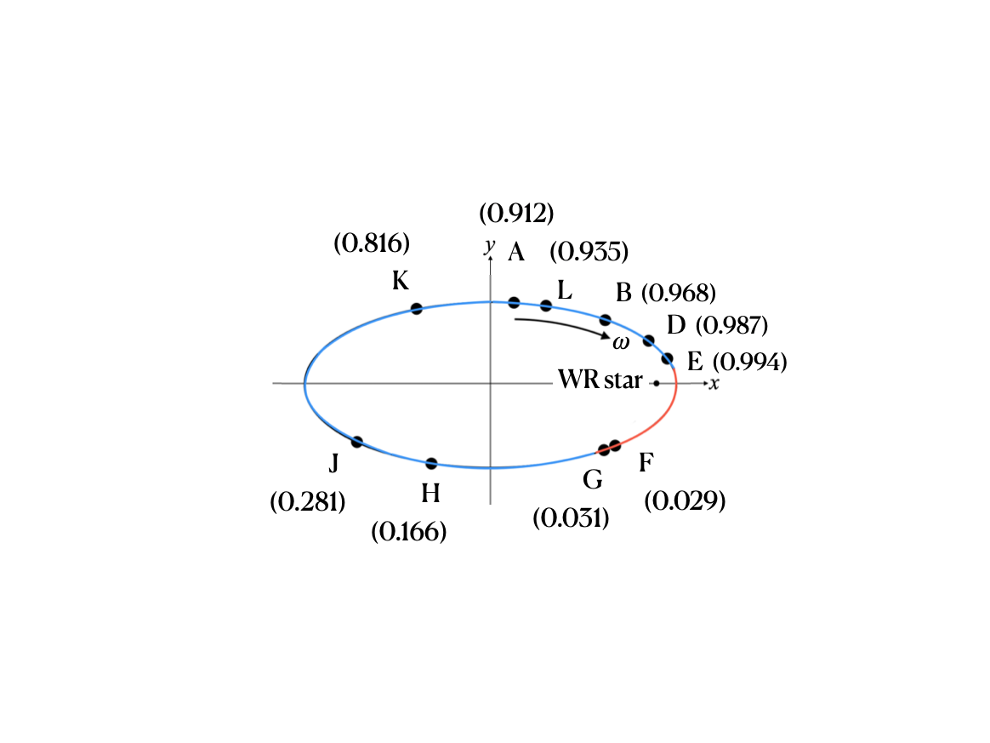
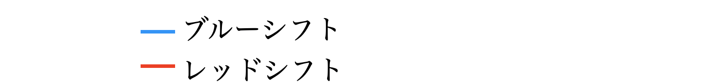
Orbital image of WR140
Credit: ESA/XMM-Newton,
CC BY-SA 3.0 IGO
Inferior conjunction
Monnier+2011
inclination: 119.6°
argument periastron: 46.8 °
Superior conjunction
The O star in the foreground of the WR star
The O star in the background of the WR star
Notes:
The orbit of WR140 is shown here. We fix the WR star at one of the foci of The elliptical orbit, and plot The O star at phases we observed.
Please imagine The observer views this system from a position elevated about 60 degrees from the plane of the paper. Except for phases F and G, The O star is on The observer's side.

Slide 4
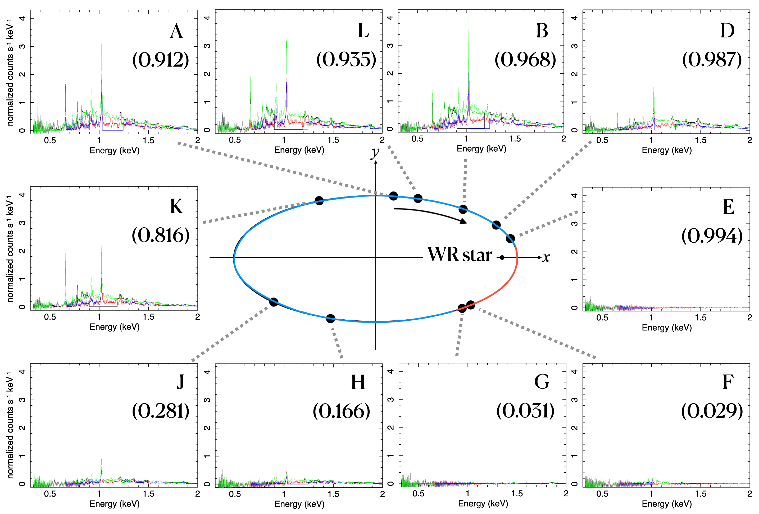
RGS spectral gallery of WR140
Notes:
This slide is the RGS spectral gallery of WR140. It’s bright enough …

Slide 5
RGS spectral gallery of WR140
Inside the shock cone
Outside the shock cone
Notes:
at phases K, A, L, B, and D. At these phases, the observer is positioned inside the shock cone, viewing the system from The O star’s side. For subsequent analysis, we use the datasets from these five phases.

Slide 6
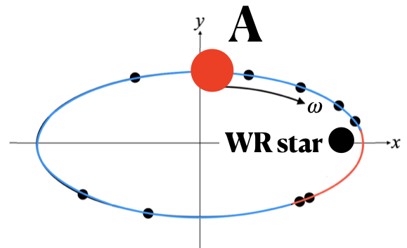
Aim of our research
Goal of our analysis
Understanding the state of
the wind-collision plasma
Deriving plasma velocities from spectrum
Understanding the shape of the shock cone
Identifying the line-emission site
Solving the density distribution
Notes:
Here we show the spectra at phase A, for example. The data mainly show K lines of Ne and O, as well as L lines of Iron. With these spectra, we aim to understand the state of the wind-collision plasma, specifically by deriving physical quantities from spectrum, understanding the shape of the shock cone, identifying the line-emission site and solving the density distribution.

Slide 7
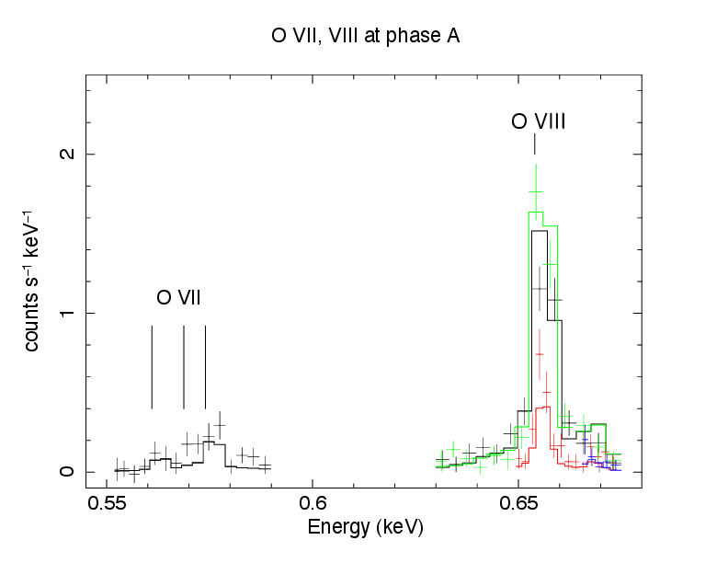
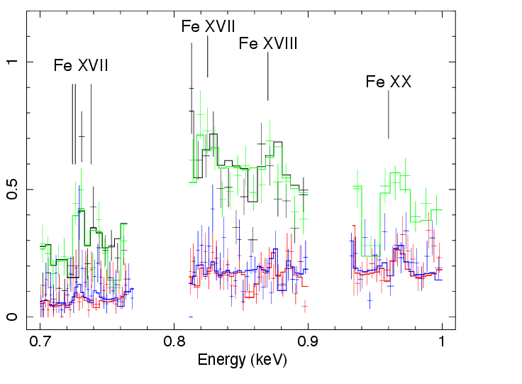
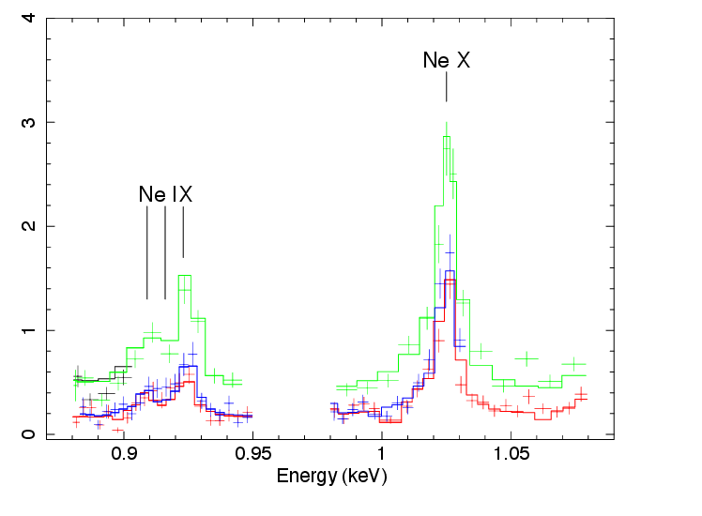
Spectral model fitting
Model : bvvapec*tbabs
Each elements, we get
  Plasma temperature
  Line-of-sight velocity
  (Line central energy)
  Velocity dispersion (line width)
Carrying out the same fitting
at phase K, A, L, B and D
O VII,VIII
Fe XVII, XVII, XVIII
Ne IX,X
7
Notes:
First, we perform a model fitting to the spectra.
We use energy bands near the target lines, and reperform a fitting with the bvvapec and tbabs model. We can determine the plasma temperature, line-of-sight velocity, its dispersion.

Slide 8
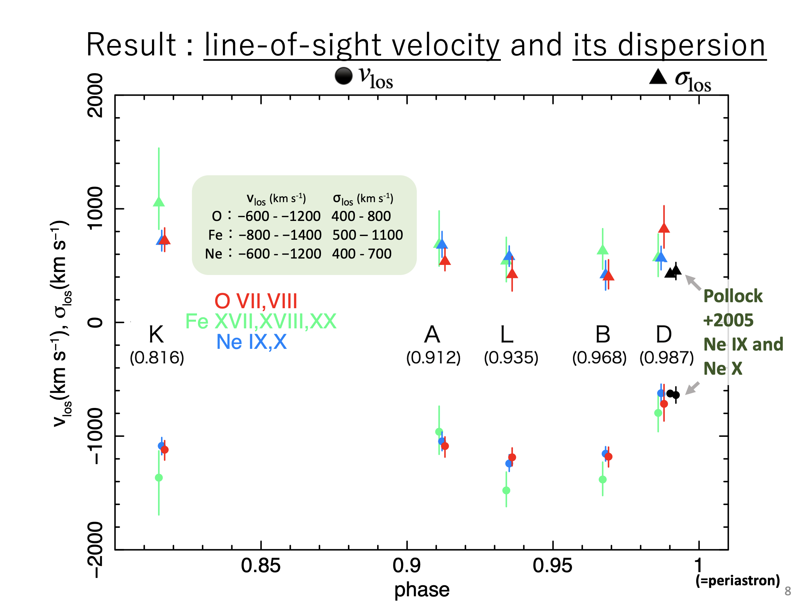
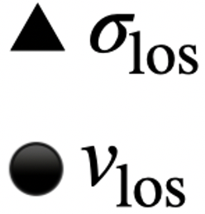
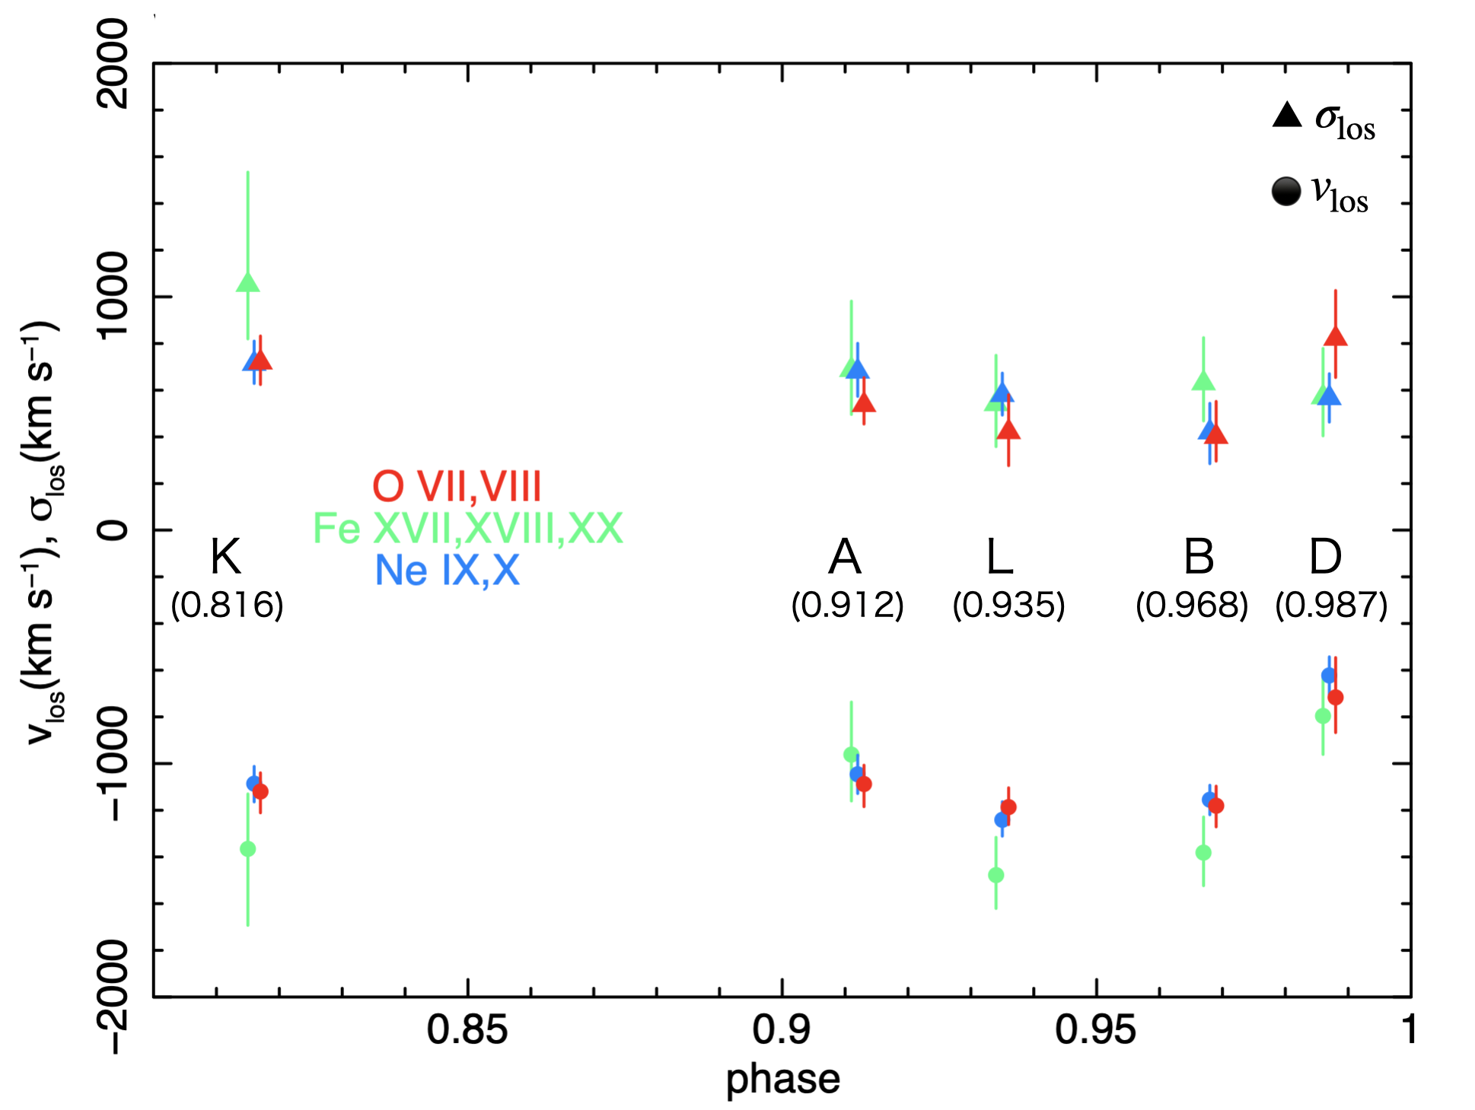
Result : line-of-sight velocity and its dispersion
v_{los} (km s⁻¹) σ_{los} (km s⁻¹)
O：−600 - −1200 400 - 800
Fe：−800 - −1400 500 – 1100
Ne：−600 - −1200 400 - 700
Pollock
+2005
Ne IX and
Ne X
(=periastron)
Notes:
This graph shows The observed line-of-sight velocity and its dispersion versus The orbital phase. We find all line-of-sight velocities are negative, indicating all O,iron,Ne lines are blue-shifted.
And the maximum values are observed at phases L and B.
These black datapoints are from Chandra observation near phase D by Pollock et al. 2005. Their results and ours are consistent.

Slide 9
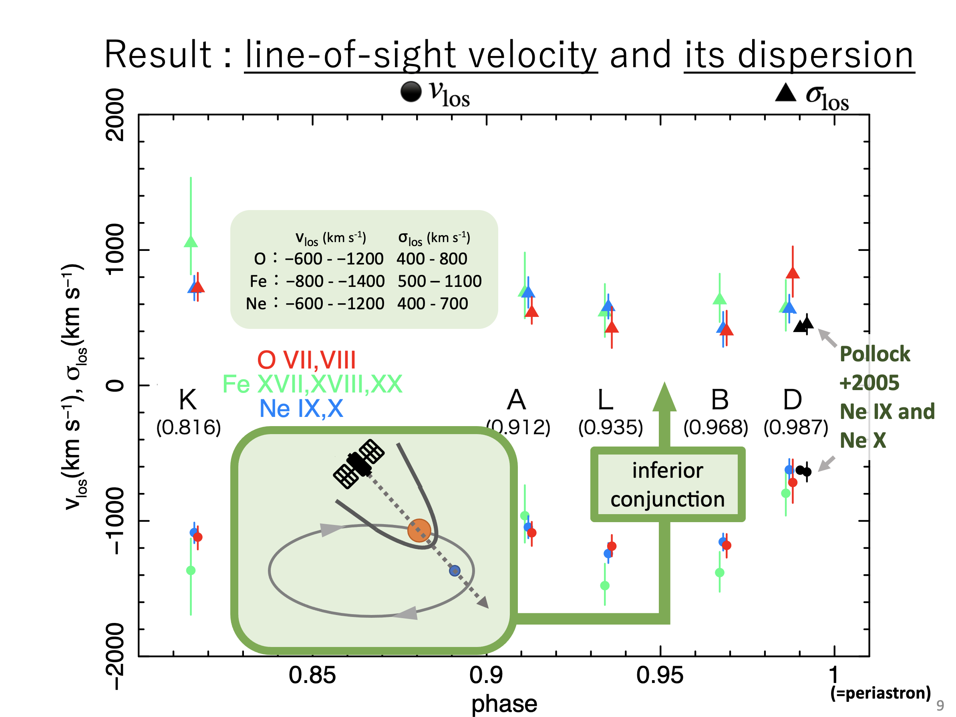

Result : line-of-sight velocity and its dispersion
v_{los} (km s⁻¹) σ_{los} (km s⁻¹)
O：−600 - −1200 400 - 800
Fe：−800 - −1400 500 – 1100
Ne：−600 - −1200 400 - 700
Pollock
+2005
Ne IX and
Ne X
inferior conjunction
(=periastron)
Notes:
In this figure, The O star’s inferior conjunction occurs between phases L and B, where The observer views the system closest to the shock cone-axis. So, we expect the line-of-sight velocity to reach its maximum-value and the dispersion of the line-of-sight velocity to be at its minimum. The results indeed show a good reproduction of this fact.

Slide 10
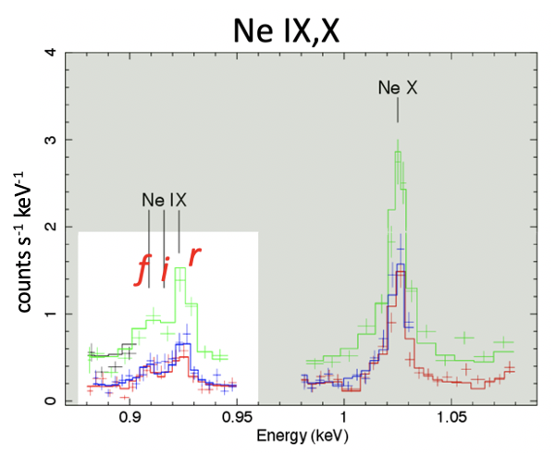
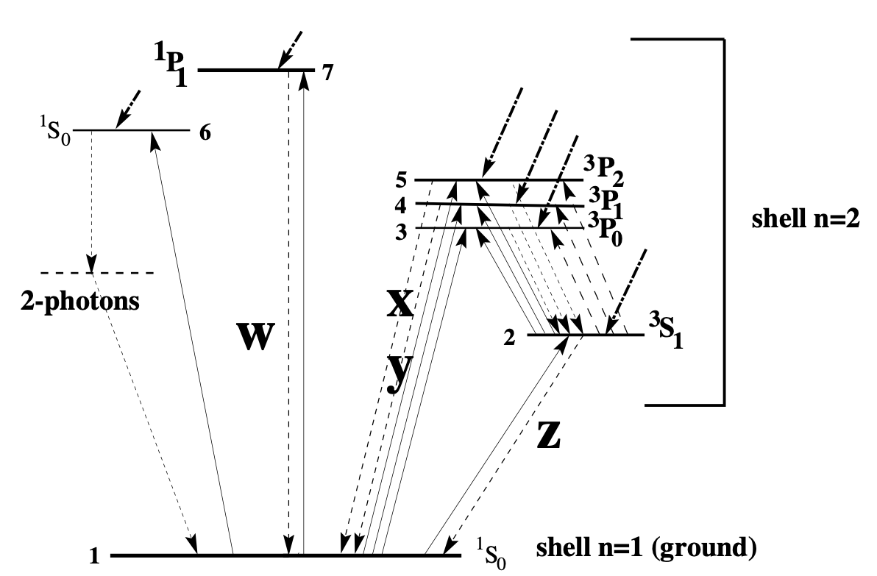
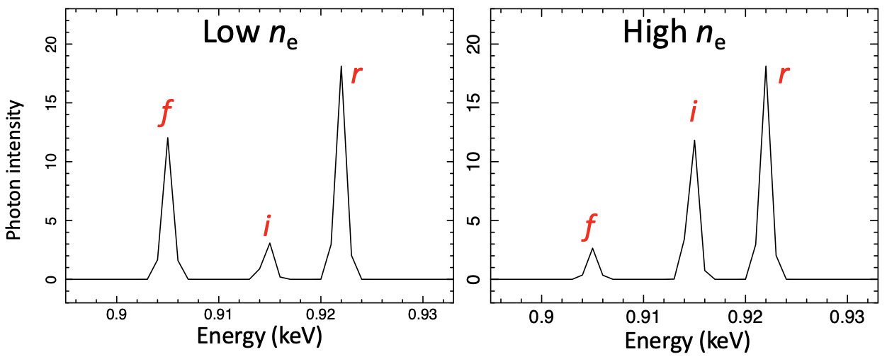
Density diagnosis at line-emission site with He-like triplet
He-like ion
r
i
f
Porquet+2001
Notes:
Next, we estimate the electron number density using The intensity-ratios of the He-like neon triplet.
It’s well known that in He-like ions, as the plasma density increases,
The intensity of intercombination lines become larger
while that of the forbidden line decreases.

Slide 11
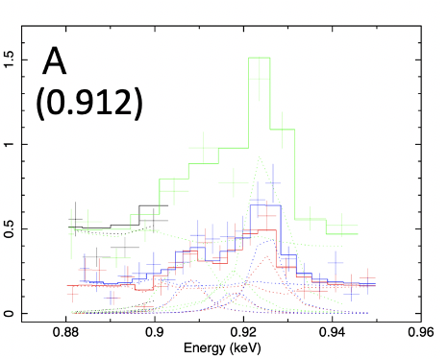
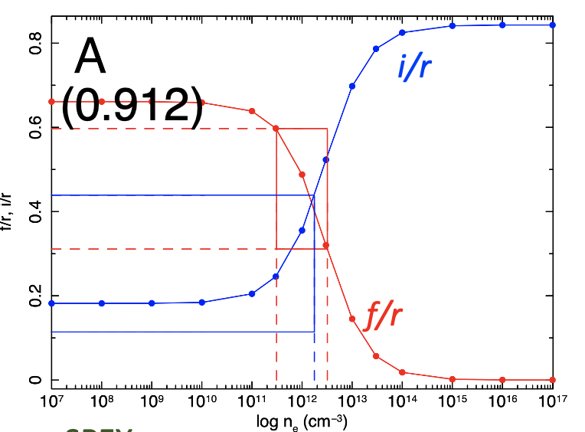
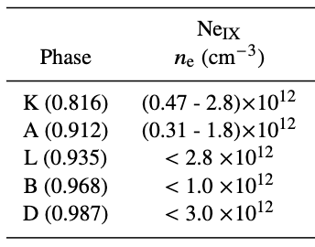
Result : Electron number density
Ne IX (for ex.)
r
f
i
SPEX: https:// www.sron.nl/ astrophysics-spex
Obtaining the observed intensities
  f, i, r ←gaussian fitting
Comparing these intensities
with the theoretical values
  From the intersections with the curves,
  we estimate n_{e}.
Notes:
First, we obtain The observed intensities at each phase.
We performed Gaussian-fitting for the f, i, and r lines-components.
Second, we compare these intensities with the theoretical values as shown here.
Here we used the f and i components normalized by the resonance line calculated with the plasma code SPEX. From The intersections with the curves, we estimate the electron number density, and the result is here.
At phases K and A, we can constrain the densities. They are about ten to the power of twelve per cubic centi-meter.

Slide 12
Result : Electron number density
Ne IX (for ex.)
⚠️ Note that the estimated density may be elevated
due to photo-excitation by EUV lights from the O star!
r
f
i
SPEX: https:// www.sron.nl/ astrophysics-spex
Obtaining the observed intensities
  f, i, r ←gaussian fitting
Comparing these intensities
with the theoretical values
  From the intersections with the curves,
  we estimate n_{e}.
Notes:
First, we obtain The observed intensities at each phase.
We performed Gaussian-fitting for the f, i, and r lines-components.
Second, we compare these intensities with the theoretical values as shown here.
Here we used the f and i components normalized by the resonance line calculated with the plasma code SPEX. From The intersections with the curves, we estimate the electron number density, and the result is here.
At phases K and A, we can constrain the densities. They are about ten to the power of twelve per cubic centi-meter.

Slide 13
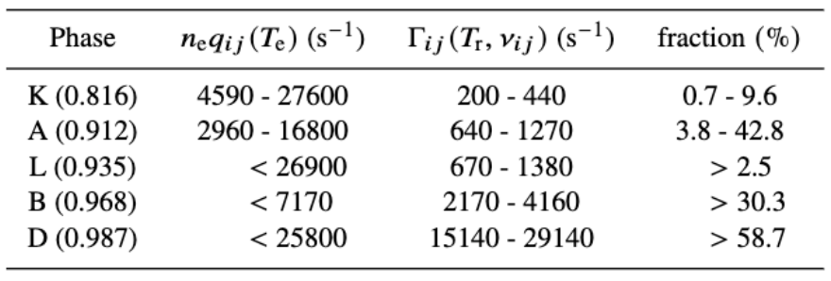
Effect of photoexcitation by O star’s EUV radiation
Rate of Rate of
the collisional excitation the photoexcitation
n_{e} q_{ij} >> Γ_{ij}
n_{e} is reliable
only if
Phase K ：The electron number density is reasonably reliable.
Phases A, L, B and D： Need a careful evaluation of EUV radiation.
➡︎ Large uncertainties of n_{e} , T_{eff,o} and R_{o} makes the results scatter in wide ranges.
Notes:
The densities obtained in this study can be considered reliable only if the rate of collisional excitation is much larger than that of photo-excitation. So we here estimate The effect of the photo-excitation by the O star‘s EUV radiation.
Here are the calculation results. At phase K, the rate of photo-excitation is at most 9.6% of that of collisional excitation. So We can say that The estimated value is reasonably reliable at this phase. At phases A, L, B and D, we need a careful evaluation of the photo-excitation.
Here we used the values we obtained for the electron number density and the distance to the Ne line-emission site. The othe parameters such as q_ij, oscillator strength and O star’s parameters are taken from these references.

Slide 14
How does the WR140 look on XRISM?
WR140’s phase withn the Cycle 1 period (GO)
:0.960-0.086
including periastron!
We simulate what the spectrum would obtain during these phases.
Notes:
We simulate what the spectrum would obtain during these phases.

Slide 15
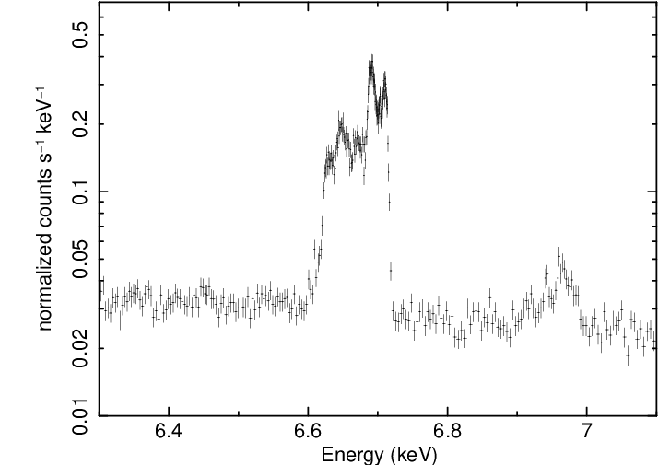
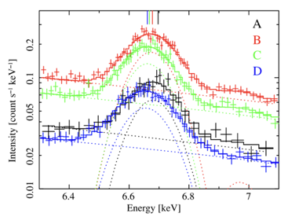
Fe25 spectrum of WR140 by XRISM
Simulation
Phase D (0.987) (2024 Oct. 15)
w w
z+x+y
Sugawara+2015
Fe H-like
Notes:
This is the XRISM simulation of the Iron 25 spectrum at phase D. and this is the suzaku’s spectrum at the same phase. This simulation is run under the following conditions.

Slide 16
Fe25 spectrum of WR140 by XRISM
Simulation
Phase D (0.987) (2024 Oct. 15)
w w
1. Exposure time is 100 ksec.
z+x+y
2. v_{los} is calculated by
dividing the shock cone
into 180 segments
in the phase-angle direction
Sugawara+2015
Fe H-like
3. v_{los}s are taken into bvvapec and
the spectra are calculated individually and added up

Slide 17
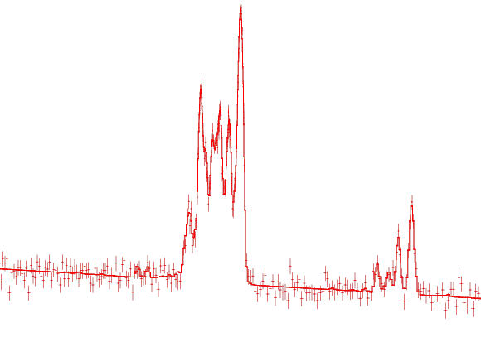
Fe25 spectrum of WR140 by XRISM
Simulation
Phase D (0.987) (2024 Oct. 15)
redshift 0
Sugawara+2015
Notes:
If there were no redshift, the spectrum would appear like this. The He-like triplet is clearly separated.
When spectra are added around the entire cone, The large and small red-shifted lines appear more intense,

Slide 18
Fe25 spectrum of WR140 by XRISM
Simulation
Phase D (0.987) (2024 Oct. 15)
Rim brightening
w w
z+x+y
Sugawara+2015
Fe H-like
Notes:
around the resonance line. Like Rim brightening. And, the forbidden line and intercombination lines are blended. From XRISM spectrum,

Slide 19
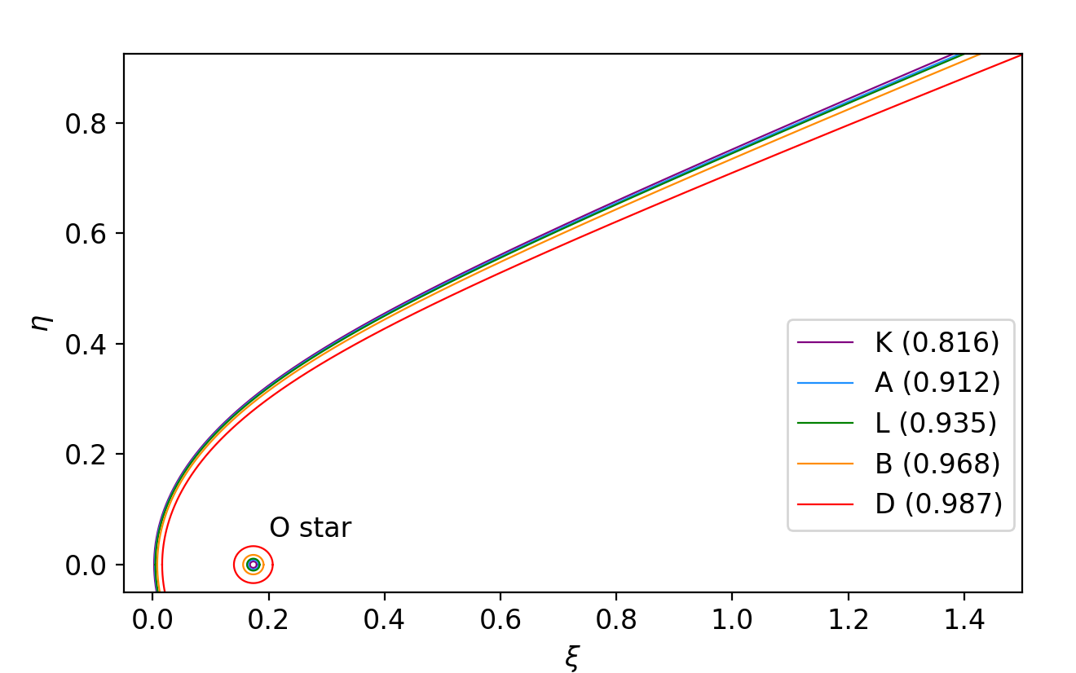
Fe25 spectrum of WR140 by XRISM
Simulation
Phase D (0.987) (2024 Oct. 15)
w w
n_{e}
w
x+y
z
z+x+y
Photon intensity
Sugawara+2015
Energy (keV)
Si, S, Ar, Ca and Fe
Fe H-like
Miyamoto+2022
Fe ?
Shock cone
(y/d)
O star
(x/d)
Miyamoto+2024
Notes:
We could perform the density diagnosis from the He-like triplet on Si, S, Ar, Ca and Iron, and identify the Iron line-emission site.

Slide 20
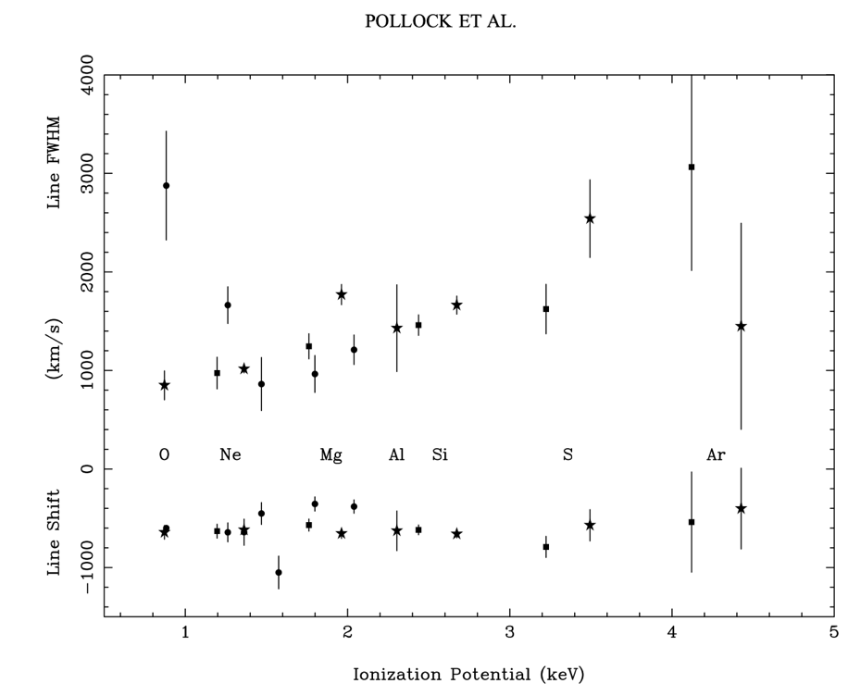
Fe25 spectrum of WR140 by XRISM
Simulation
Pollock+2005
Fe XRISM
Simulation
-1000 0 1000 2000 3000 4000
Line Shift (km/s) Line FWHM
O Ne Mg Al Si S
Ar
Fe ?
cooling?
heating?
1 2 3 4 5
6
Ionization Potential (keV)
Notes:
If we can determine the Iron line-of-sight velocity and its dispersion from observations, we can fill in Iron components of this figure from Pollock et al. 2005.

Slide 21
Fe25 spectrum of WR140 by XRISM
Simulation
Pollock+2005
Fe XRISM
Simulation
Miyamoto+2022
(y/d)
-1000 0 1000 2000 3000 4000
Line Shift (km/s) Line FWHM
Ne
Fe
・
・
O Ne Mg Al Si S
Ar
Fe
cooling plasma
(x/d)
1 2 3 4 5
6
Ionization Potential (keV)
Notes:
If They are small values, Iron lines mainly emit from the top of the shock cone. It means this is cooling plasma.

Slide 22
Fe25 spectrum of WR140 by XRISM
Simulation
Pollock+2005
Fe XRISM
Simulation
Miyamoto+2022
Fe
・
・
(y/d)
-1000 0 1000 2000 3000 4000
Line Shift (km/s) Line FWHM
Ne
O Ne Mg Al Si S
Ar
Fe
(x/d)
heating plasma
1 2 3 4 5
6
Ionization Potential (keV)
Notes:
on the other hand, If They are large values, Iron lines mainly emit from around here, so It means this is heating plasma.

Slide 23
Fe25 spectrum of WR140 by XRISM
Simulation
Pollock+2005
Fe XRISM
Simulation
-1000 0 1000 2000 3000 4000
Line Shift (km/s) Line FWHM
O Ne Mg Al Si S
Ar
Fe ?
cooling?
heating?
1 2 3 4 5
6
Ionization Potential (keV)
Notes:
so we can understand the dynamic state of the plasma near the top of the shock cone by XRISM.

Slide 24
Summary
v_{los} (km s⁻¹) σ_{los} (km s⁻¹)
O：−600 - −1200 400 - 800
Fe：−800 - −1400 500 – 1100
Ne：−600 - −1200 400 - 700
Measuring |v_{los}| and σ_{los} using X-ray
spectroscopy of the RGS.
Estimating n_{e} using intensity ratios of the He-like triplet.
  Ne : Phase K : (0.4 - 2.8)×10¹² cm⁻³ , Phase A : (0.3 - 1.8)×10¹² cm⁻³ (Phase A)
  Estimate the effect of the photoexcitation : n_{e} of Ne phase K is reasonably reliable
By XRSIM obsevation:
Plasma density diagnosis with He-like triplet on Si, S, Ar, Ca, Fe.
By measuring plasma velocities,
  Identifying the Fe line-emission site
  Understanding the dynamic state of plasma
WR140‘s next periastron comes in GO1!
We can’t miss this opportunity!
References：Miyamoto+2024 accepted, Miyamoto+2022 MNRAS, Monier+2011 ApJ, Sugawara+2015 PASJ, Pollock+2005 ApJ, Usov 1992 ApJ, Cantó+1996 ApJ, Porquet+2001 A&A, Mauche+2001 ApJ, Pradhan+1981 ApJ, Nahar+1999 A&A, Martins+2005 A&A, “XMM-Newton Users Handbook1” 2022 (ESA:XMM-Newton SOC), http://harmas.arc.hokkai-s-u.ac.jp/~okazaki/cwb/WR140/index.html
Notes:
This is the summary slide. thank you for listening!

Slide 25
Effect of photoexcitation by O star’s EUV radiation
Rate of Rate of
the collisional excitation the photoexcitation
n_{e} q_{ij} >> Γ_{ij}
n_{e} is reliable
only if
Oscillator strength
→ From Nahar+1999
O star ’s parameters : Effective surface
temperature and radius
→ From Martine+2005
Distance from the O star to line-emission site
→ Values we determined (Miyamoto+2022,2024)
Electron number density n_{e}
→ Values we calculated
Maxwellian-averaged
collision strength q_{ij}
→ From Pradhan+1981
Phase K ：The electron number density is reasonably reliable.
Phases A, L, B and D： Need a careful evaluation of EUV radiation.
➡︎ Large uncertainties of n_{e} , T_{eff,o} and R_{o} makes the results scatter in wide ranges.
Notes:
The densities obtained in this study can be considered reliable only if the rate of collisional excitation is much larger than that of photo-excitation. So we here estimate The effect of the photo-excitation by the O star‘s EUV radiation.
Here are the calculation results. At phase K, the rate of photo-excitation is at most 9.6% of that of collisional excitation. So We can say that The estimated value is reasonably reliable at this phase. At phases A, L, B and D, we need a careful evaluation of the photo-excitation.
Here we used the values we obtained for the electron number density and the distance to the Ne line-emission site. The othe parameters such as q_ij, oscillator strength and O star’s parameters are taken from these references.

Slide 26
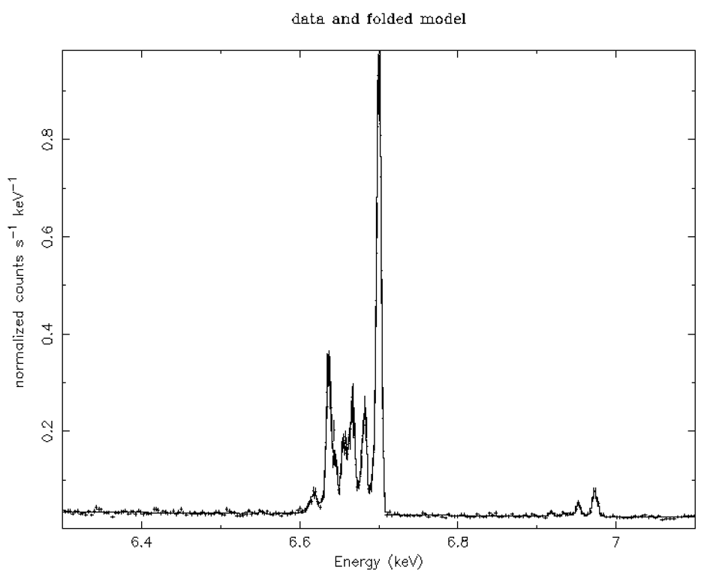
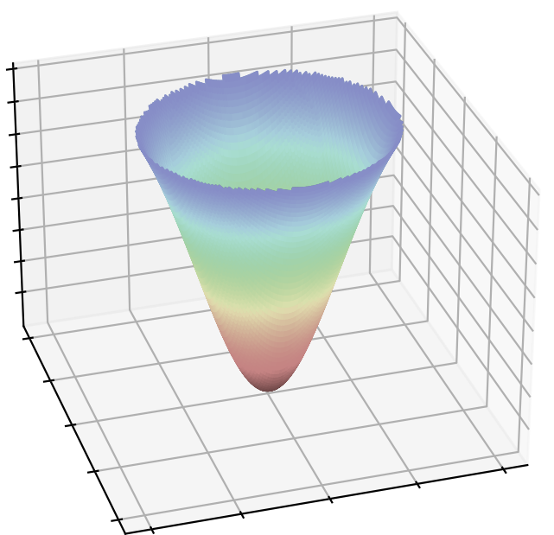
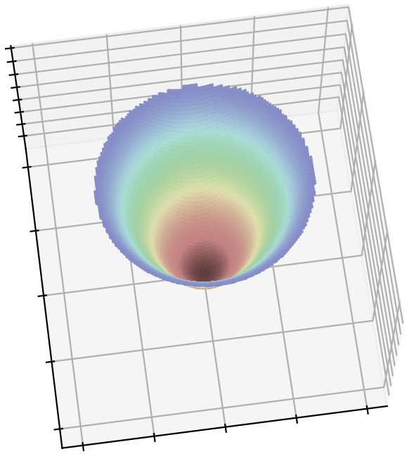
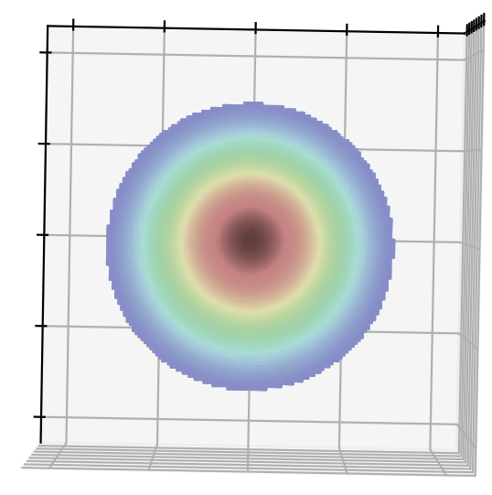
Fe25 spectrum of WR140 by XRISM
Simulation
We think these spectra to be averaged over the axisymmetric region of the shock cone. Spectrum simulated is created by calculating and adding together at each point of this ring a spectrum with the redshift of the plasma in phase D(0.987), which is aligned with the direction of the observer's line of sight, in the model. In this case, the spectra of 180 points were added together in 2° increments.
Fe H-like

Slide 27
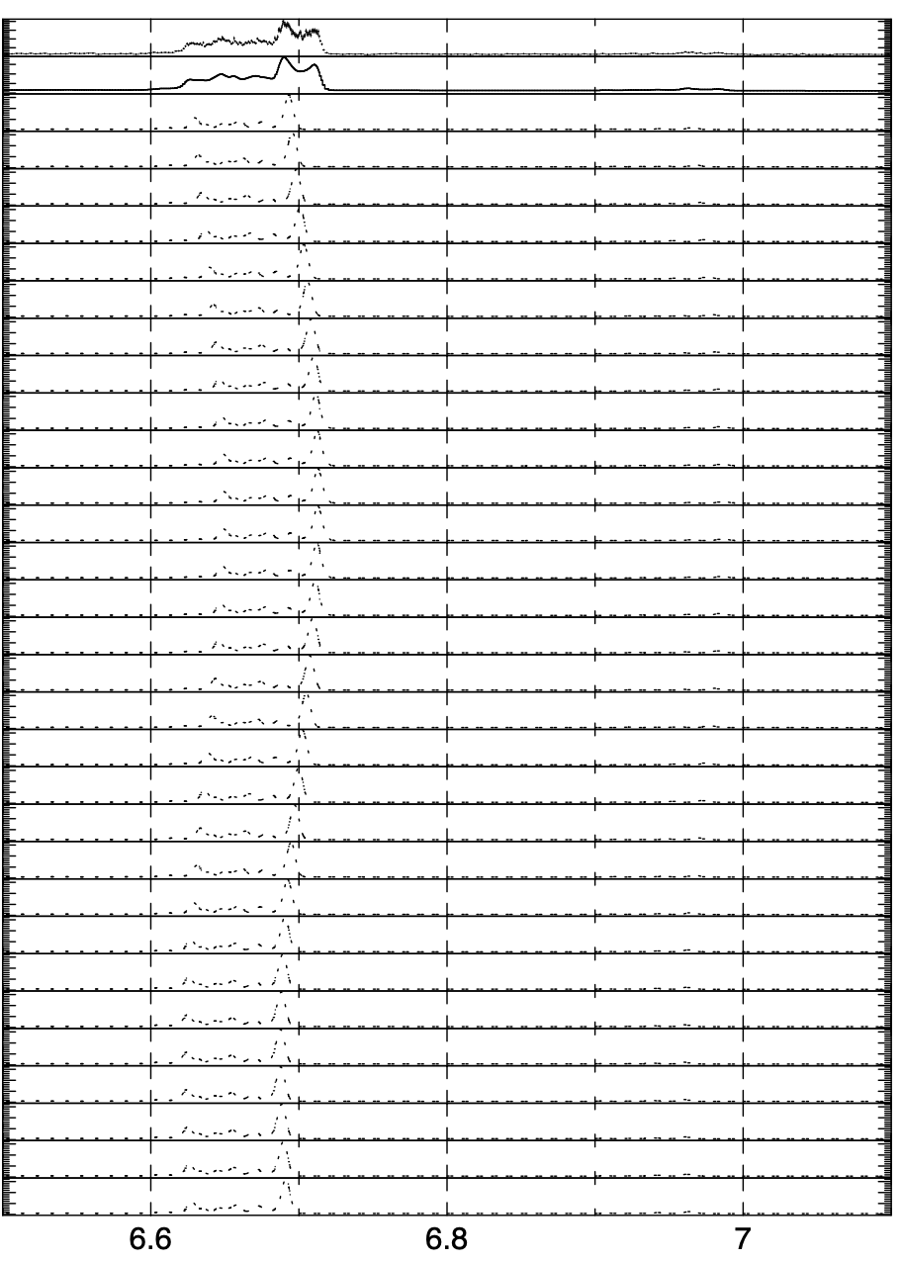
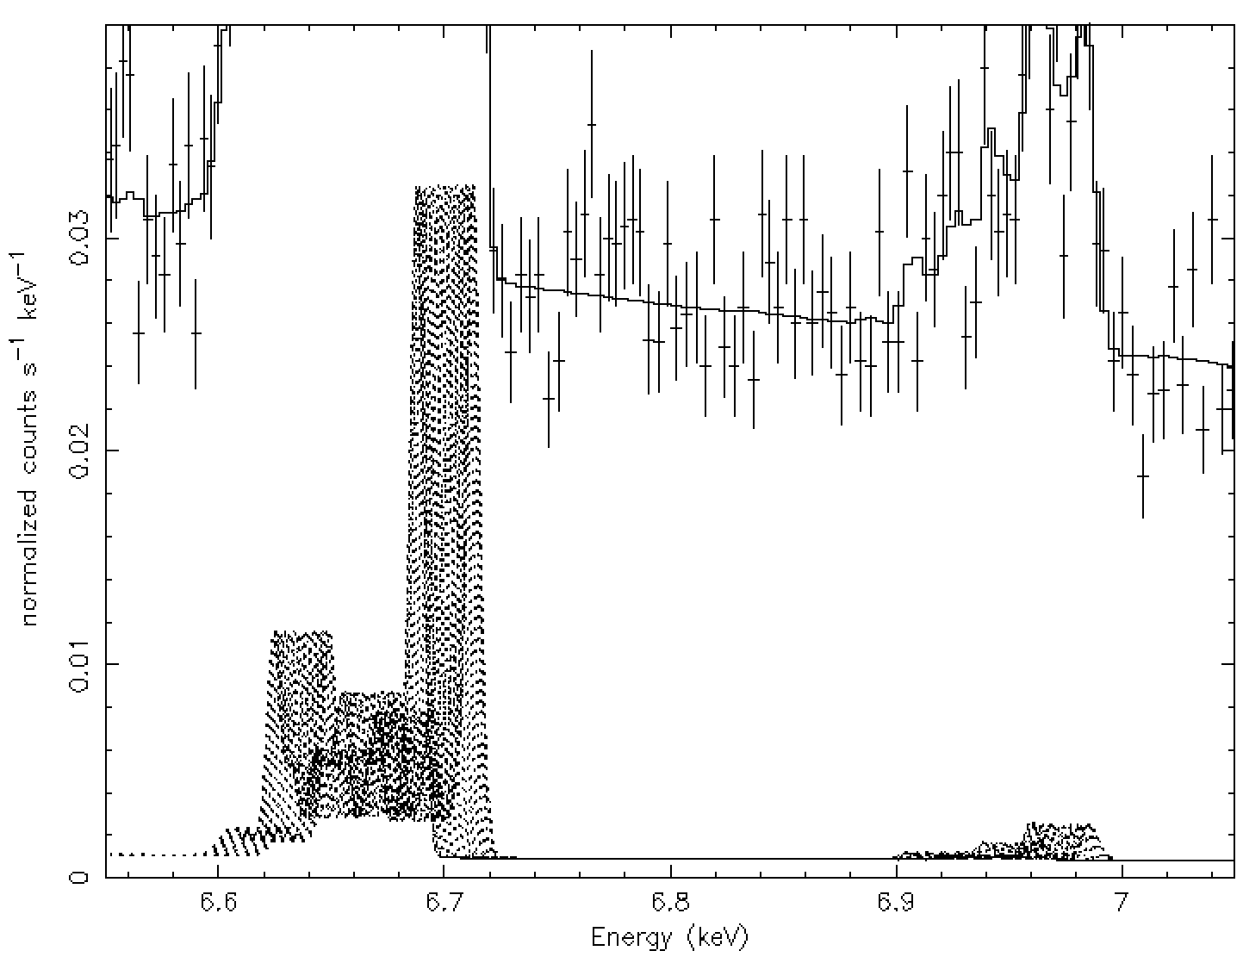
Fe25 spectrum of WR140 by XRISM
Simulation
Rim brightening
ex) 30 Models
ex) 30 Models
In this method, the central energy changes SIN functionally, so there is inevitably more distribution around the maximum and minimum values, and the resonance lines appear separated.
Energy (keV)

Slide 28
Fe25 spectrum of WR140 by XRISM
Simulation
Pollock+2005
Fe XRISM
Simulation
-1000 0 1000 2000 3000 4000
Line Shift (km/s) Line FWHM
・
・
O Ne Mg Al Si S
Ar
Fe
cooling
1 2 3 4 5
6
Ionization Potential (keV)
Notes:
If we can determine the Iron line-of-sight velocity and its dispersion from observations, we can fill in Iron components of this figure from Pollock et al. 2005. and obtain information about the dynamic state of the plasma near the top of the shock cone.

Slide 29
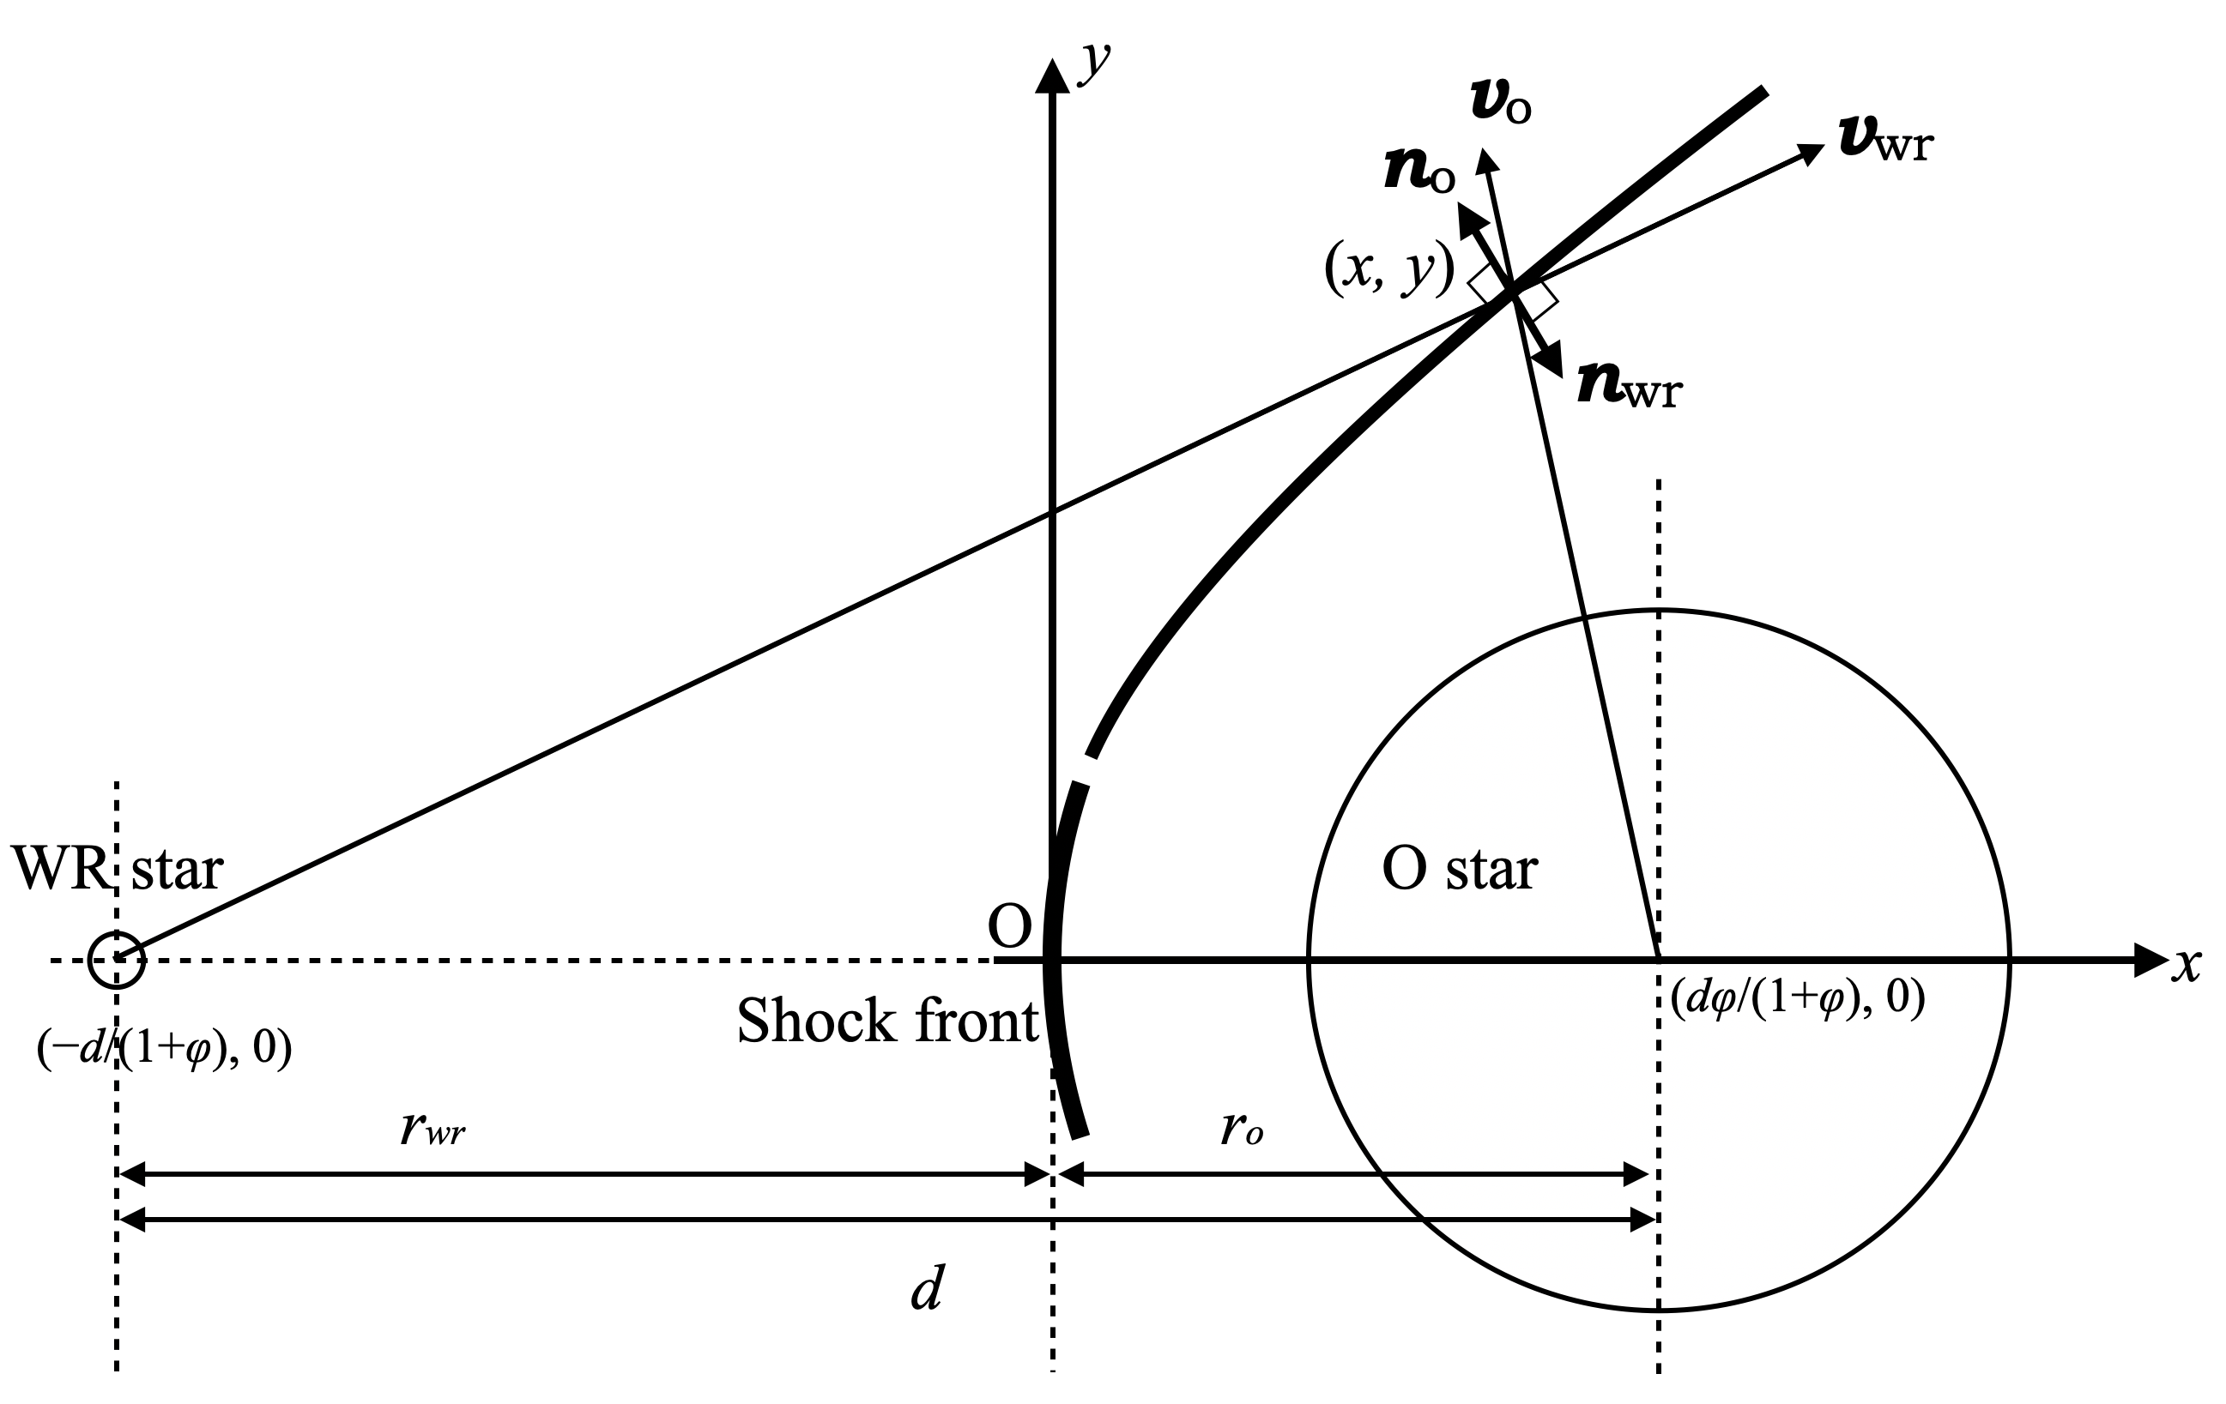
Shape of the shock cone
2
1. Deriving the location of stagnation point from balance of ram-pressure between the stellar winds.
2. Calculating the cone of the subsequent shock front by taking into account the pressure
balance of the winds normal to the cone.
Usov 1992,
Cantó+1996
Notes:
To do this, we first calculate the shape of the shock cone. It’s derived from balance of ram-pressure between the stellar winds.
The ram-pressure can be expressed like this, using the stellar wind-velocity and mass-loss rate.

Slide 30
Result : Shape of the shock cone
2
When normalized by the binary separation d
they exhibited a similar shape at each phase.
(≡y/d)
(≡x/d)
Notes:
The results are shown here.
The coordinates x and y are normalized by the binary separation 'd', and written as ‘xi' and 'eta’.
The shape of the shock cones is almost the same among the phases, but we find a slight decrease in The opening-angle as the binary-separation decreases.
It’s because as the binary separation-decreases, the shock cone is formed before The acceleration of The O star's wind completes.

Slide 31
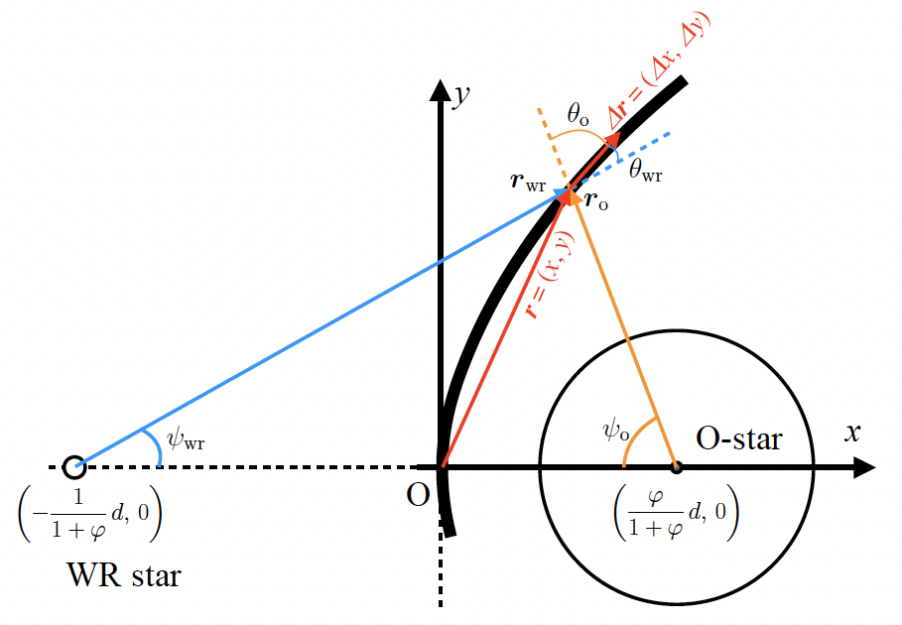
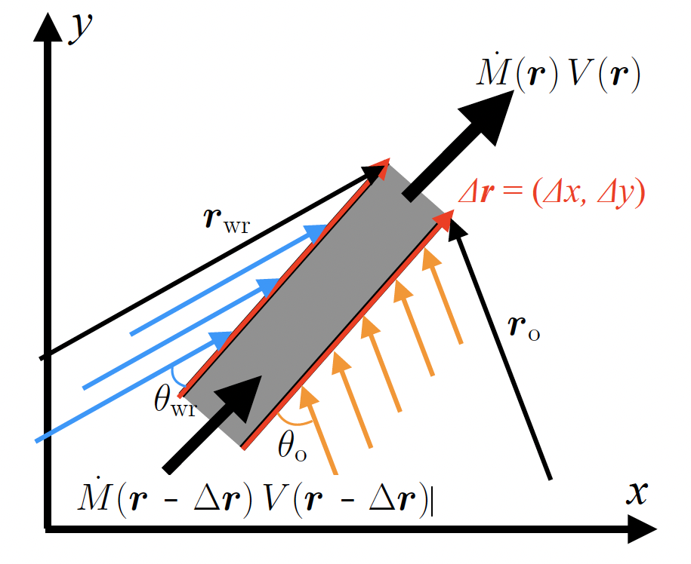

Numerical calculation of velocity along the shock cone
3
1. Derivation of the plasma flow velocity along the shock cone.
In unit time, the line segment Δ𝒓 receives the tangential component of momentum flowing in from the two stars.
$v\left(r\right)\cos{θ}$： The tangential components of stellar winds from each star.
$∆Ω\left(r\right)$： The solid angle subtended by the annulus containing Δ𝒓 over each star.
Notes:
Next, we calculate the plasma flow velocity along the shock cone. In this figure, Δr is a small vector along the shock cone. This small panel is a blow-up around Δr. The plasma flow entering into Δr receives the tangential component of the momentum from the stellar winds, and increases after passing through it according to this equation.
The second term v*cosθ is the tangential component of the WR star wind, and ΔΩ is the solid angle subtended by the annulus containing Δr over the WR star.
The third term represents the momentum-increase by The O star.

Slide 32
Numerical calculation of velocity along the shock cone
3
1. Derivation of the plasma flow velocity along the shock cone.
In unit time, the line segment Δ𝒓 receives the tangential component of momentum flowing in from the two stars.
$v\left(r\right)\cos{θ}$： The tangential components of stellar winds from each star.
$∆Ω\left(r\right)$： The solid angle subtended by the annulus containing Δ𝒓 over each star.
Initial value : V(0)=8.0×10⁷(cm s⁻¹)： The sound velocity
of the plasma having a temperature of 3.5 keV（Sugawara et al. 2015）
Notes:
In this study, we give eighty million cent meter/sec as an initial velocity, that is the sound velocity of the plasma having a temperature of 3.5 keV at the stagnation point.

Slide 33
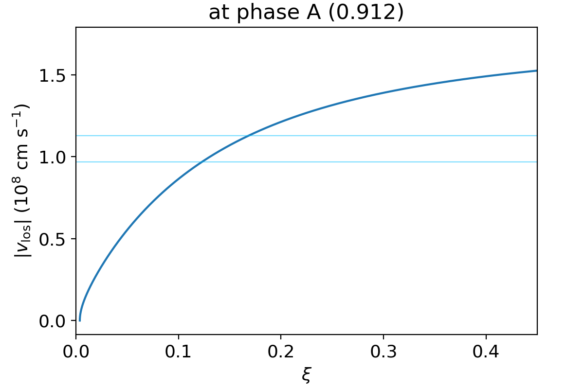
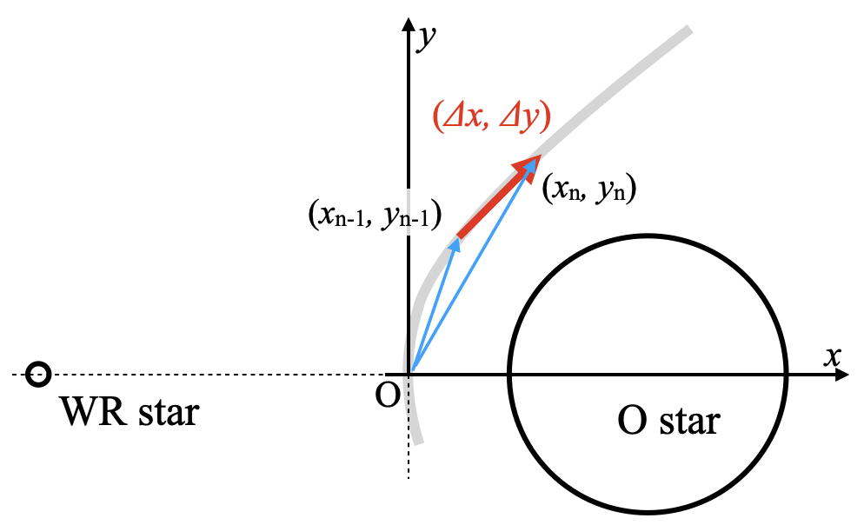
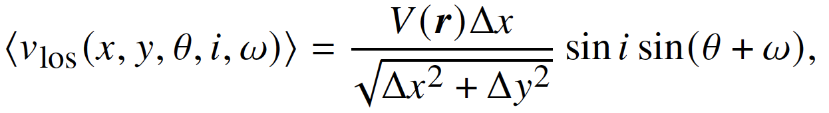
Numerical calculation of line-of-sight velocity
3
2. Deriving line-of-sight velocities from flow velocities.
i: inclination=119.6° ω : argument periastron=46.8°
θ: true anomaly
Observed value
ξ
Laminar flow
Flowing along the shock cone
Miyamoto+2022
Notes:
Next, we calculate the line-of-sight velocities. It’s the line-of-sight velocity versus the distance from the stagnation point (xi).
Assuming the shock plasma is laminar and flows along the shock cone, we can determine the line-of-sight velocity using The inclination (i), argument periastron (ω), and Δx, like this. where theta is the true anomaly. We use the flow velocity V calculated in the previous slide.

Slide 34
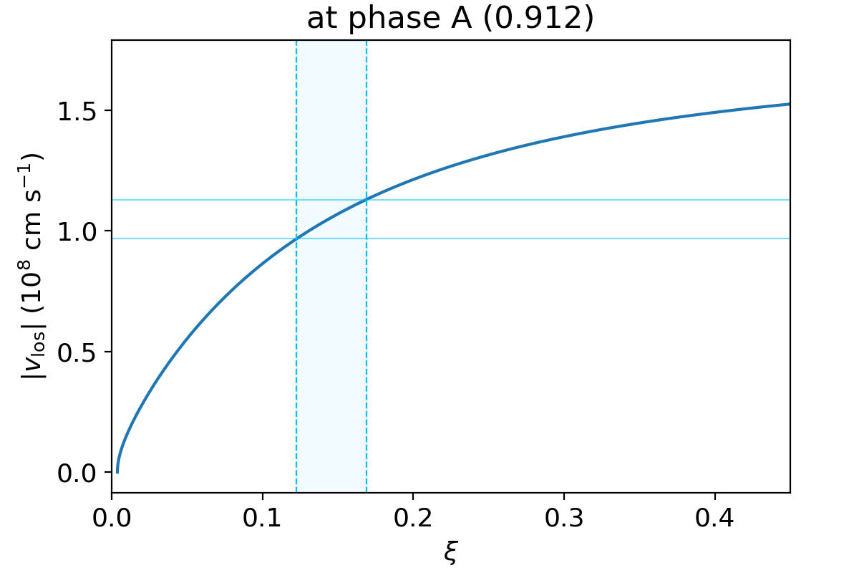
Ne line-emission site
3
Observed value
2. Deriving line-of-sight velocities from flow velocities.
i: inclination=119.6° ω : argument periastron=46.8°
θ: true anomaly
ξ
Laminar flow
Flowing along the shock cone
Ne line-emission site at phase A (0.912)
x = (2.5-3.4)×10¹³ (cm)
Miyamoto+2022
Notes:
In this result, We can determine the line-emission site from The intersection point.
At phase A, We find it’s about ten to the power of thirteen cent meter for Ne.

Slide 35
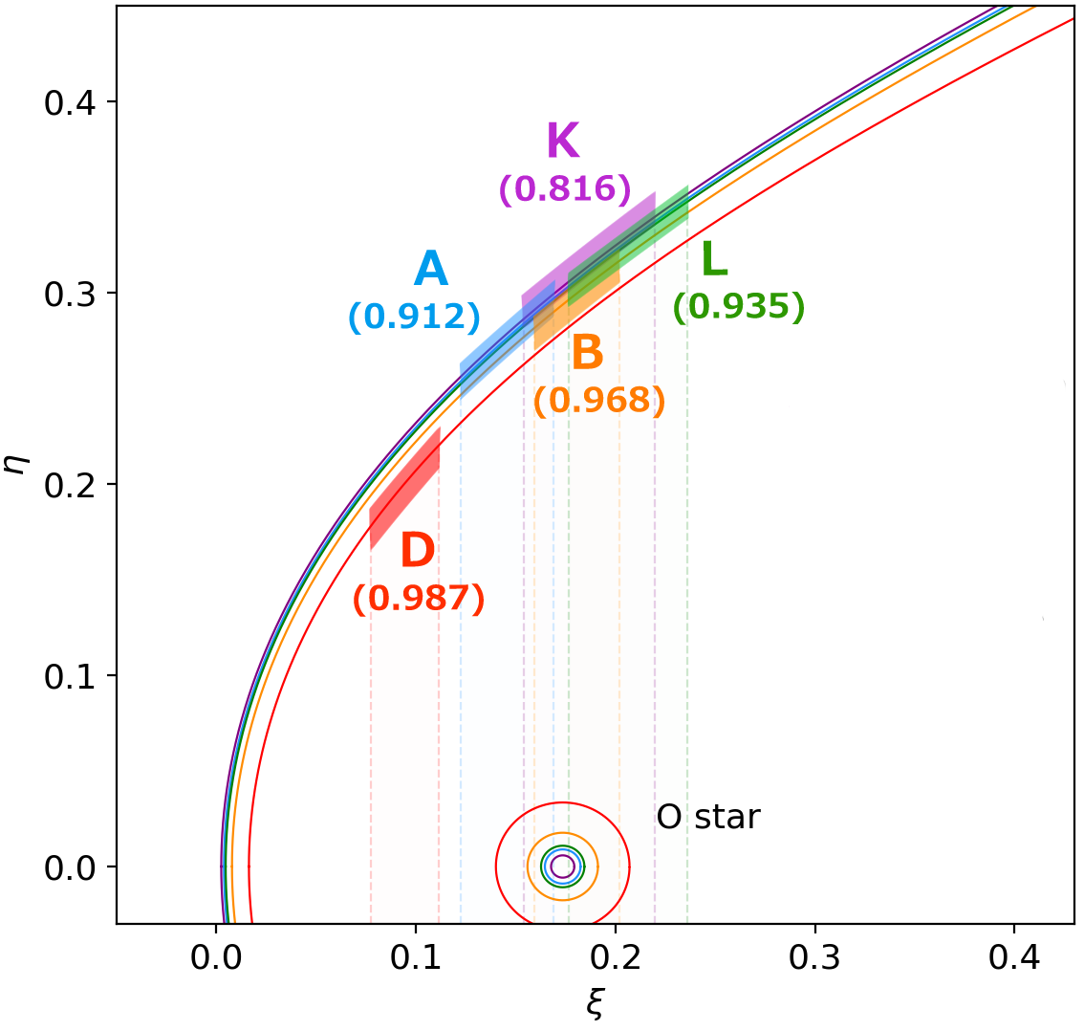
Result : Ne line-emission site
3
Ne line-emission site:
10¹³ - 10¹⁴ cm
(phase D) (phase K)
Notes:
We performed the same calculations at other phases,
We are able to constrain the locations of The emission regions at all phases. It's about 10 to the power of 13 to 14 cm.

Slide 36
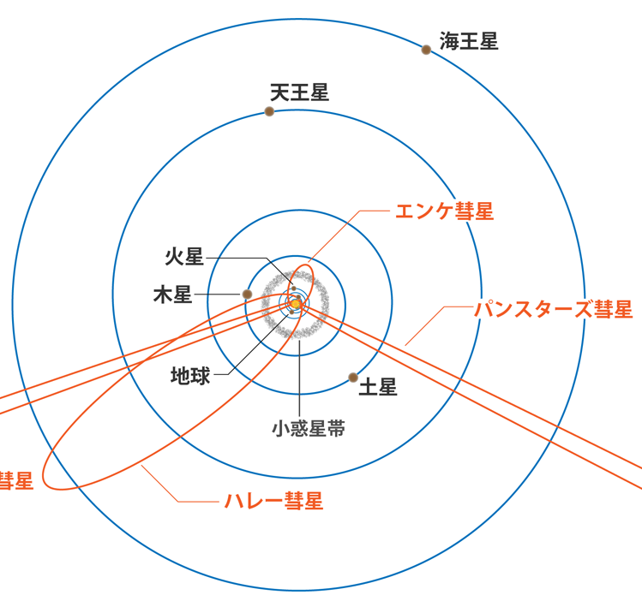
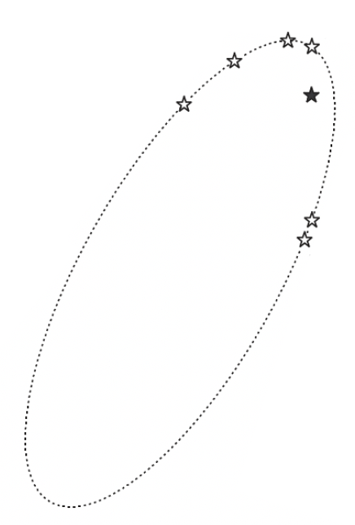
Introduction：WR140
Wolf-Rayet(WR) 140
cf. Orbital image of the Solar system
Orbital image of the WR140 projected to the sky
Neptune
Uranus
19.2 AU
★ WR star
Comet Encke
Mars
☆ O star
Jupter
Comet PANSTARRS
15.3 AU
Earth
Saturn
Asteroid belt
1P/Halley
De Becker et al. 2011
Orbital period 2896.35 days
Orbital eccentricity 0.8964
〜Size of the orbit of the Uranus
Credit: NAOJ

Slide 37
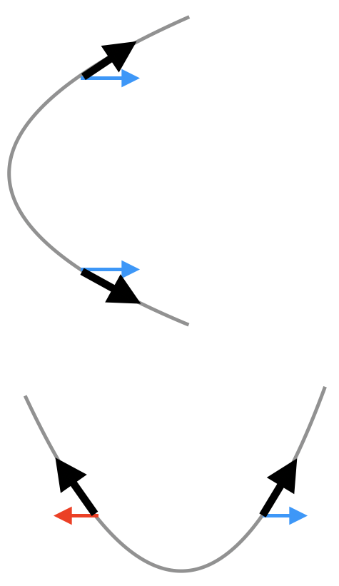
Los velocity and its dispersion
Viewing on the shock cone axis
Fitting parameters are observed averaged over the axisymmetric region of the shock cone.
WR O
Los velocities have various directions around the shock cone, which are averaged together, so they have dispersions.
Viewing from a location perpendicular
to the shock cone axis
O
WR

Slide 38

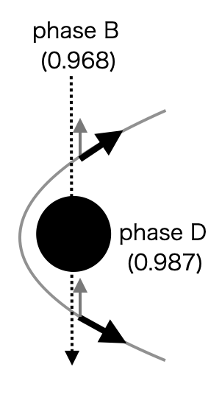
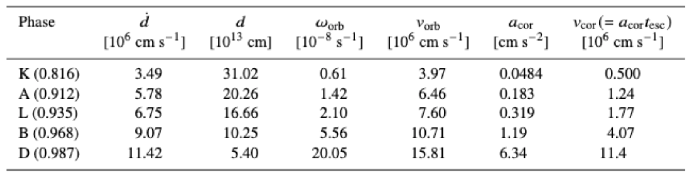



Coriolis forces can be ignored!
The acceleration of the Coriolis force $a$working on the component stars is written as $a_{\text{cor}}=−2ω_{\text{orb}}×υ_{\text{orb}}$, where $ω_{\text{orb}}$ is the angular velocity of the binary stars whose norm is the time derivative of the true anomary θ, namely, $ω_{\text{orb}}=\frac{\text{d}θ_{orb}}{\text{d}t},$and $v_{\text{orb}}$is the velocity of the component stars:
Since $ω_{\text{orb}}$ and $v_{\text{orb}}$are mutually perpendicular, $a_{\text{cor}}=2ω_{\text{orb}}v_{\text{orb}}$. We take time interval Δt = 2.5×10^4 s. $\dot{d}$ and $ω_{\text{orb}}$ are calculated as the increment of d and $θ_{orb}$ over this Δt.
To obtain a transverse velocity by $a_{\text{cor}}$, we need a typical escape time of the shock cone plasma：$t_{\text{esc}}$=10d/ $V_{\text{flow}}$.
We approximate $V_{\text{flow}}$as $v_{∞\text{,}\text{O}}$ (= 3×10⁸ cm s⁻¹).
Even at phase D (0.987), $v_{\text{cor}}=$1.14×10⁷ cm s⁻¹, which is more than an order of magnitude smaller than $V_{\text{flow}}$.
From these results, the Coriolis force can be neglected when we think about axial symmetry of the shock cone shape.
$$V_{\text{flow}}$$
$$v_{\text{orb}}$$

Slide 39

Spatial extent of the line-emission site
We are diligently writing a paper on it....
We estimate the cooling time from the thermal energy and emissivity of the plasma emitting the Ne emission lines.
From the product of this and the flow velocity we determine the spread of the plasma over the shock cone.
We confirm that this is at most 10% of the distance from the stagnation point.
~0.45keV↓
↑This results show that Ne are only observed when the plasma temperature is below 1 keV.
The stagnation point is observed to be 3.5 keV (Sugawara+2015). Ne is not visible until the plasma is at least cooler than the stagnation point.
3.5keV→

Slide 40


Gravity can be largely ignored
We think that the effect of gravity is incorporated to some extent in the β of the stellar wind velocity equation used to calculate ram-pressure.
$$v_{\text{esc}}=\sqrt{\frac{GM}{R}}$$
The escape velocity of the O star’s wind at the surface of the O star is ~560 km/s.
It is roughly 200 km/s at the stagnation point, which is about 1/10 of the terminal velocity of the star wind.

Slide 41




Results: turbulent velocity
解析3
The ovserved $σlos$ has the components of laminar and turbulent.
$σlos=\sqrt{σ_{lam}^{2}+σ_{turb}^{2}}$
O VII,VIII
Ovserved σ_{los}
D
A
K
σ_{lam} read from intersections
L
L
B
We read the dispersion at the line-emission site ➡︎It’s the laminar component of the dispersion σ_{lam}
A

Slide 42






Identifying the line-emission site
解析3

Slide 43



視線速度の解釈
解析1
コーン状の衝撃波の軸対称領域で平均されている
対称軸からずれた位置から観測
対称軸上から観測

Slide 44




Shape of the shock cone
解析2
1. The position of the stagnation point
                Stellar wind velocity：
                $v\left(r\right)=v_{∞}{\left(1−\frac{R_{∗}}{r}\right)}^{β}$,
                $v_{∞}:terminal velocity$, R*: radius of a star ,
                β=1 (Sugawara et al. 2015)
                Mass-loss rate： $\dot{M}=4πr^{2}ρv,$
                $ρ:$ $:stellar wind density$
                ram-pressure：

Slide 45
Location of the line-emission site
Ovserved σ_{los} is laeger than theoretical one
➡︎ The effect of turbulence

