Slide 1
The X-Ray Imaging and Spectroscopy Mission
Richard Kelley
NASA Goddard Space Flight Center
On behalf of 100’s of scientists, engineers, technicians, managers and support staff in the US, Japan, and Europe.
2nd XRISM Community Workshop
University of Maryland
January 17, 2024
Chandra image
Hitomi/SXS spectrum

Slide 2
XRISM Successfully Launched!
Tanegashima Space Center, Japan
7 September 2023, 08:42:11 JST
Dual manifest with SLIM
Excellent orbit insertion (576 km)
Critical operations complete:
Solar array deployment
Sun acquisition
Cryocooler start up and operation
Resolve electronics ON
Commissioning still underway

Slide 3
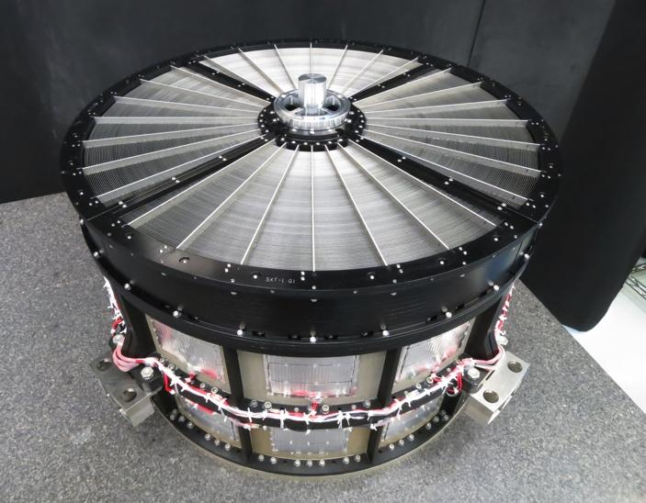
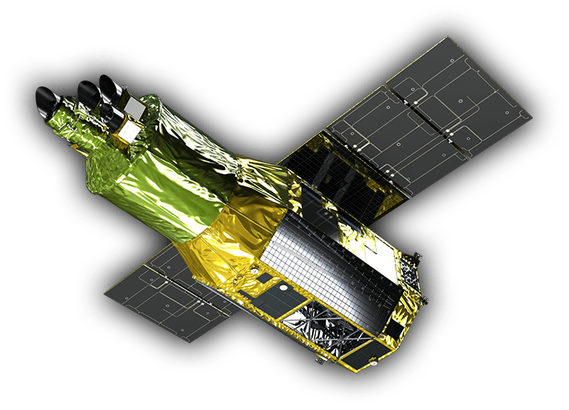
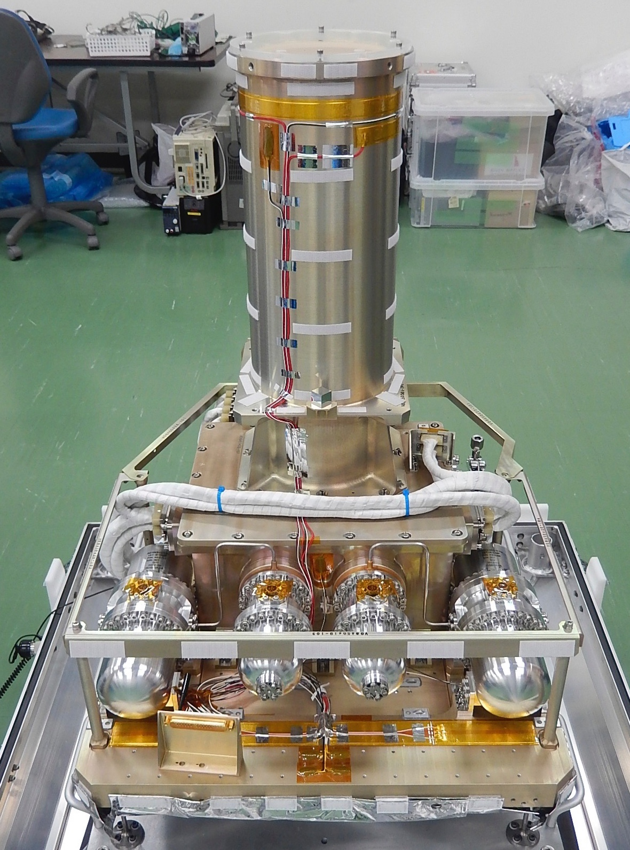
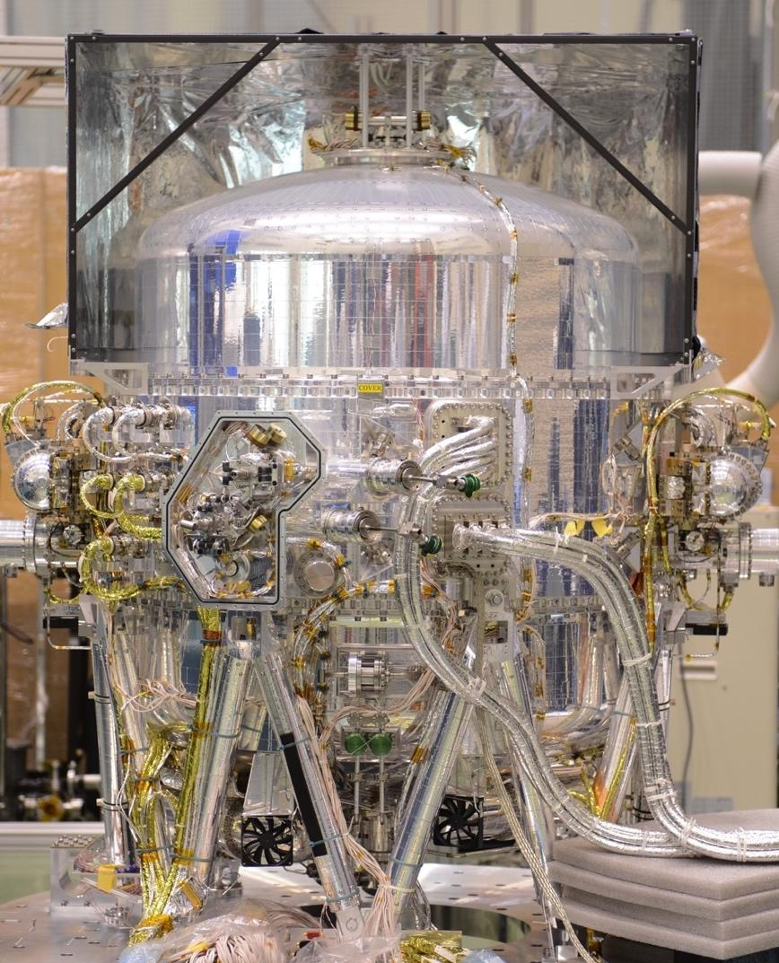
The X-Ray Imaging and Spectroscopy Mission
X-Ray Mirror Assemblies (2)
Focal length for both instruments = 5.6m
Xtend CCD Imager
Resolve X-Ray Spectrometer
Xtend - developed by numerous institutions in Japan, led primarily by Osaka University.
developed jointly by NASA and JAXA
Filter Wheel and Cal sources from ESA

Slide 4
Xtend X-Ray Camera
Large FOV, highly-sensitive X-ray CCD camera
Very large FOV of 38′×38′
Complementary to Resolve - ”Xtends FOV!
High detection efficiency over 0.4-13 keV
~ 190 eV energy resolution (FWHM) at 6 keV.

Slide 5
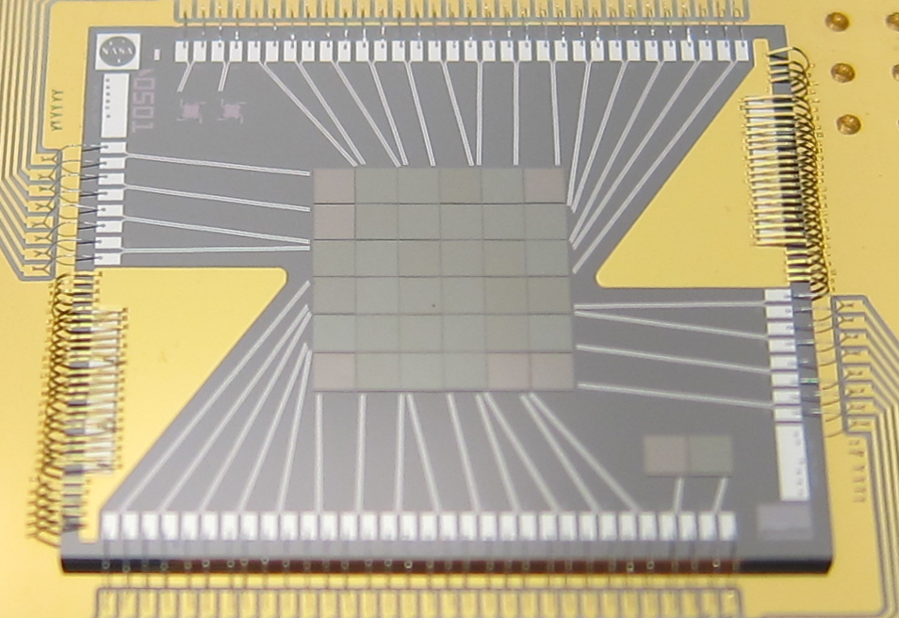
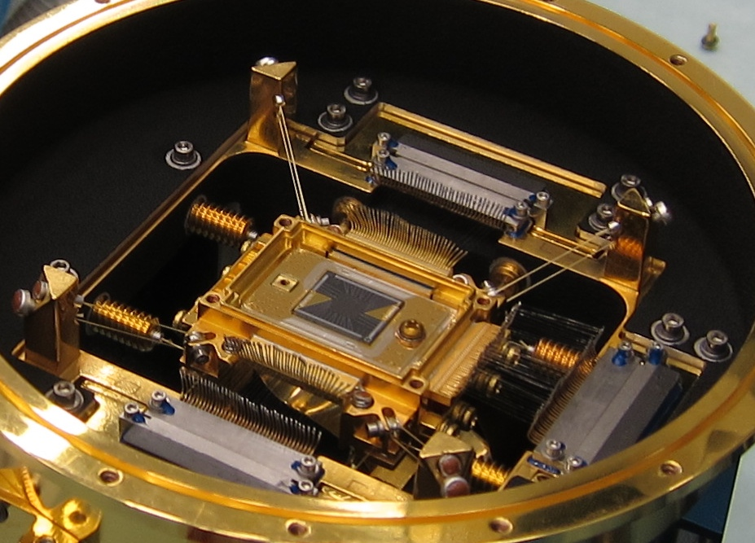
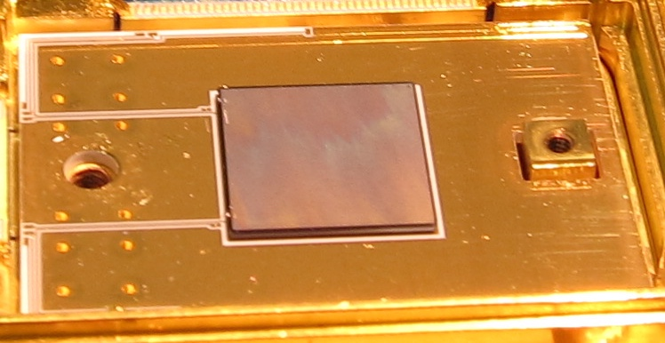
Resolve detector system – operates at 0.05K
Focal Plane Assembly
X-Ray Calorimeter Array
30” pixels - 3x3’ FOV
Anti-coincidence Detector

Slide 6
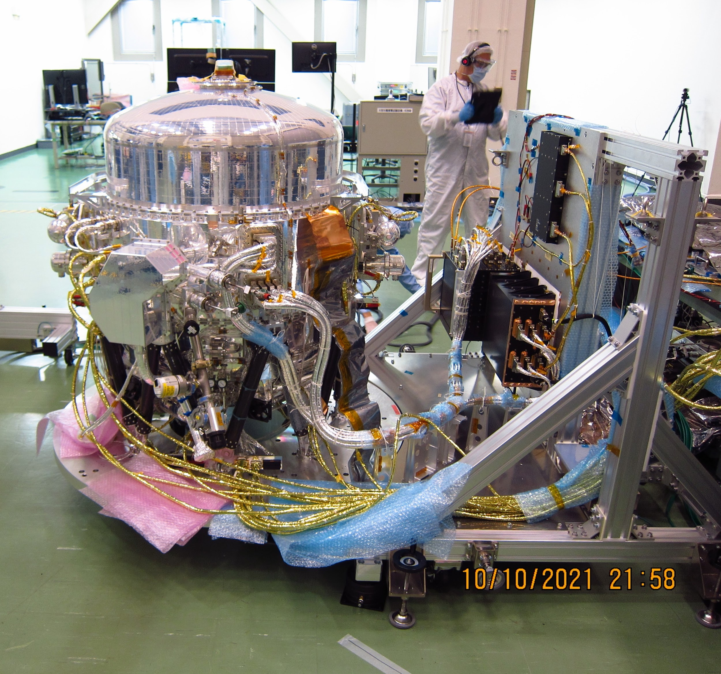
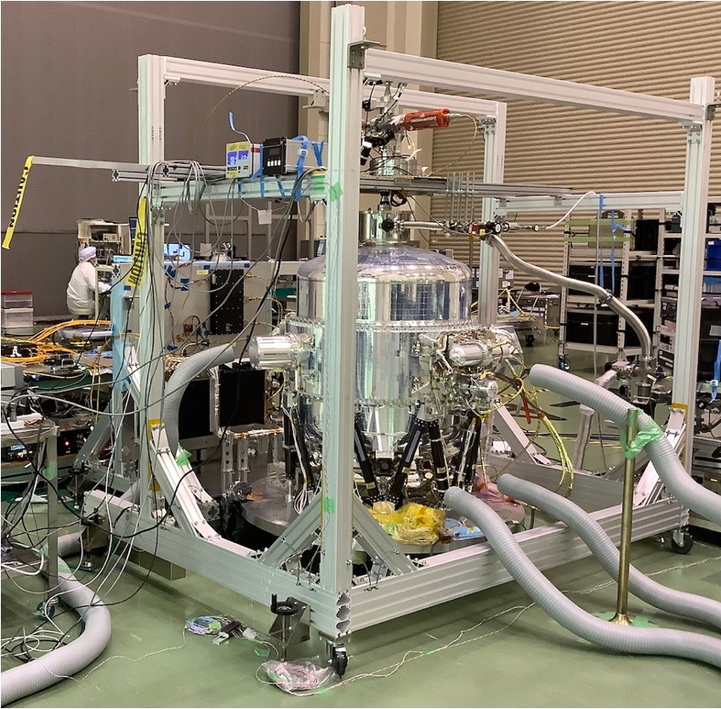
Resolve – complete instrument

Slide 7
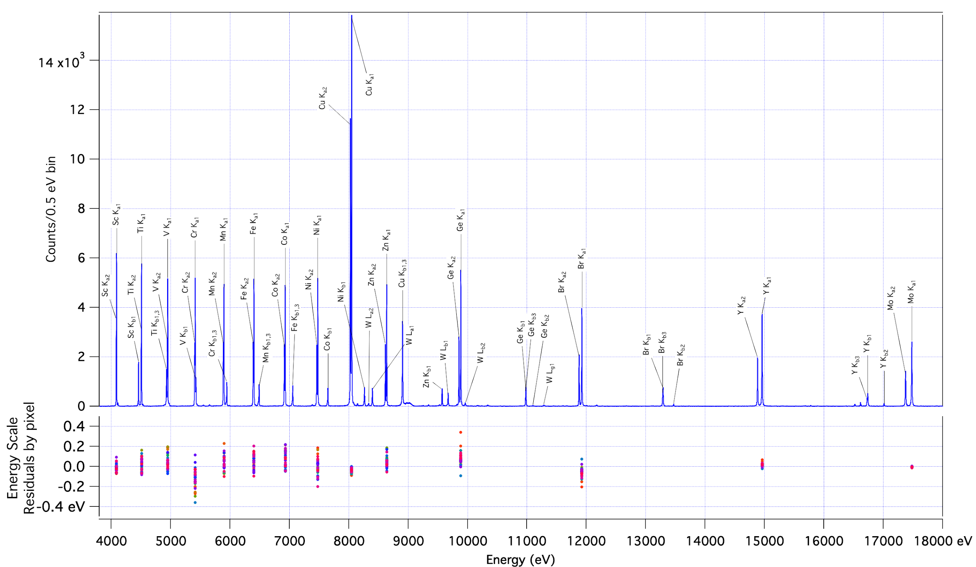
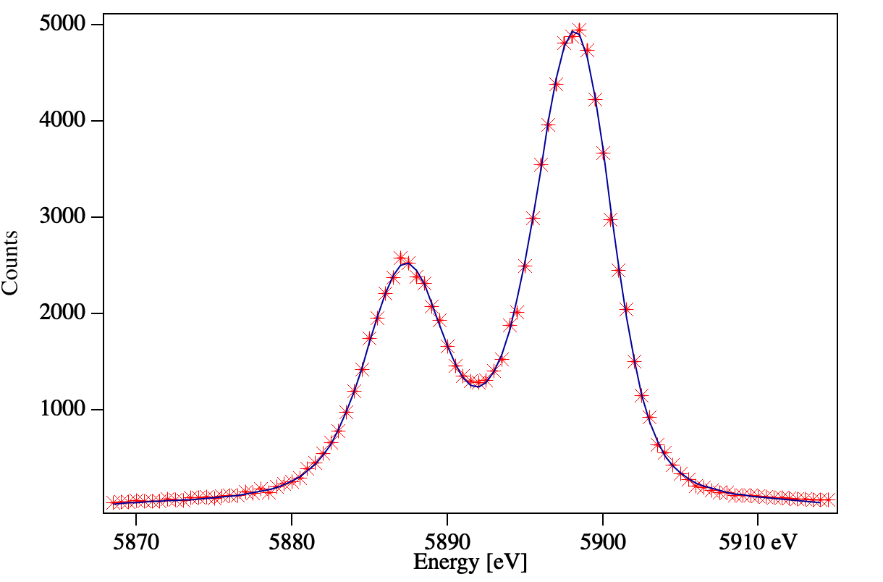
XRISM/Resolve Energy Scale Calibration
Resolution at 6 keV:
4.27 eV FWHM

Slide 8
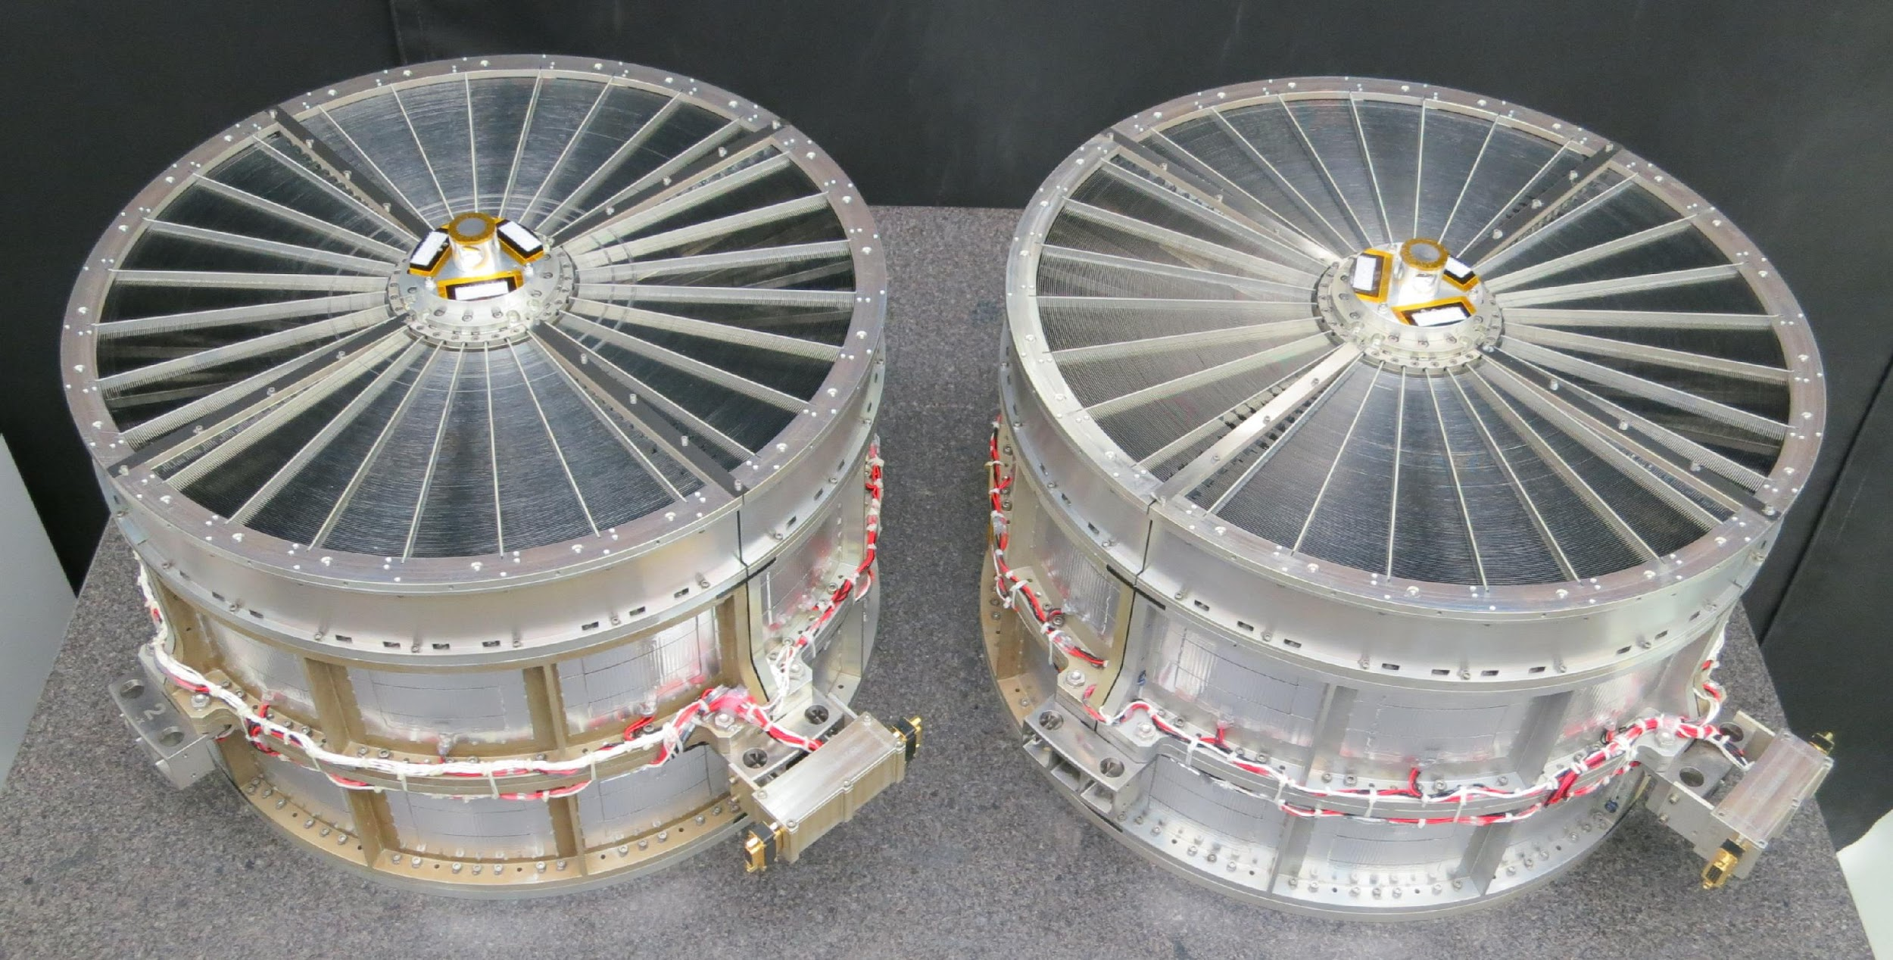
X-Ray Mirror Assemblies
1624 individual reflectors
7” FWHM
1.3’ HPD
Xtend
Resolve
~ 45 cm diameter

Slide 9
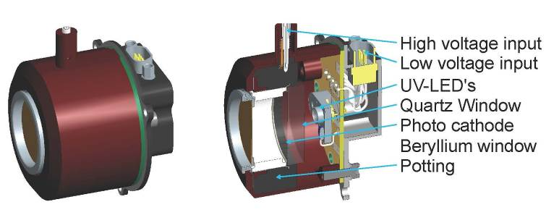
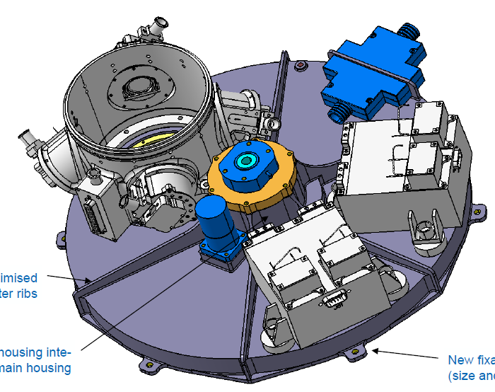
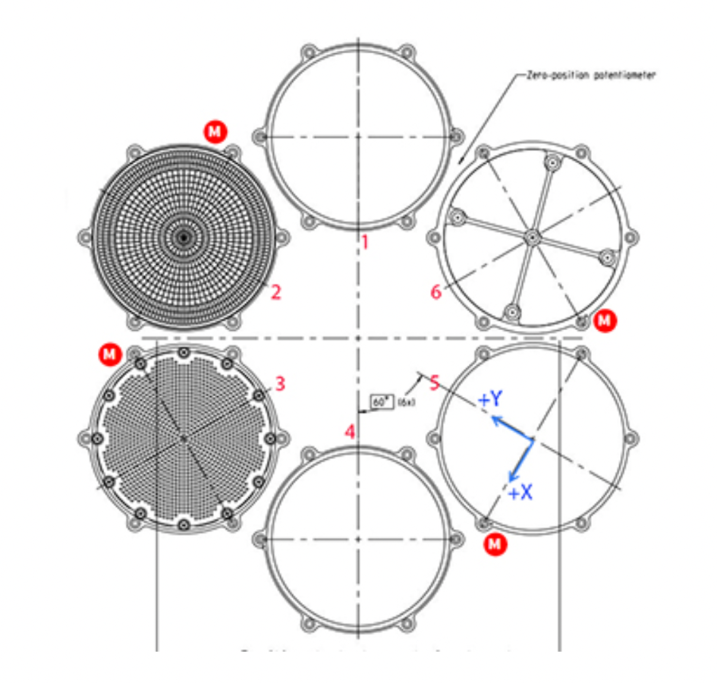
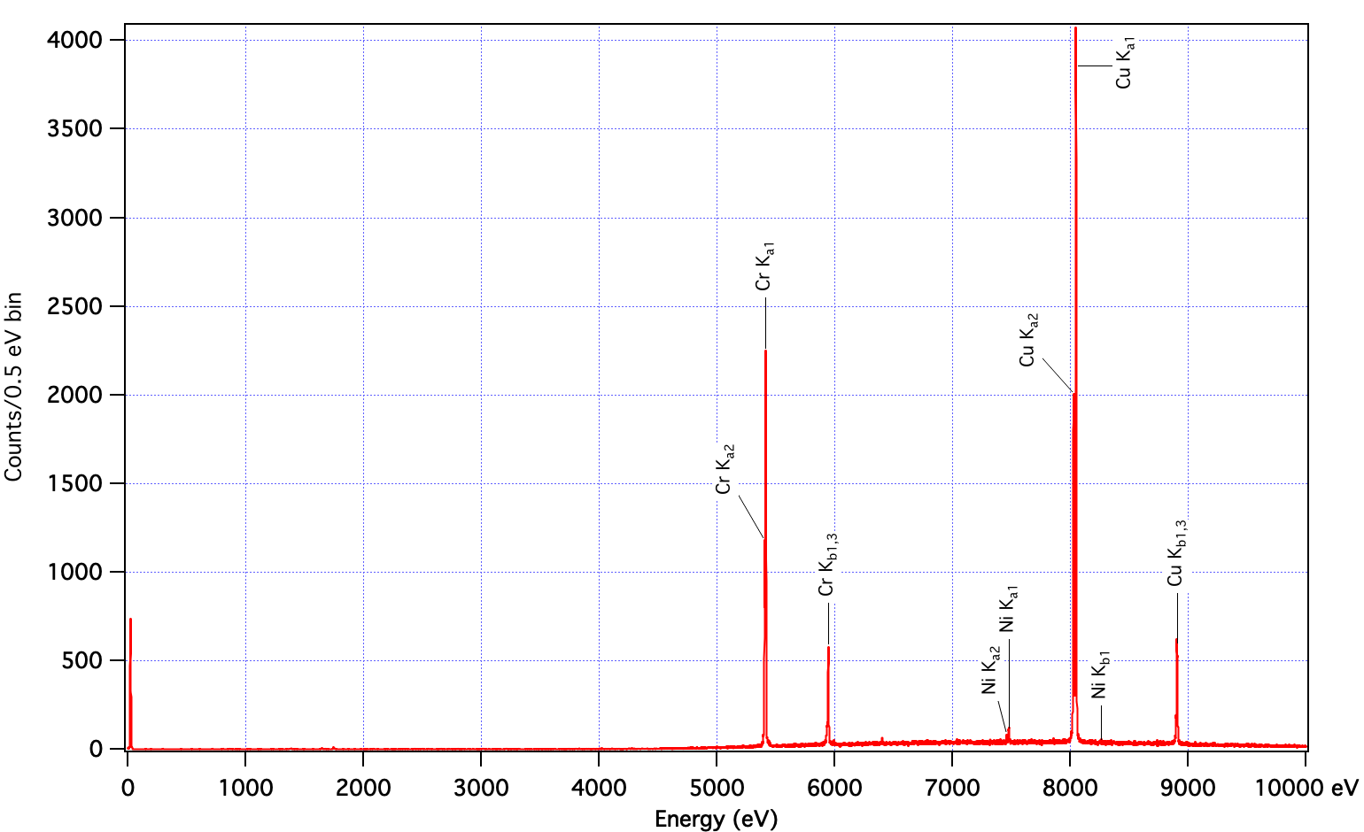
Resolve Filter Wheel and Calibration Sources
Filter Wheel: 6 positions
Filter wheel
(view from the bottom)
Filter ring
Filter with ⁵⁵Fe source
Modulated X-ray Source
(Cu, Cr, ..)
Open
Polyimide
Open/⁵⁵Fe
ND
Be
(25 µm)
Open

Slide 10
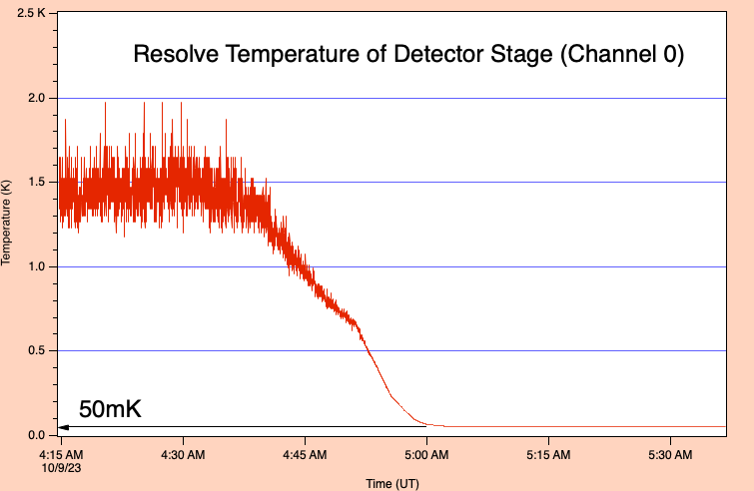
Reaching 50 mK
Resolve has 7 cooling stages:
2-stage Stirling coolers (2)
160K, 28K
Joule-Thomson cooler
4.5K
Liquid Helium ~ 1.3K
3-stage ADR
(1.3K), 0.5K, 50mK
L+32 - October 9
ADR cycle1 – 50mK achieved!

Slide 11
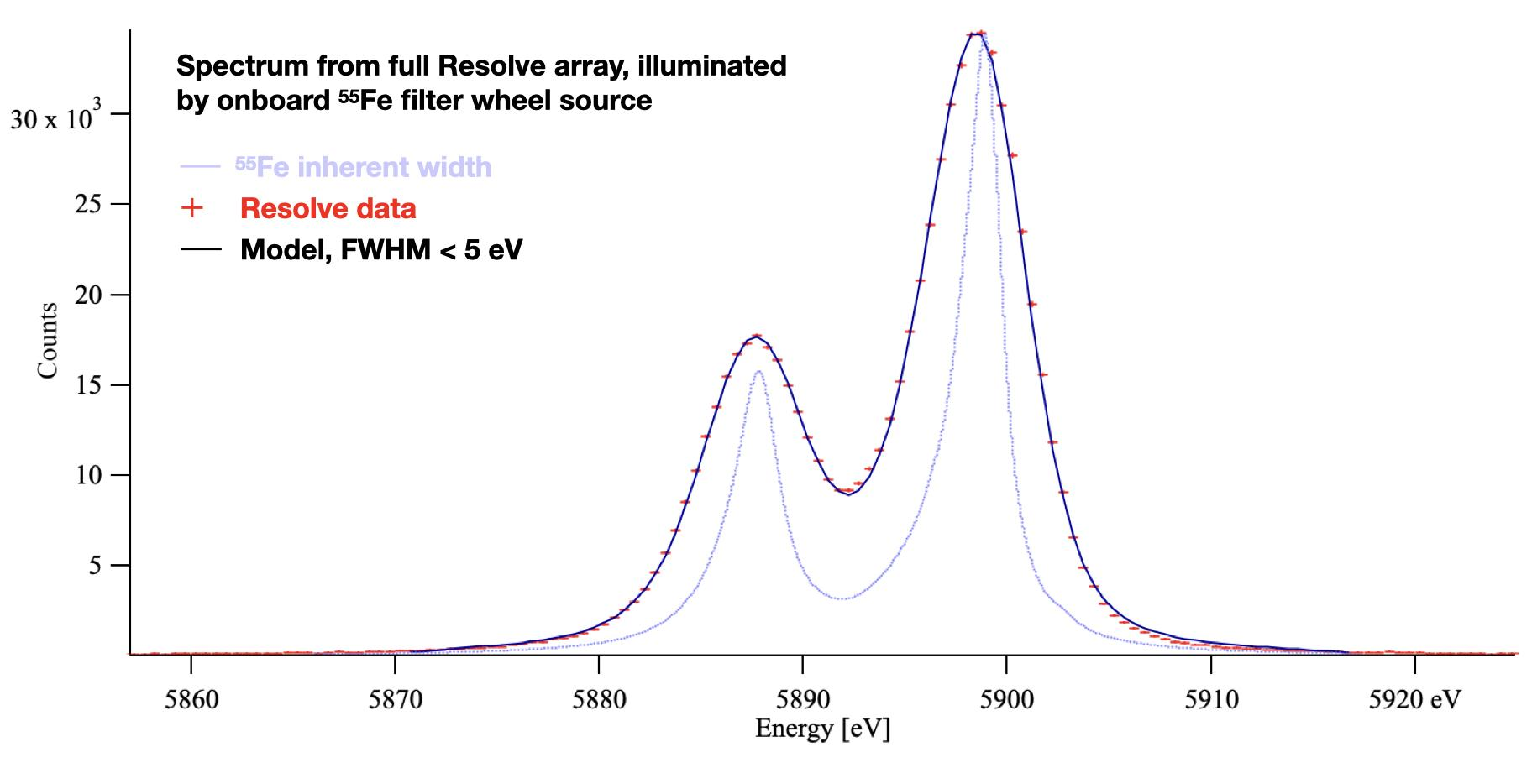
In-flight performance of array using calibration source

Slide 12
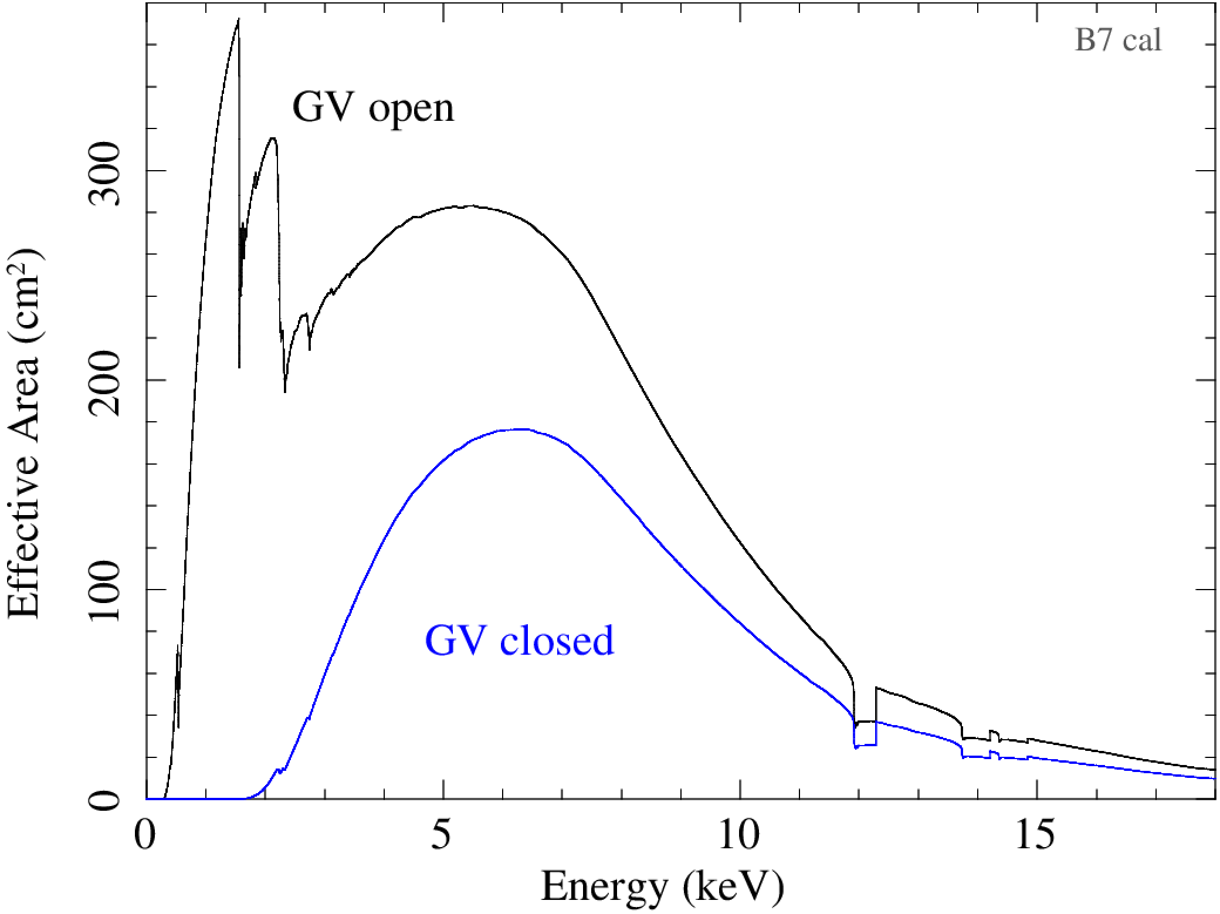
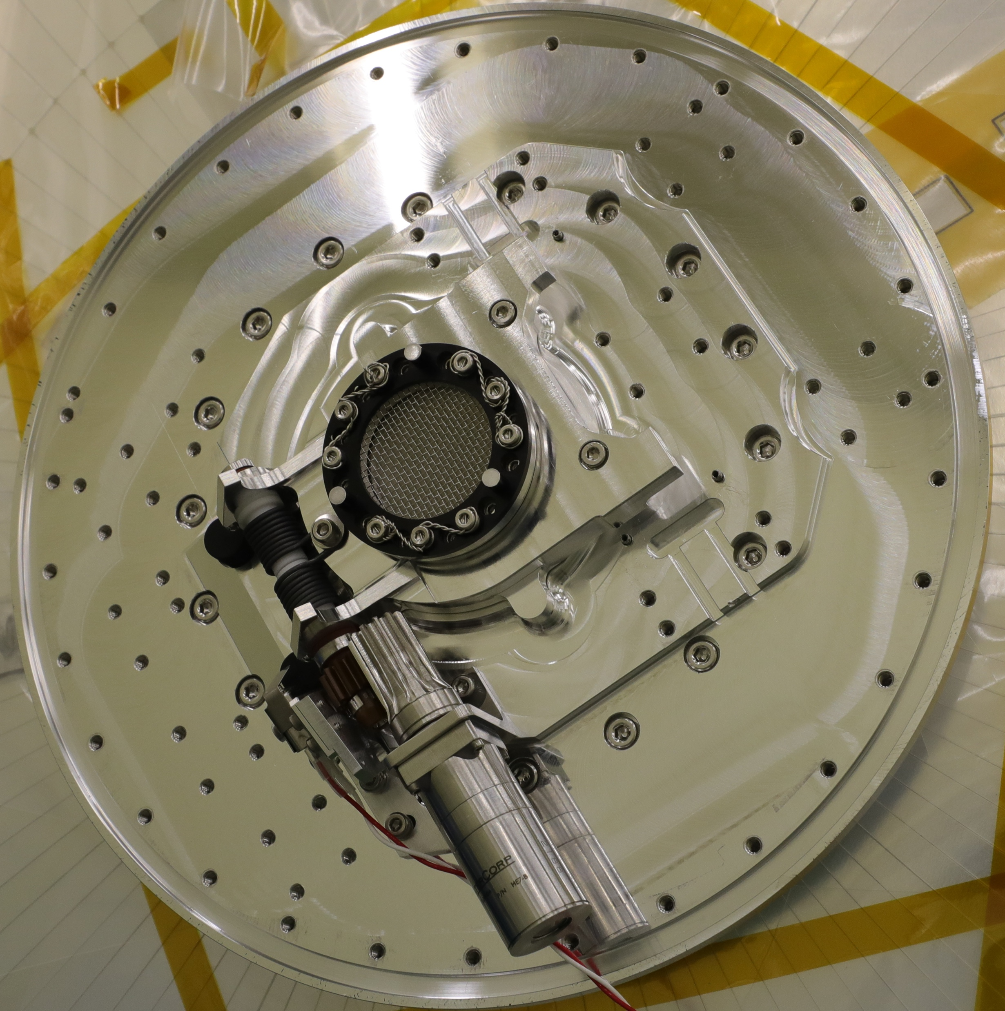
Resolve Effective Area
Aperture door (“gate valve”) not yet opened despite 3 attempts. Design is a “one-shot” mechanism.
Aperture door has a Be window and a protective stainless steel support mesh.
This was implemented to permit safe and easier testing with X-rays before launch without having to open the door. Dewar is under vacuum.
Be window is also a risk mitigation in the event the door does not open in orbit…
JAXA team is hopeful that the door will open if the temperature can be significantly elevated from the -16C nominal and is investigating the possibility of doing this through a combination of heaters and orbital orientation.
Aperture door OPEN
Be window (250 µm)
+ SS mesh
Aperture door
CLOSED

Slide 13
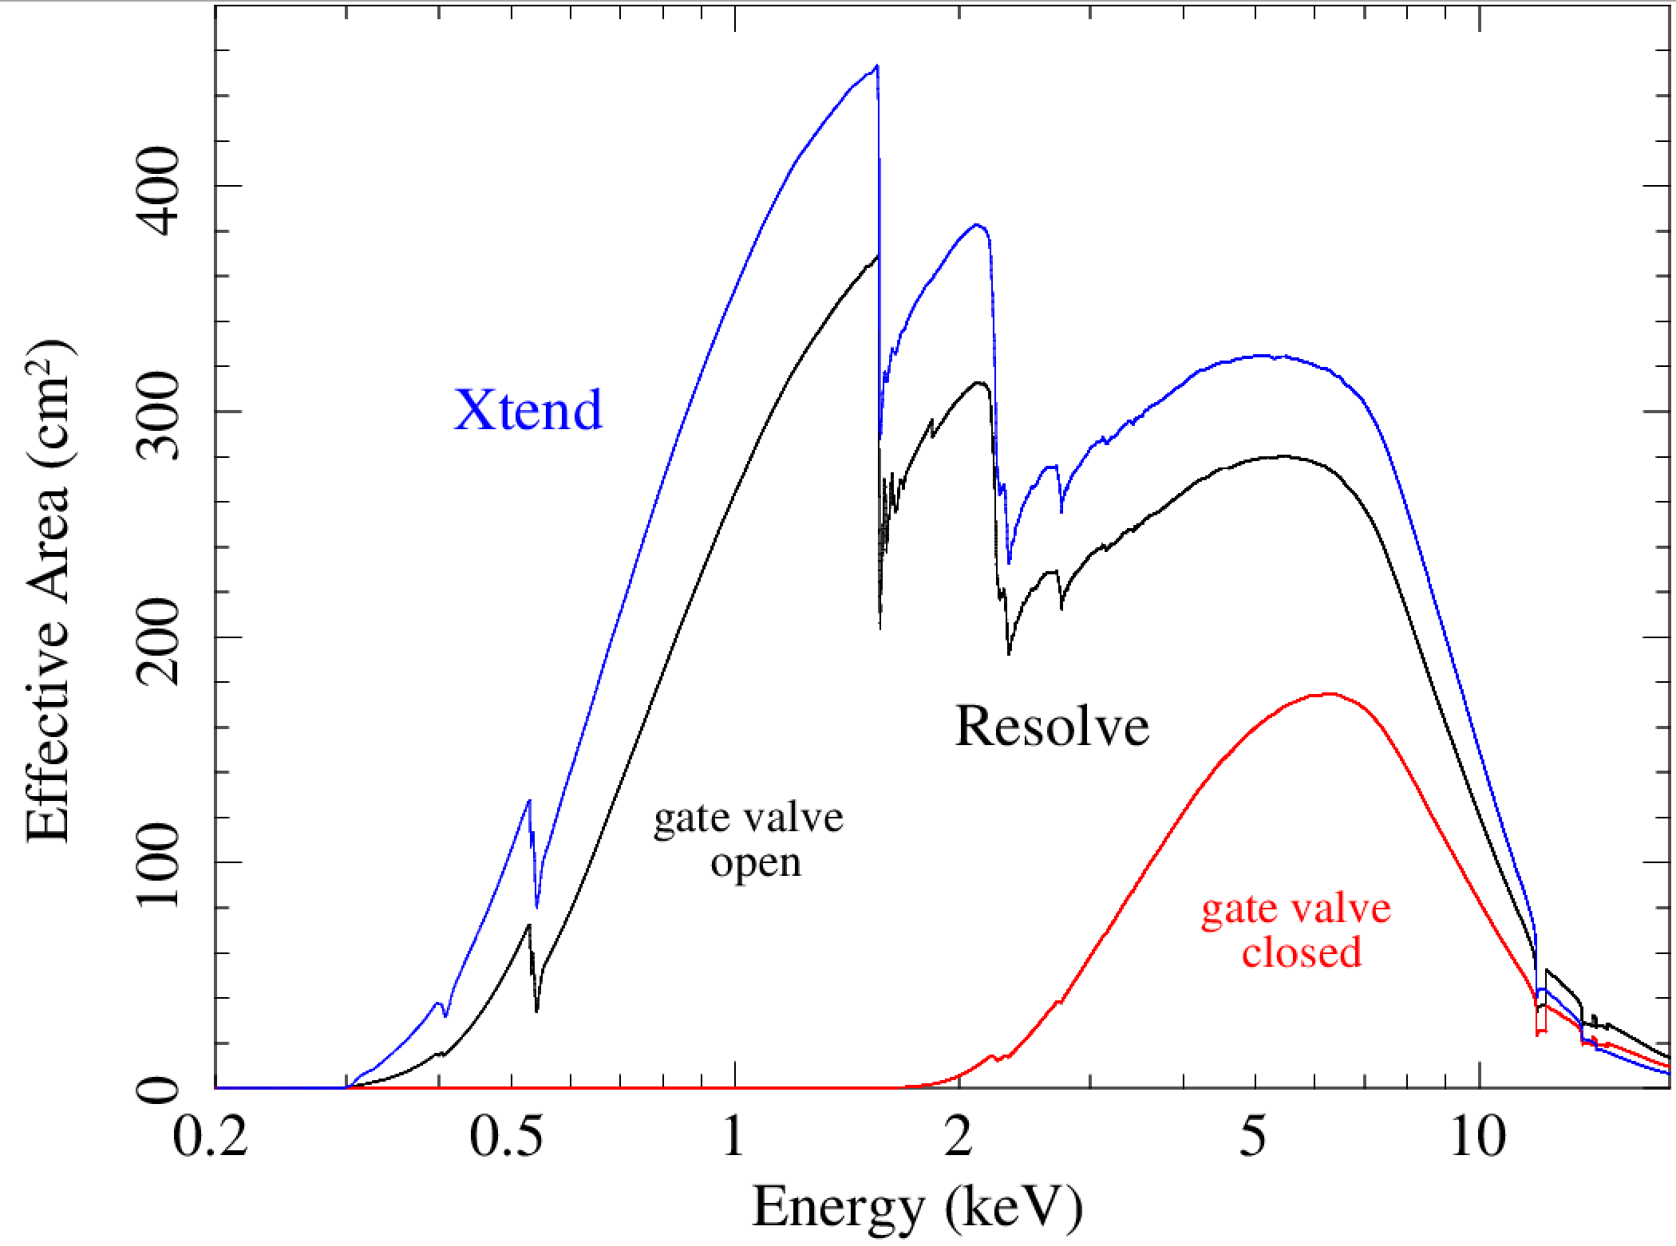
Xtend and Resolve Effective Area

Slide 15
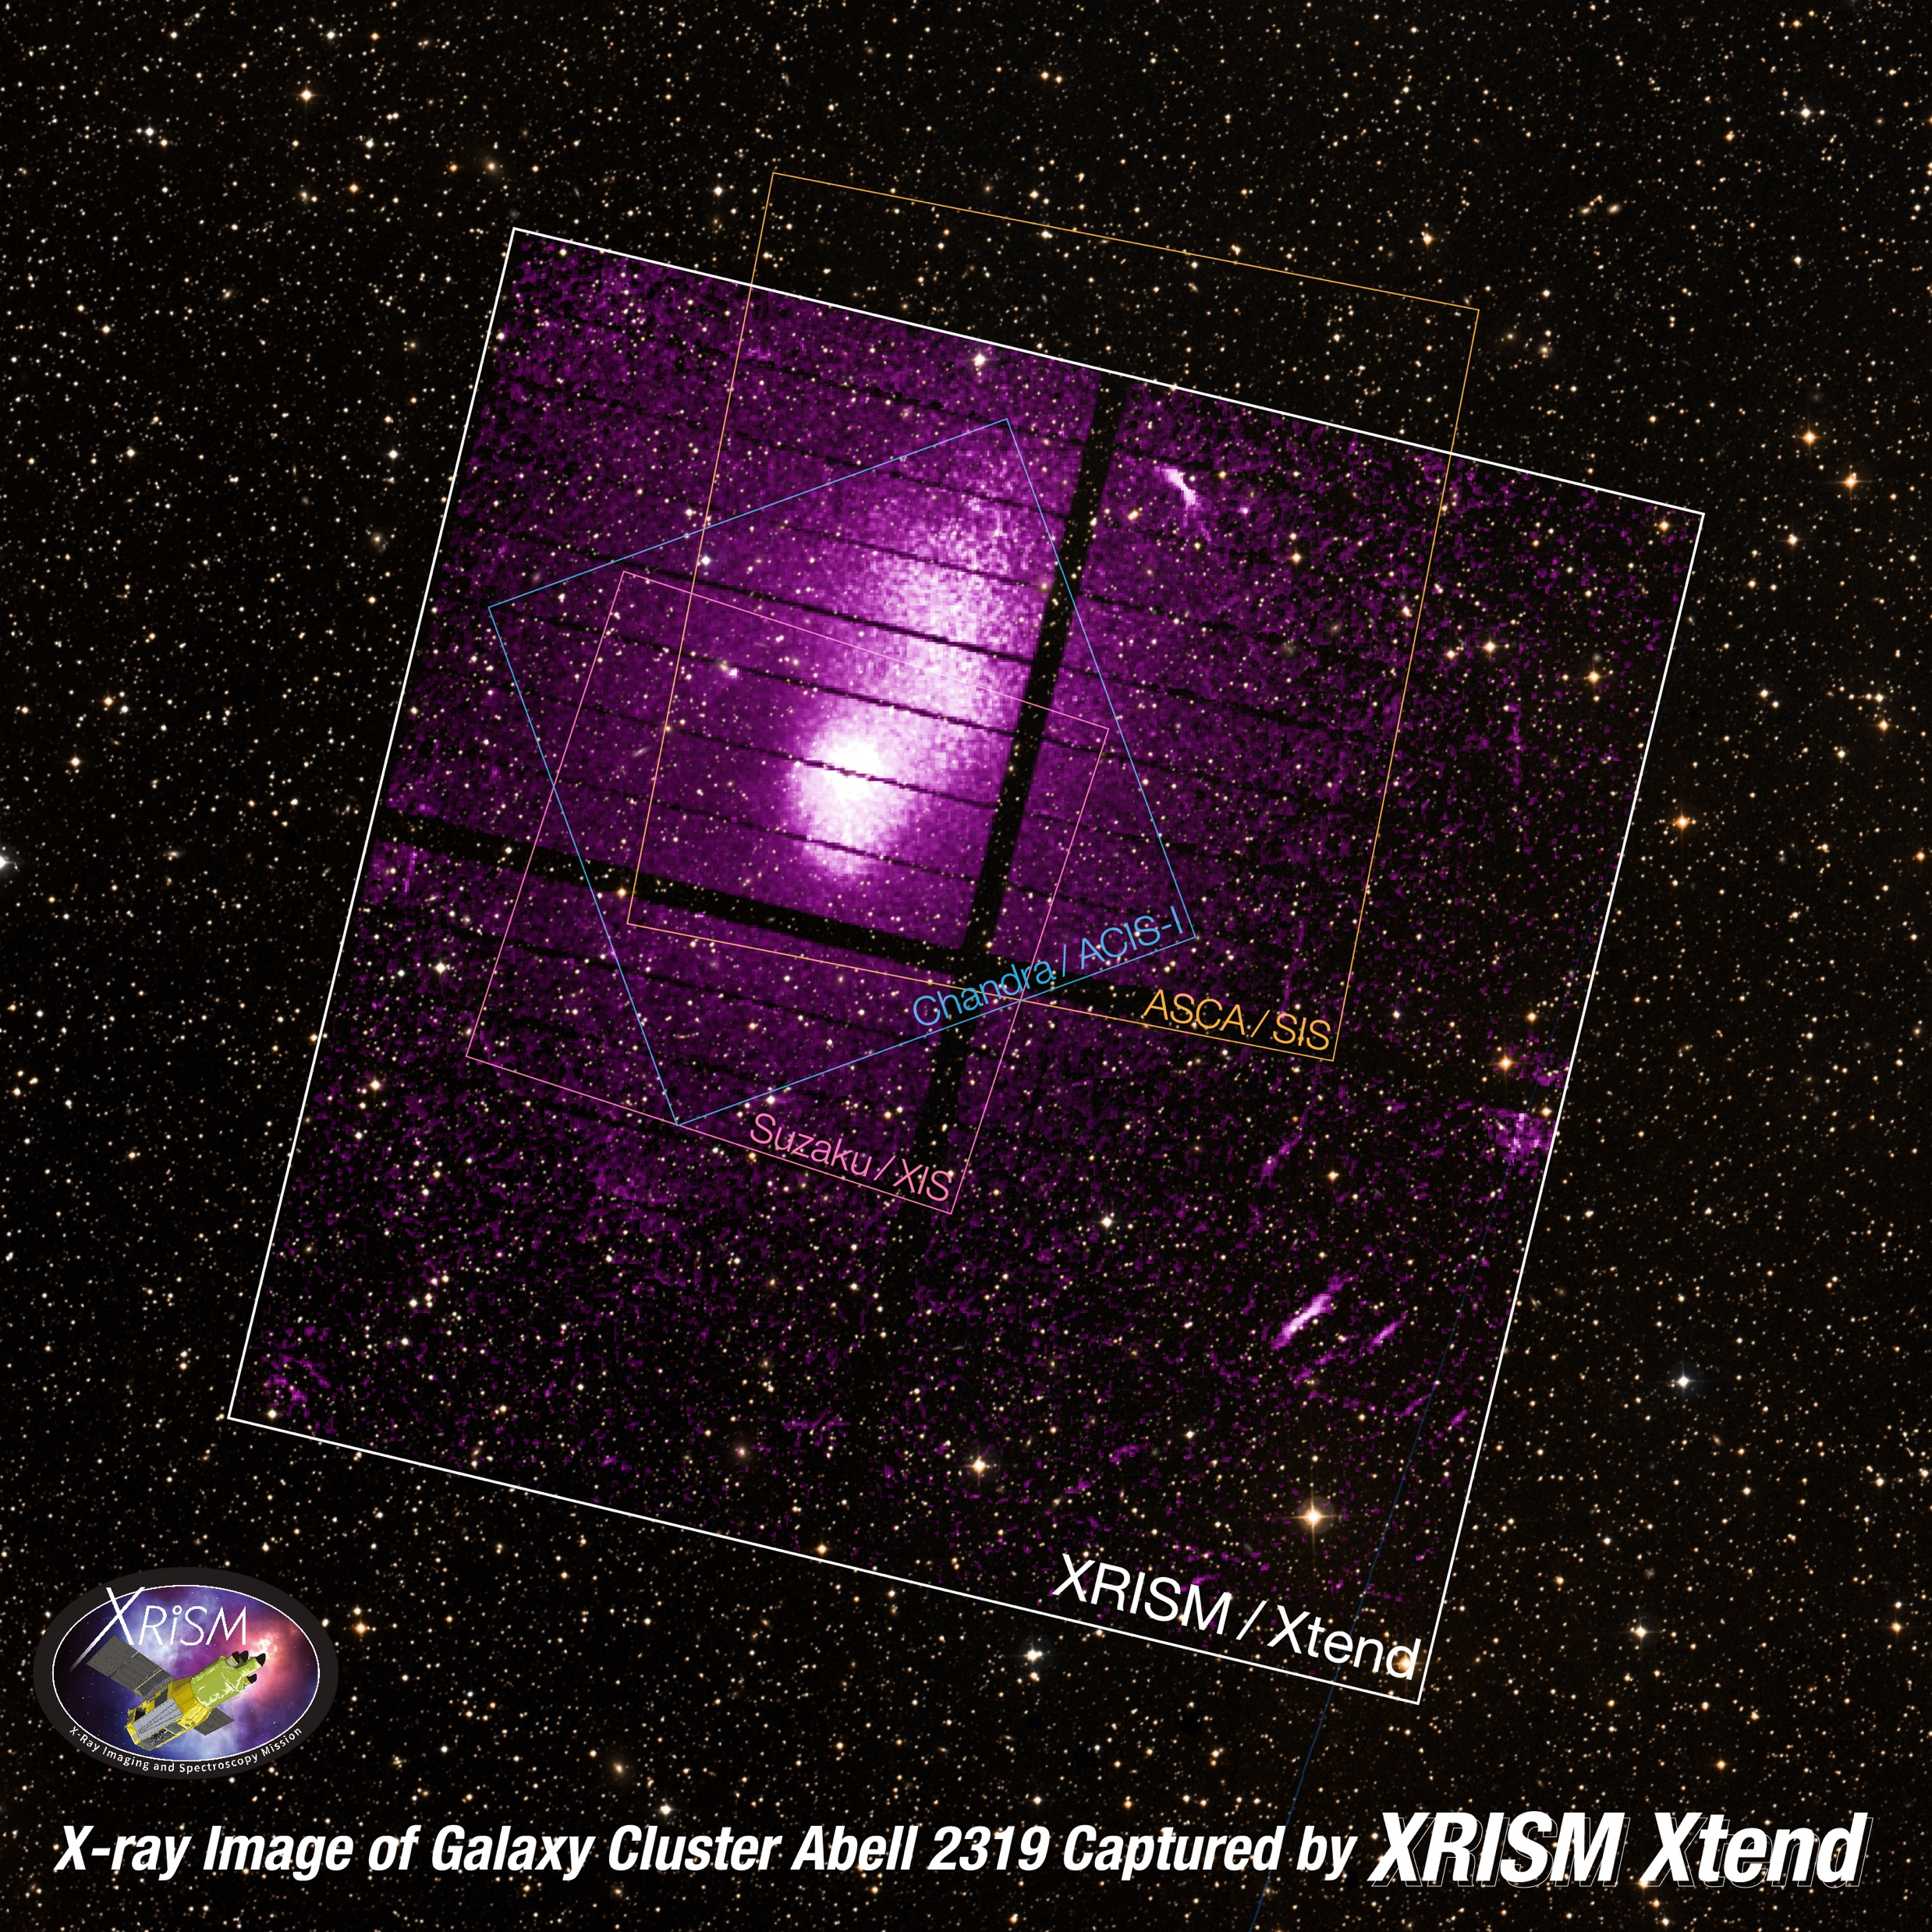
Xtend especially useful for getting the big picture!

Slide 16
Status as of January 2024

