Slide 1
XRISM/Resolve data (a whirlwind tour)
F. Scott Porter
XRISM/Resolve Instrument Scientist
NASA/GSFC
January 18, 2024

Slide 2
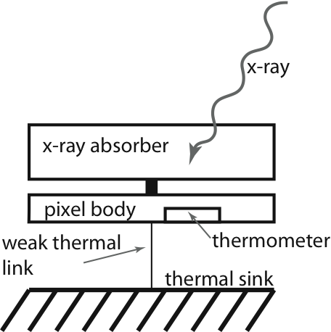
An x-ray calorimeter is a thermal measurement of the photon energy
High resolution non-dispersive spectrometer
linear detectors: large bandpass
Must operate at low temperatures for high resolution
IR/microwave

Slide 3
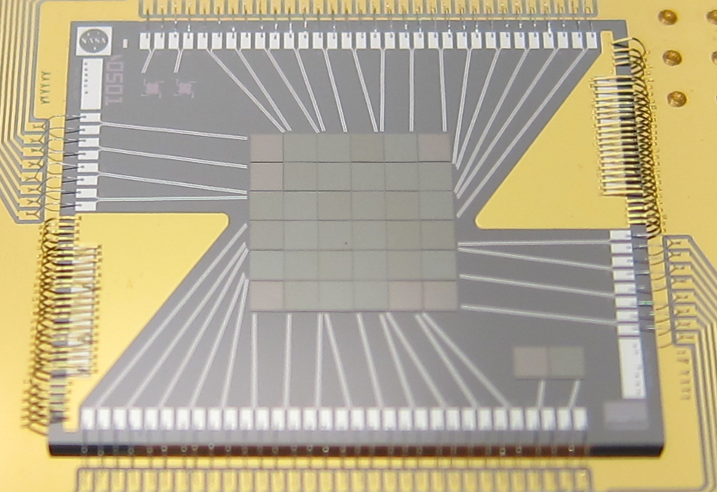
Resolve detector system
Detector Array
Focal Plane Assembly
Anti-coincidence detector

Slide 4
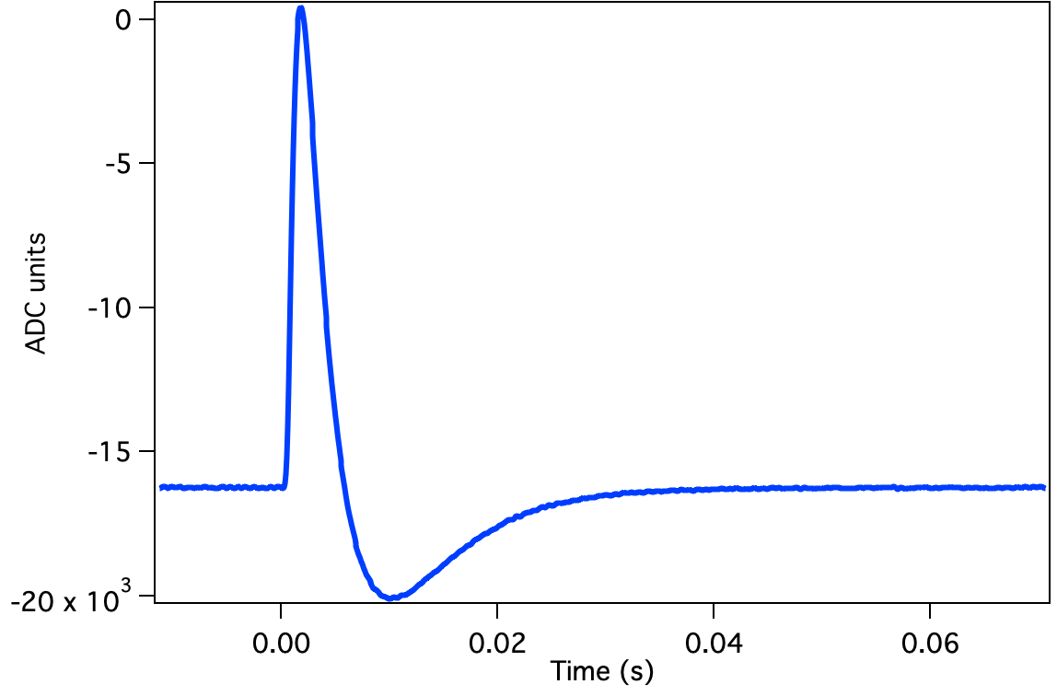
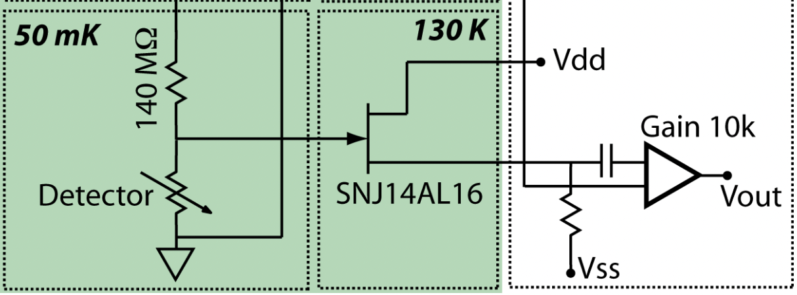
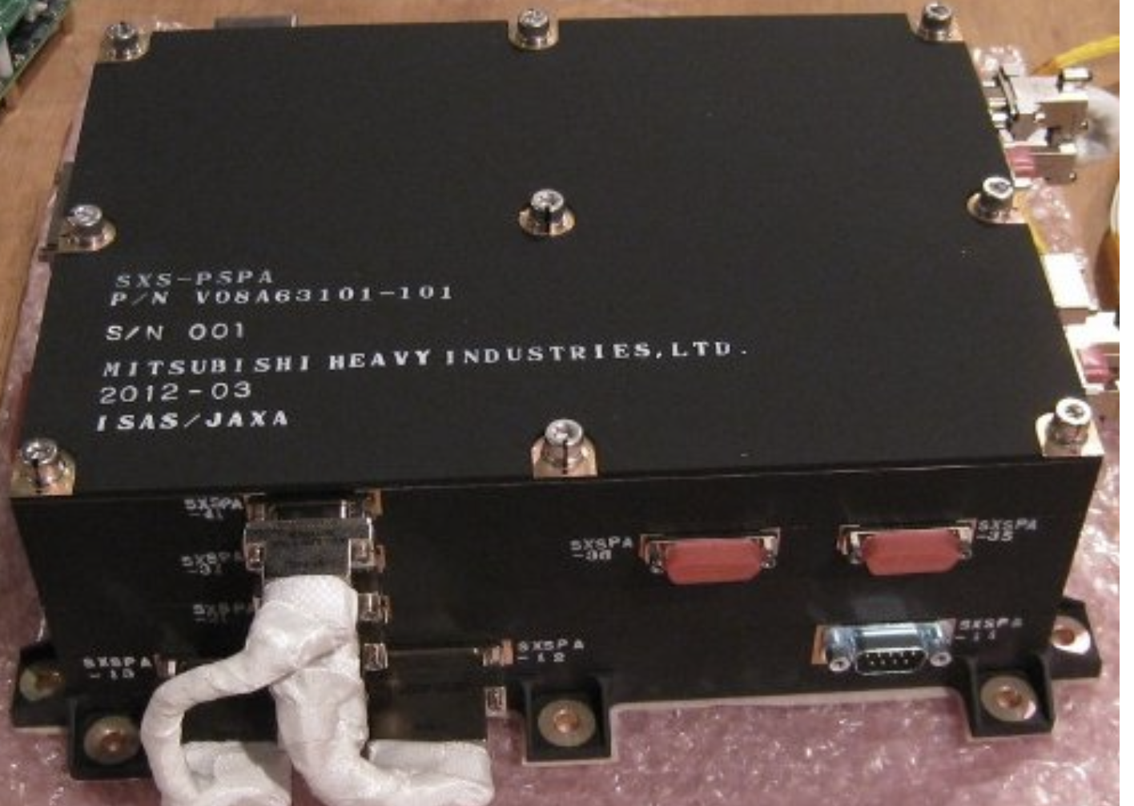
X-ray signal path
XBOX
bias
8 Mb/s
20 kb/s
Ground station
Event list:
PH (det units)
Event time
Risetime
Grading
Pile-up
etc
Pre-pipeline (fff)
Quick
look
Pipeline
Pulse Shape Processor
Observer data

Slide 5
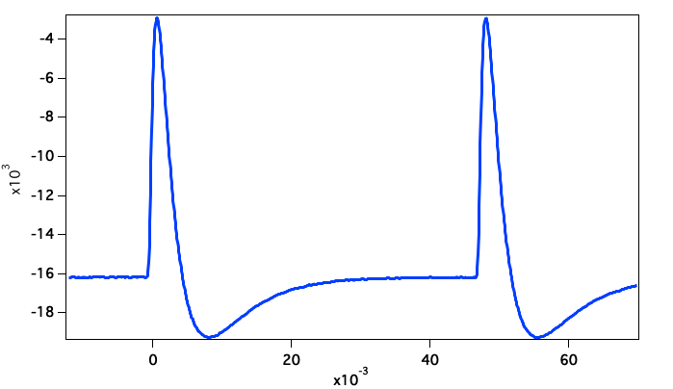
Pulse height processing and event grading
Want to measure x-ray energy
Use all available information
Optimal estimator
Signal/noise in all freq bins
What do you do with pile-up?
Primary
Secondary
Two kinds of pileup
Only effects the pulse processing
Effects the pulse thermally
Event grades:
High Resolution → full record
Mid Resolution → ¼ record
Low Resolution → Simple PH
Secondaries (only mid and low)

Slide 6
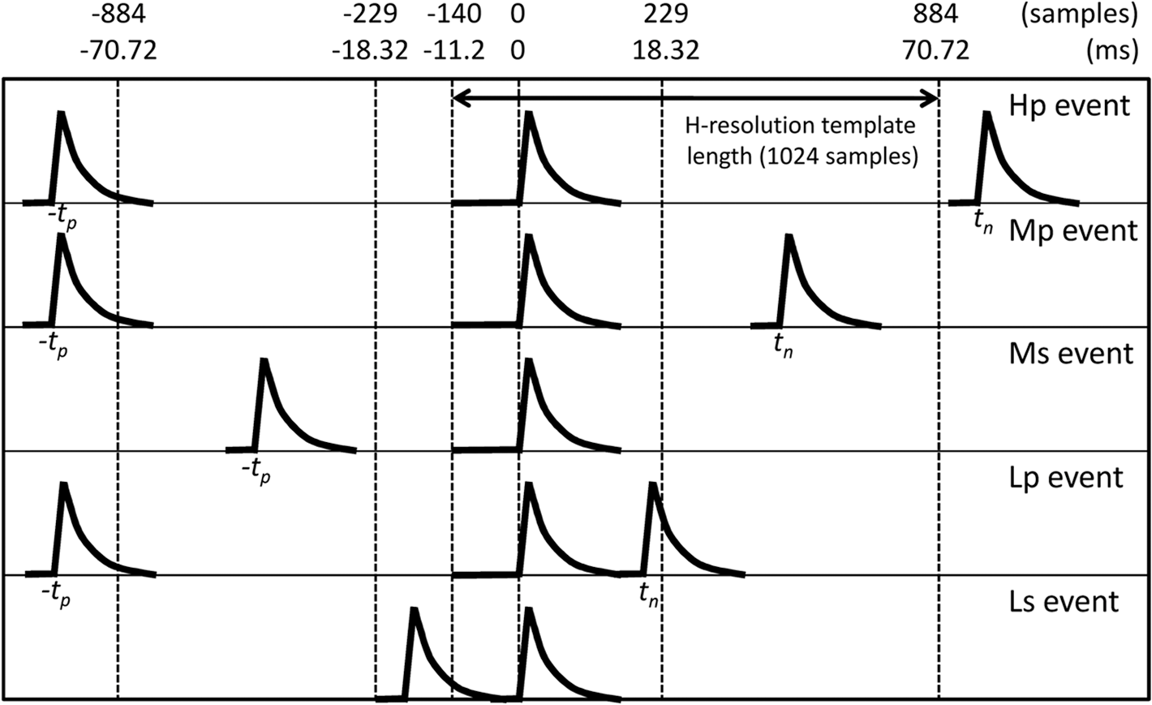
Event grades
Full event grading matrix for Resolve
Ishisaki et al. (2018)

Slide 7
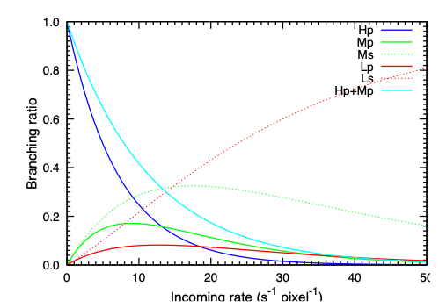
Branching ratio
Note: Most celestial sources are < 1 cps/pixel

Slide 8
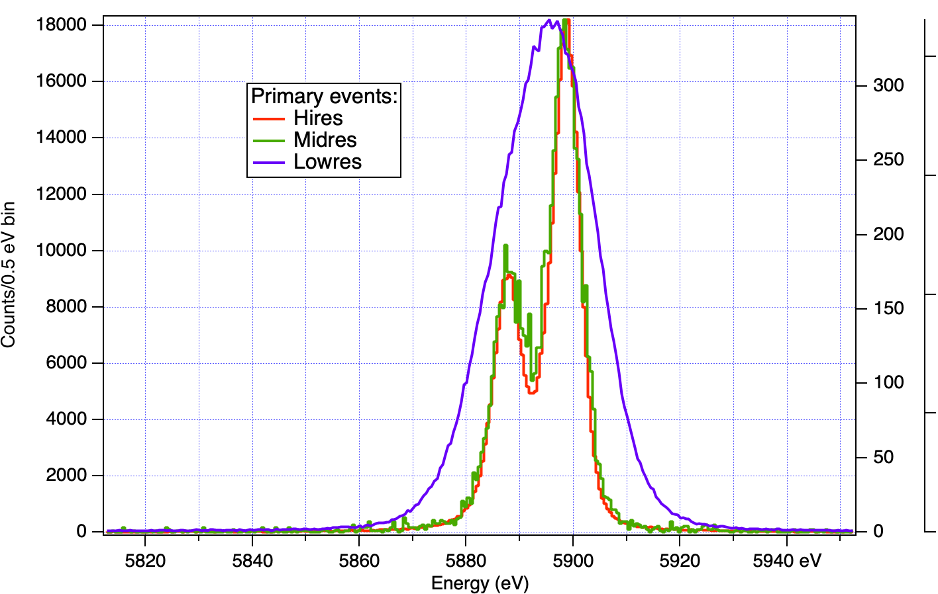
Performance for different grades
Both Hp and Mp must meet energy resolution requirement of 7eV
Low res and secondaries are degraded
Example from in-flight data:
At 6 keV:
Hires: 4.5 eV
Midres: 4.8 eV
Lowres: 15.8 eV

Slide 9
Calibration
Put physical units on instrument data
Parameterize model of the instrument response
Correct instrument non-linearities
Examples:
Line spread function and redistribution (inputs to rmf)
Spectrometer Energy Scale and reconstruction
Throughput (i.e. effective area)

Slide 10
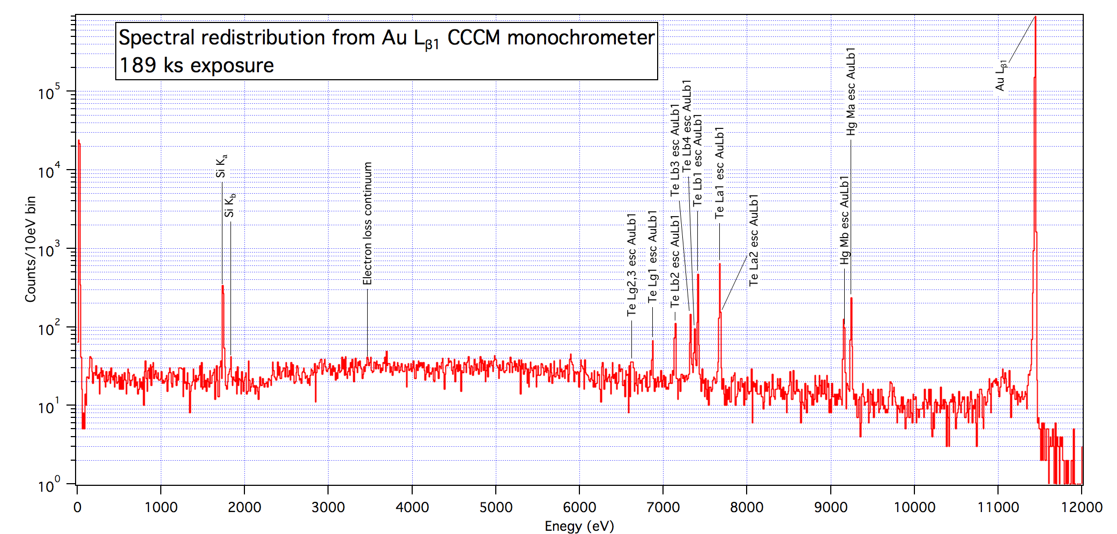
Spectral redistribution
Core line shape: dominated by detector intrinsic noise and system noise
Broadband redistribution: dominated by detector material properties.
To measure: Monochrometers, modeled fluorescent lines, EBIT measurements

Slide 11
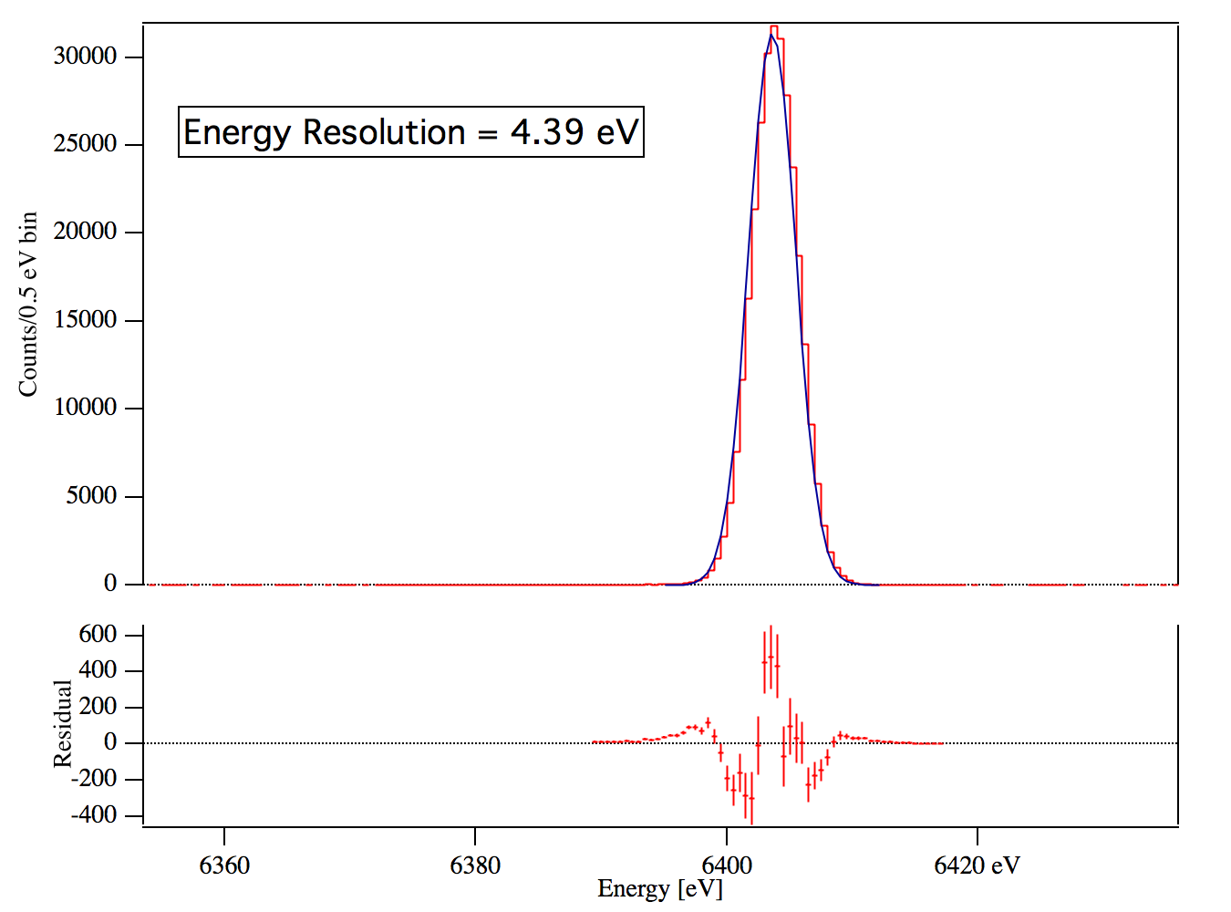
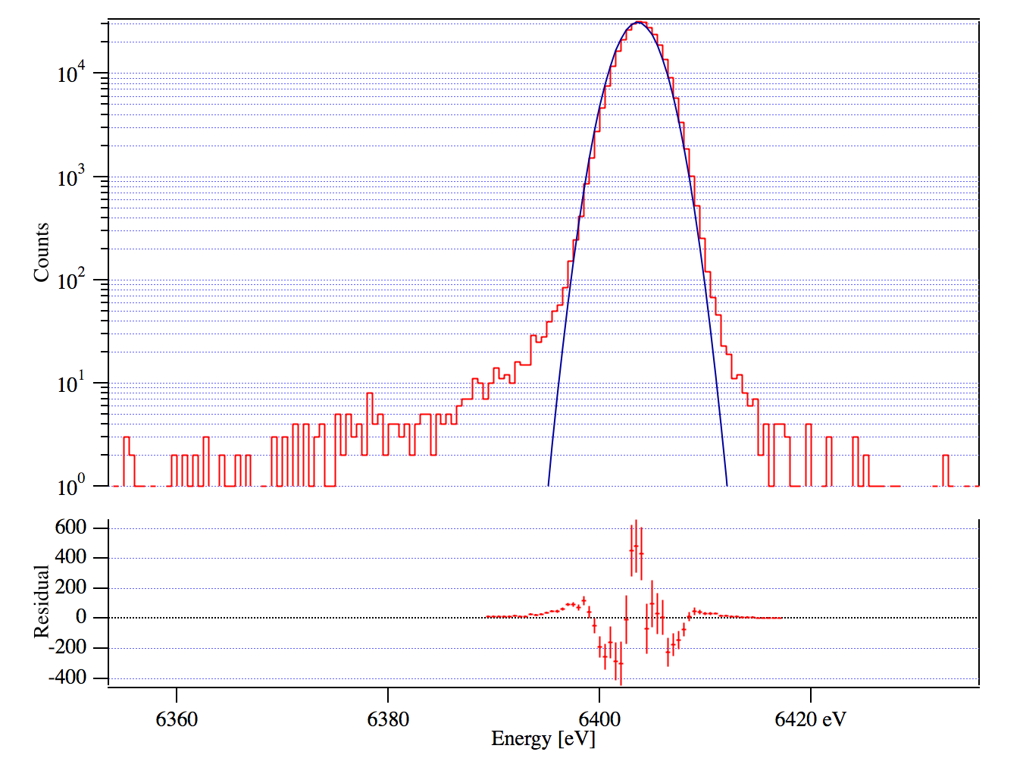
Core line shape
Deviates from a gaussian instrumental function at the 1% level

Slide 12
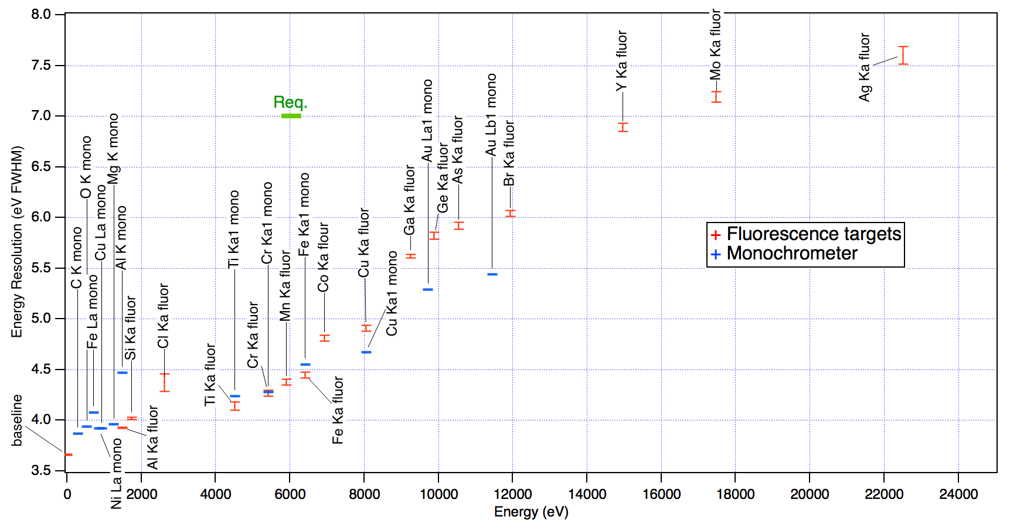
Core line shape across the band pass
Energy resolution scales with Energy
Some systematic differences between monochrometer and fluorescent measurements: incomplete line shape knowledge

Slide 13
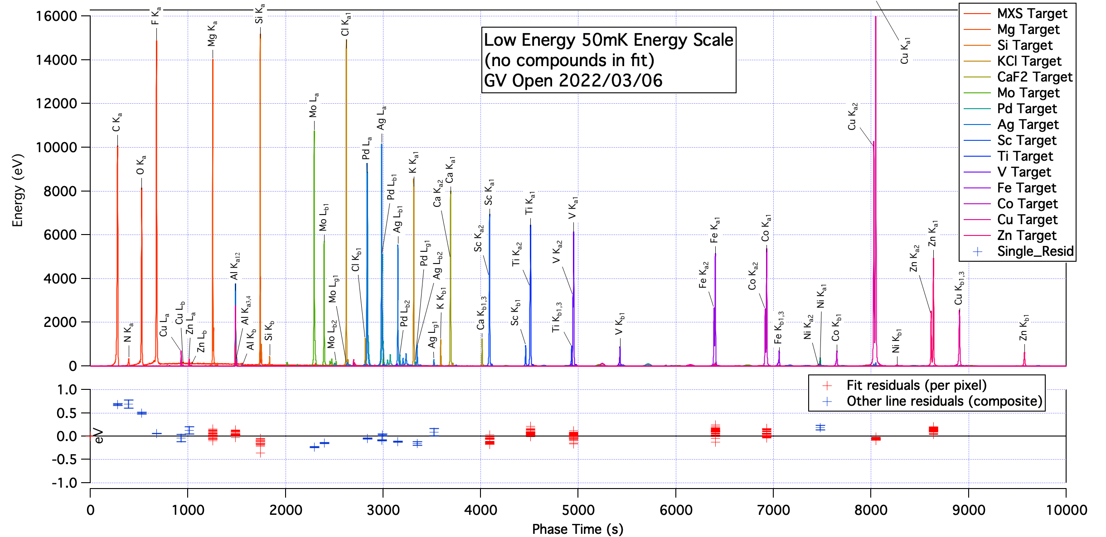
Energy Scale measurement
One of 3 sets of measurements to span bandpass
Precision dominated by fluorescent line models

Slide 14
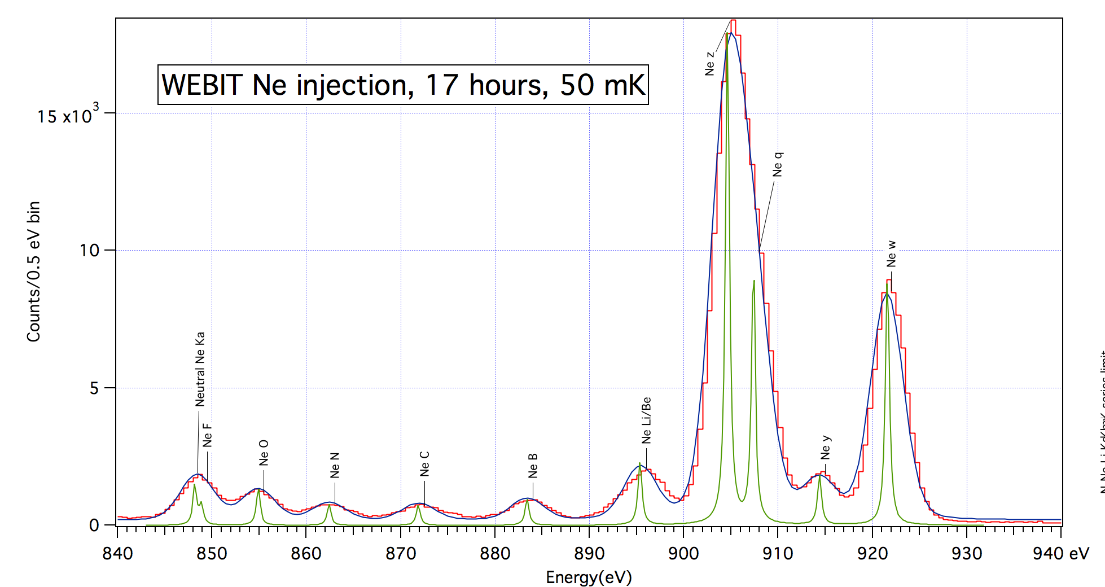
Low energy measurements with EBIT
EBIT results for Neon
Energy scale error = +0.41 eV, Energy resolution = 3.83 eV (composite 35 pixels)

Slide 15
Summary of EBIT results
Fluorescent line energy scales meet requirements
Some systematic errors which can be corrected using EBIT measurements.
Target species | Injected gas | Lines fit | Nominal energy | Energy resolution | Energy scale error
Nitrogen | N₂ | He-like | 424 eV | 4.05 eV* | +0.75 eV
Oxygen | CO₂ | He-like | 565 eV | 3.81 eV | +0.62 eV
Fluorine | C₃F₆ | He-like | 732 eV | 3.81 eV | +0.59 eV
Neon | Ne | He-like and lower charge states | 905 eV | 3.83 eV | +0.41 eV
Silicon | DMTSiloxane | He-like and lower charge states | 1860 eV | 3.85 eV | +0.09 eV
Sulfur | SF₆ | He-like and lower charge states | 2445 eV | 4.20 eV | +0.02 eV

Slide 16
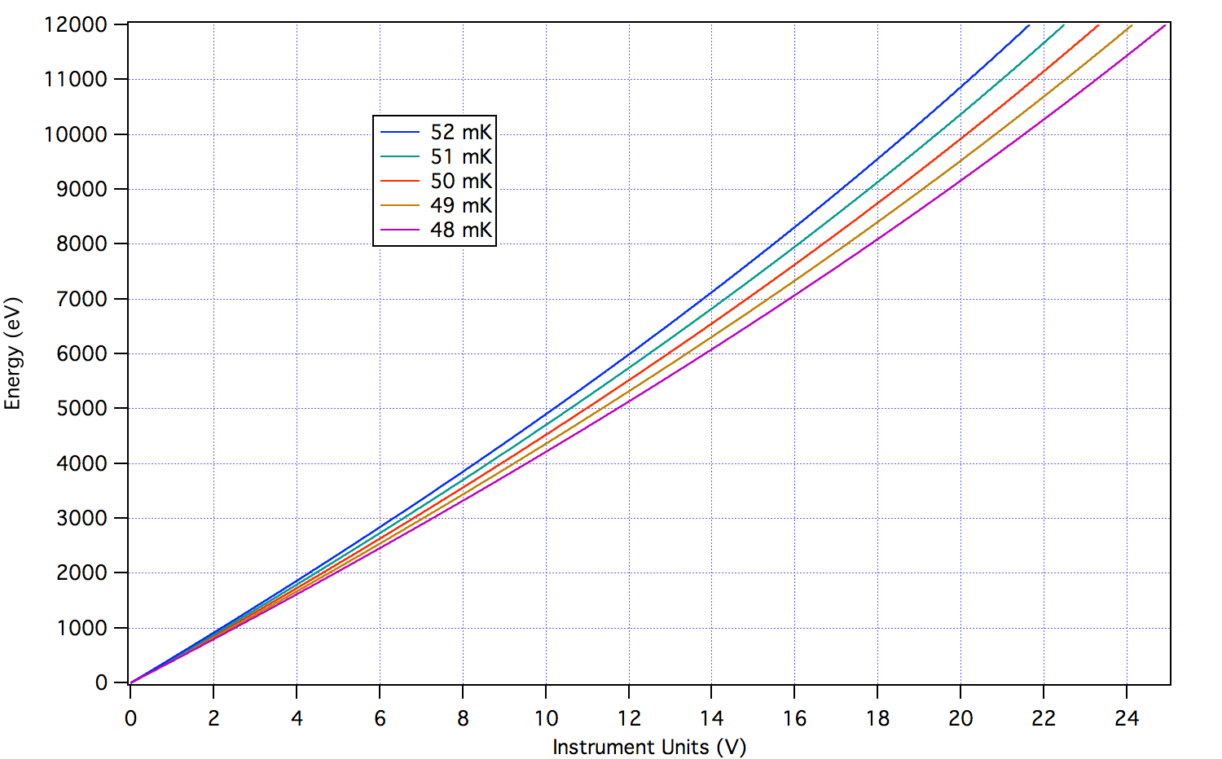
Energy scales (cont’d)
Energy Scale is non-linear and varies with temperature
Need to reconstruct vs time on-orbit using a fiducial

Slide 17
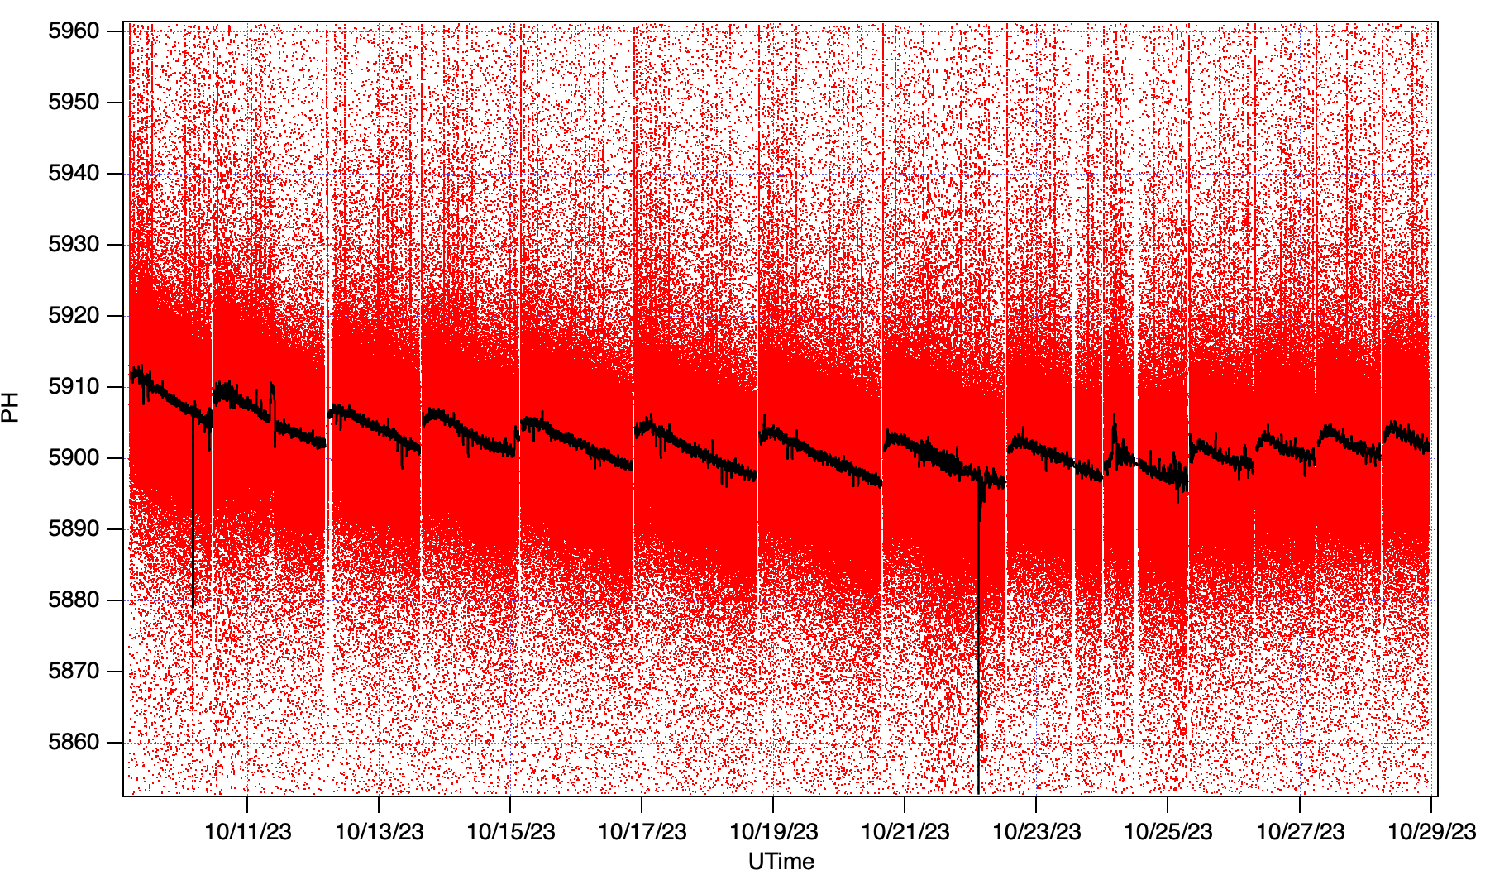
Energy scale reconstruction
XRISM has three fiducials to track detector gain vs time:
Calibration pixel with internal 55-Fe source (5.9 keV), always on
Modulated x-ray source: flood source for all pixels, but well defined time
55-Fe source on the filter wheel which can be rotated into the FOV
XRISM on orbit
Cal pixel
Gain tracking function

Slide 18
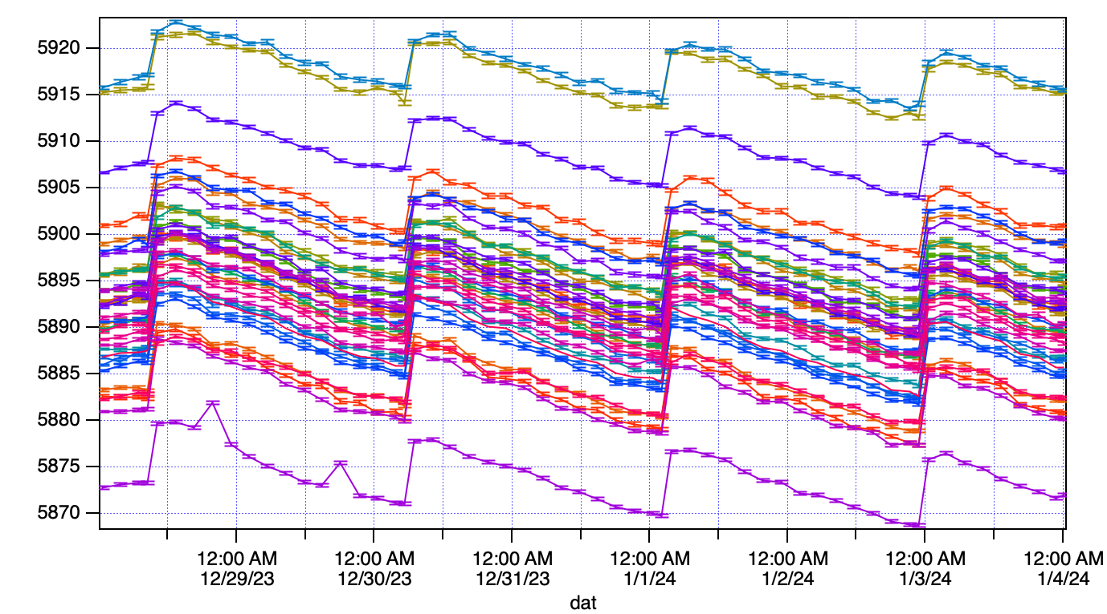
During Gate valve closed observations → FW 55-Fe
With the Gate Valve closed, each modulated x-ray source only illuminates ½ the array → gain tracking using the FW 55-Fe source during eclipse
Gain tracking during 7 day trial observation of the Centaurus Cluster

Slide 19
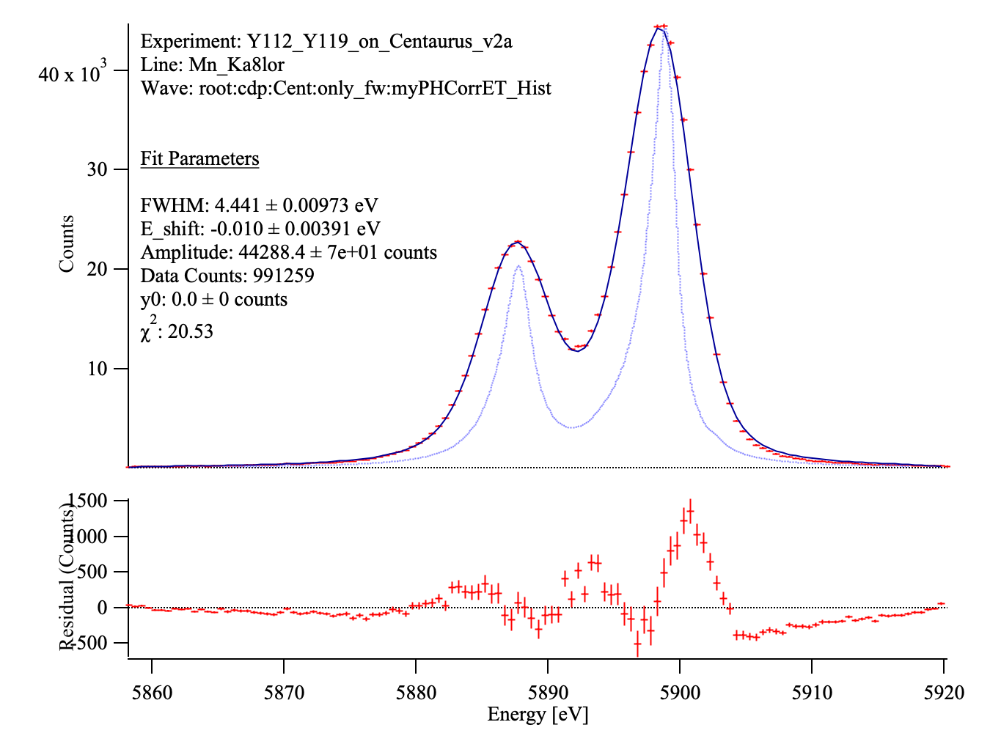
Reconstructed energy scale
Reconstructed 55-Fe spectrum from 58 gain fiducials (104 ks):
Composite resolution of 35 pixels: 4.4 eV. Energy scale error = 0.01 eV at 6 keV

Slide 20
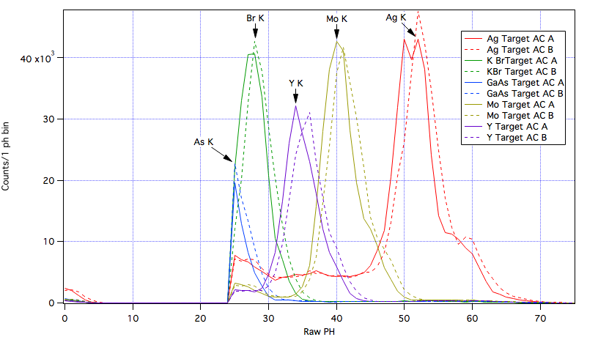
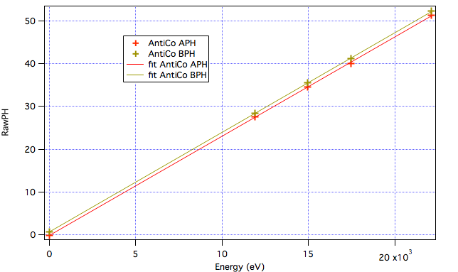
Anti-coincidence detector energy scale
Low voltage ionization detector behind the main detector array
Dual independent readouts for redundancy
Energy scale is very linear
Use same RTS measurements, use the fact that the main array is partially transparent
Anti-coincidence detector

Slide 21
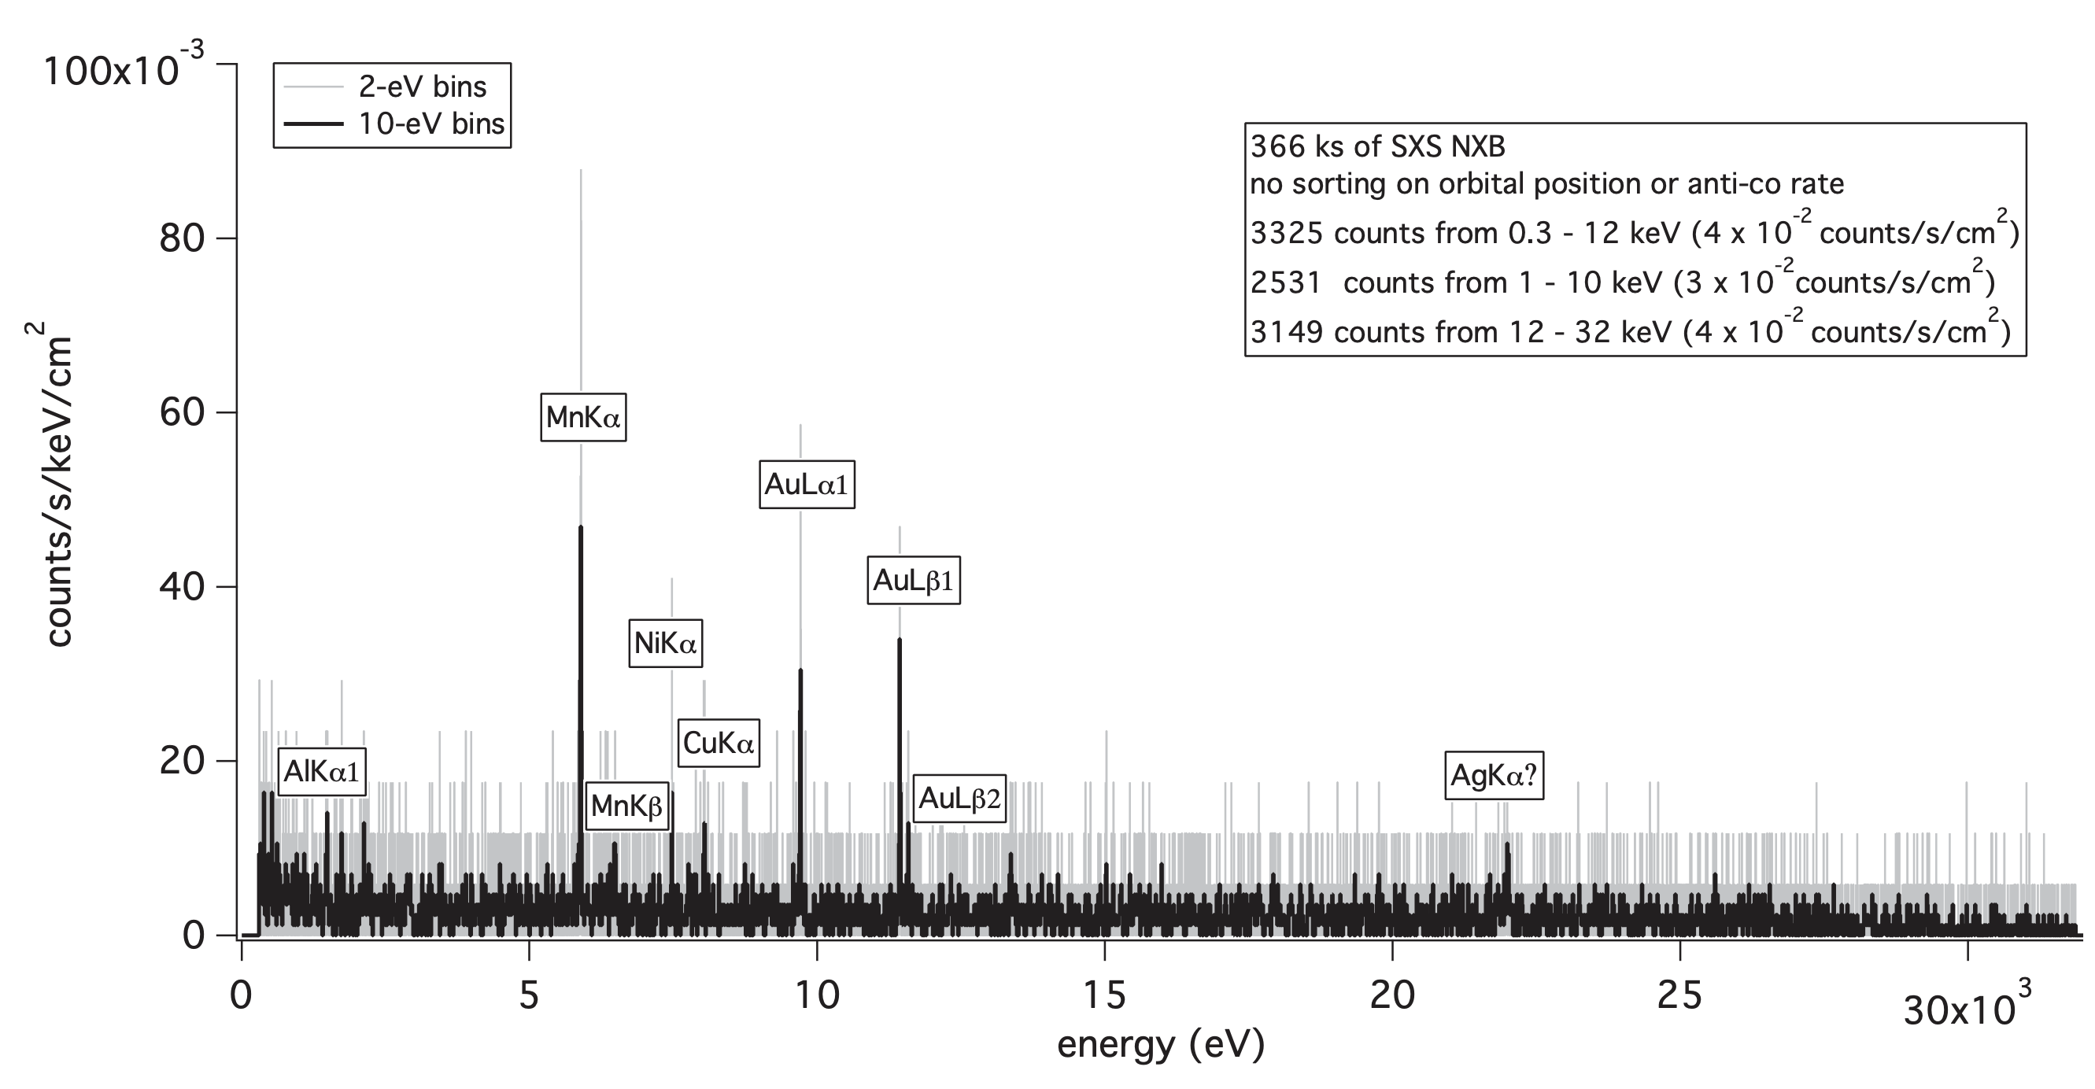
Resolve non-xray background
Measured background from Hitomi/SXS. Early indications are that XRISM/Resolve is very similar
Kilbourne, et al., PASJ, 2018

Slide 22
Summary
XRISM/Resolve instrument consists of thermal detectors, and you have to keep that in mind when working with the instrument.
Each pixel is an independent spectrometer
Requires extensive ground calibration and in-flight verification
Inflight calibration/verification is currently on-going

