Slide 1

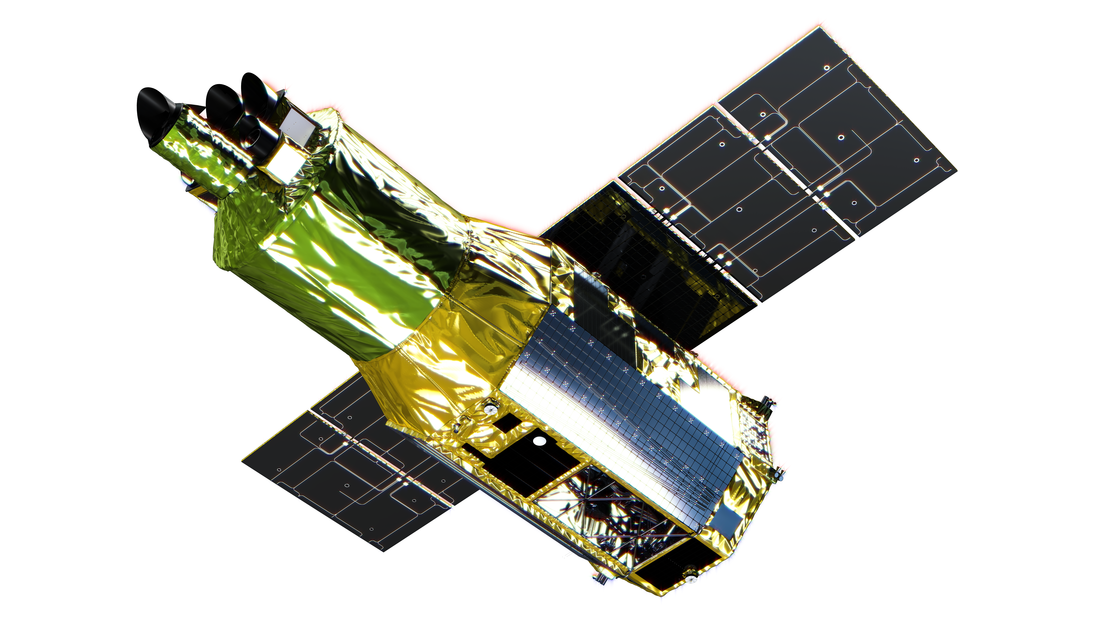
Overview of Tools & Resources
Koji Mukai
NASA Goddard Space Flight Center
and University of Maryland, Baltimore County
NASA XRISM Guest Observer Facility

Slide 2
XRISM and HEASARC
HEASARC (High Energy Astrophysics Science Archive Research Center) is the main archive of high energy (X-ray and gamma-ray) astrophysics missions for NASA and beyond.
All XRISM observational data will be archived at HEASARC and will be made public after the exclusive-use period is over.
The xrismmastr catalog (to be made available via Browse and Xamin interfaces) will contain searchable information on accepted, planned, performed and/or archived XRISM observations.
As with other GOFs located at GSFC, XRISM GOF shares resources with HEASARC and relies on infrastructures provided by HEASARC.
XRISM data are provided as FITS files that follow the HEASARC (“OGIP”) standards.
XRISM-specific processing and analysis software will be released as part of HEAsoft.
The community is of course free to use other archives and software developed elsewhere – but our support is focused on HEASARC/GOF tools.

Slide 3

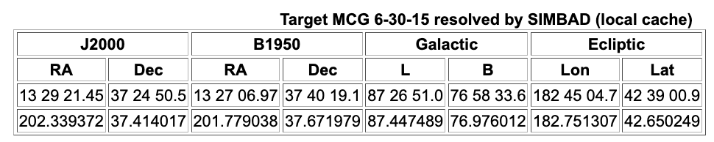
Proposal-related tools and services at HEASARC
Many useful tools and resources can be found via the “HEASARC Quick Links” pull-down menu on all HEASARC pages.
For developing the science case: Archive of past X-ray observations, with ADS links. Also the mission-related Bibliography lists compiled by HEASARC, including for Hitomi.
For searching for suitable target for the science: X-ray catalogs (including Chandra Source Catalog, XMM-Newton Serendipitous Source Catalog, and Swift XRT Point Source Catalog).
Observing window (for time-critical observations), Viewing, and a tool to investigate what roll angles are possible, and when (https://heasarc.gsfc.nasa.gov/cgi-bin/Tools/viewing/xrism_roll.pl).
Coordinate look-up/conversion tool and nH (returns total Galactic column in that direction)

Slide 4
Feasibility of XRISM/Resolve observations: 3 regimes
We can distinguish potential XRISM/Resolve targets into 3 regimes.
Moderately-bright, point-like sources – no instrument-specific complications, beyond the need to accumulate sufficient counts to be able to achieve the scientific objectives. Count rate estimates (WebPIMMS) and spectral simulations (e.g., using WebSpec) will be sufficient.
Extended sources – even estimating the total count rate can on the Resolve array can be tricky, depending on the source extent and spatial structures. Moreover, given the large pixel size and small FOV compared to the XMA PSF, Spatial-Spectral Mixing (SSM) may need to be considered.
Bright sources – for bright sources, not all events can be detected & characterized at the highest resolution of Resolve. In particular, there is a possibility that low-resolution events (with estimated resolution of ~18eV) may not be useful for your science case. Proposals must account for the (H+Mp) branching ratio in performing scale the spectral simulations.

Slide 5
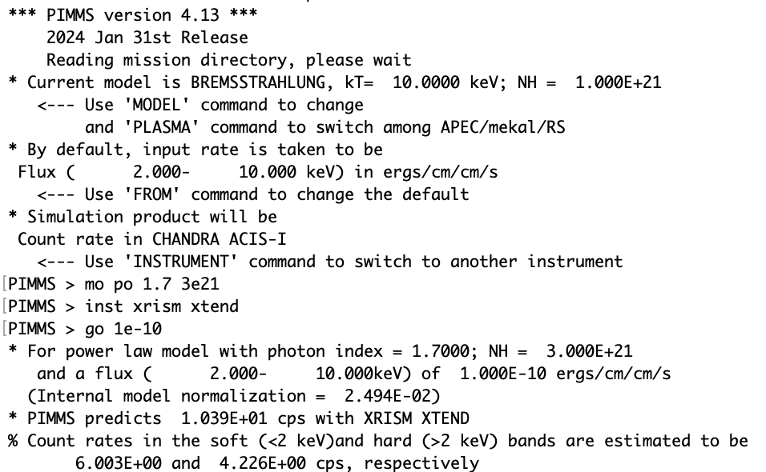
PIMMS/WebPIMMS
The XRISM updates will be included in the near-future release of PIMMS/WebPIMMS.
Estimated count rate may be useful as a first step before performing more sophisticated simulation, by giving you a hint at what kind of exposure time may be needed.
However, PIMMS uses response files appropriate for a point source observed on-axis.

Slide 6
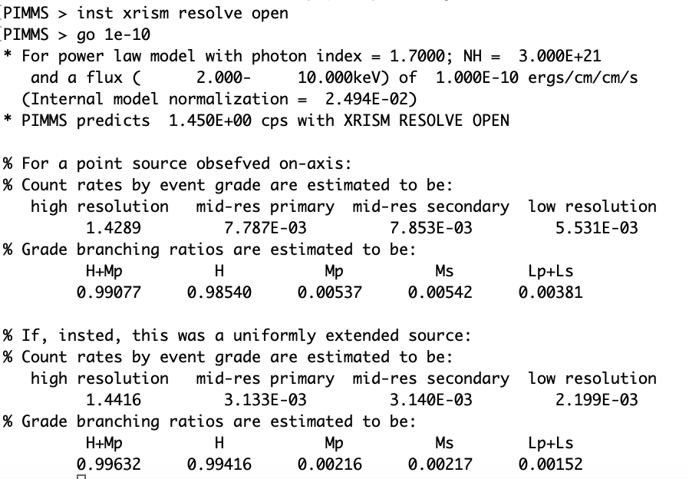
PIMMS/WebPIMMS (cont’d)
With the Gate Valve closed, the grade branching ratio is not a concern even at a flux leel of 1e-10 cgs (2-10 keV). Nevertheless, there are bright sources (mostly X-ray binaries) where this still is a concern.

Slide 7
Feasibility of XRISM/Resolve observations: Next Steps
For all proposals – spectral simulation. Use the simulation-grade response files that will be provided (see the next talk) and your favorite X-ray spectral fitting package. One option is to use WebSpec, a HEASARC tool.
Extended sources – event-by-event simulation using tools such as heasim (part of HEAsoft), or external packages such as SimX and SIXTE (see presentations on each on Friday). These packages all have their own strengths, so proposers should pick one that suites them (due to scientific requirement and/or familiarity).

Slide 8
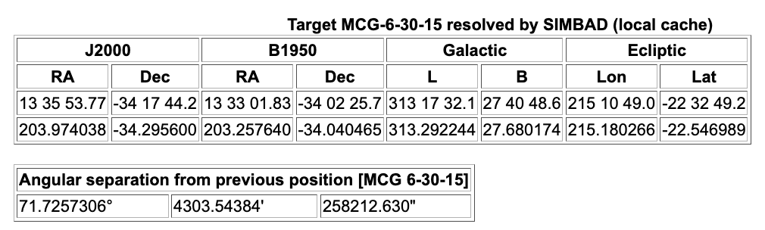
Final remarks
HEASARC provides many multi-mission tools, to which we have added XRISM support as needed (Viewing, WebPIMMS etc.). Let us know if additional tools are needed.
However, tools may not always do what you want it to do – do not turn your brain off!

