Slide 1
What XRISM response files are provided for the Cycle 1 GO proposers?
The files available for spectral simulations
The XRISM Community Workshop, Jan 17th, 2024
Mihoko Yukita (GSFC/JHU)

Slide 2

What Are Response Files?
Flux
E
S(E) = Source photon flux

Slide 3
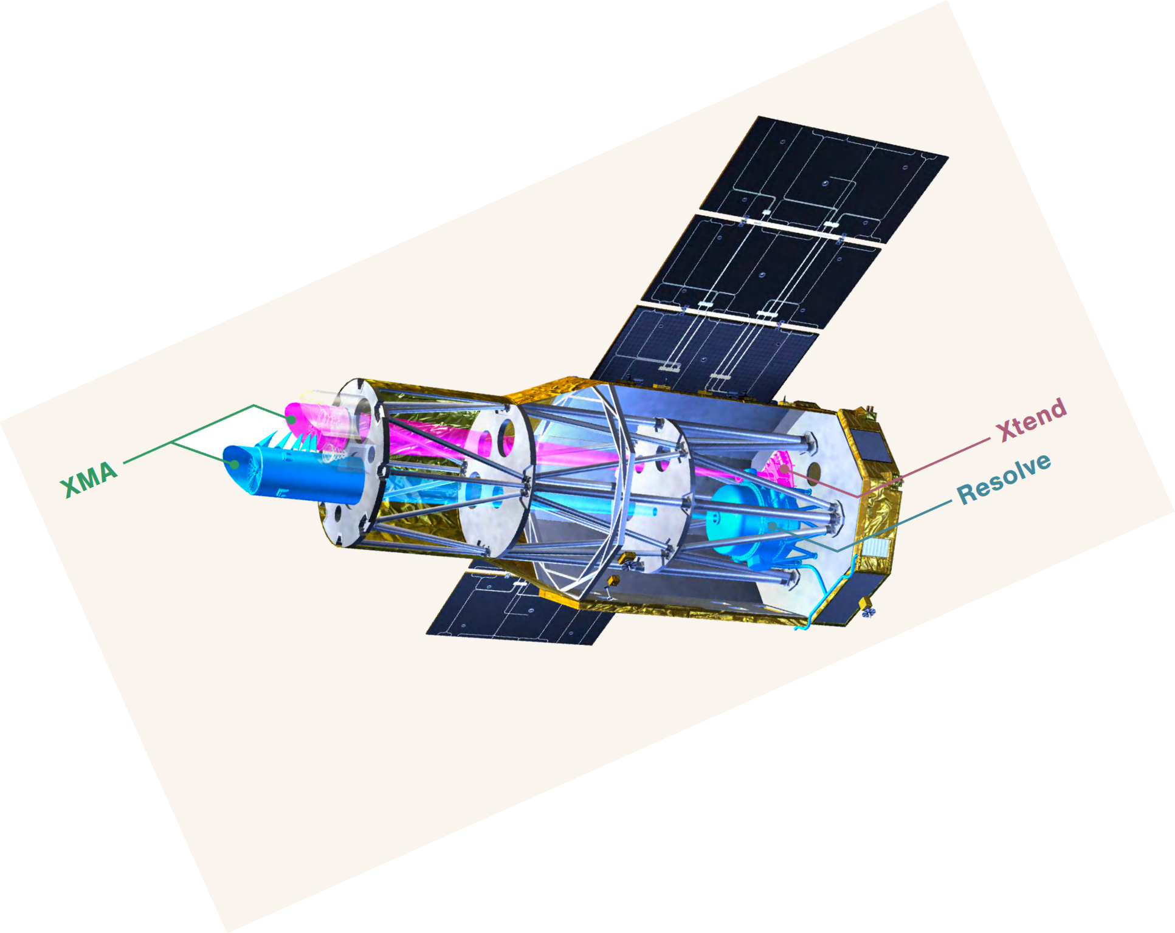
What Are Response Files?
Flux
cm²
E
E
E
A(E) = Effective area
R(E, h) = Detector redistribution from energy E to channel h

Slide 4

What Are Response Files?
HEASARC
Flux
cm²
CTS/S
E
E
E
Channel
C(h) = Counts in detector channel h

Slide 5
What Are Response Files?
HEASARC
Flux
cm²
CTS/S
E
E
E
Channel
Ancillary response file: A(E) = Effective area
Redistribution matrix file: R(E) = Detector redistribution from energy E to channel h

Slide 6
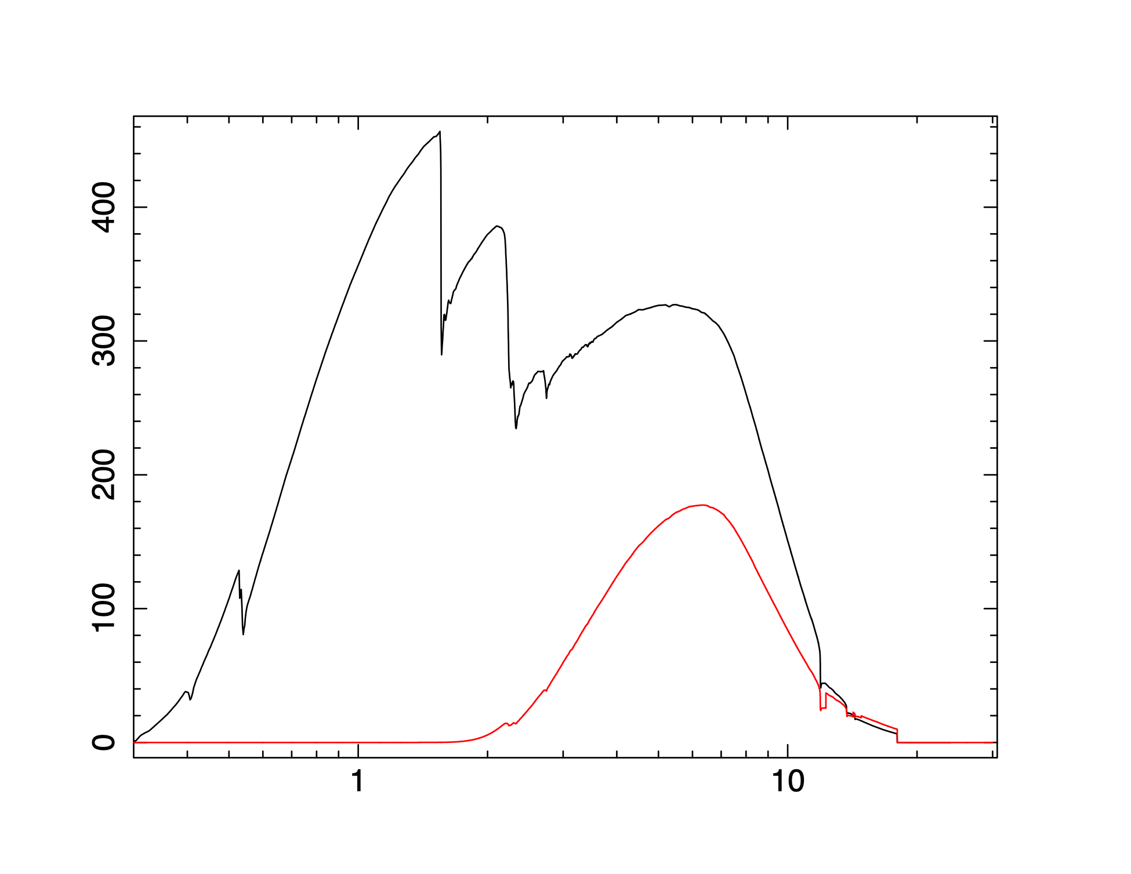
The ancillary response file (ARF)
The ARF contains the effective area as a function of energy. The ARF includes the geometric collecting area of the instrument multiplied by the energy-dependent efficiencies of:
mirrors
filters
detector
XRISM effective area curves (point source)
Xtend
Effective Area (cm²)
Resolve GVC
Energy (keV)

Slide 7
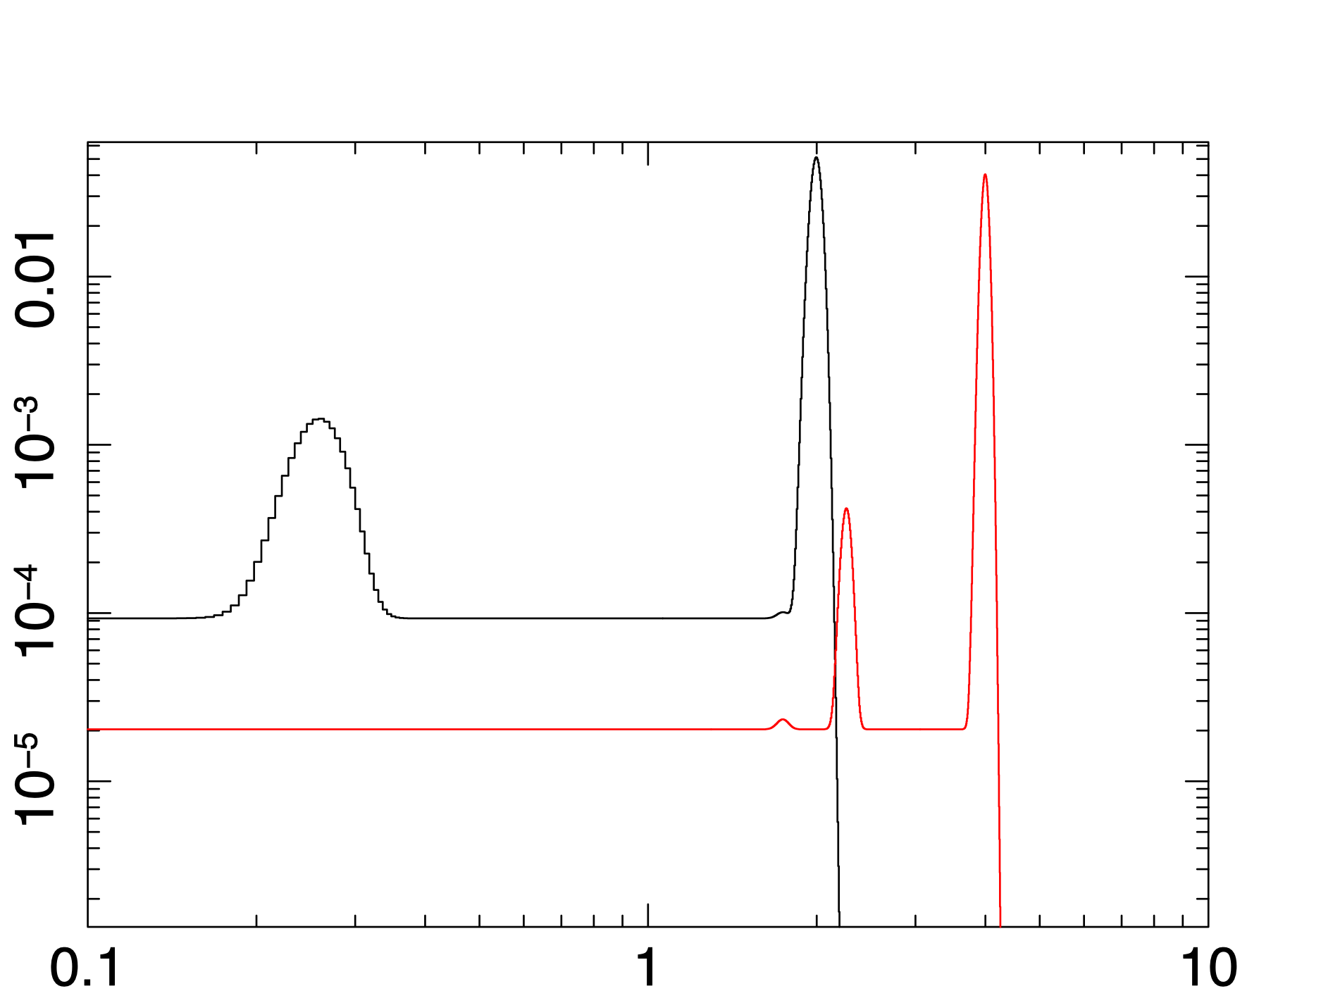

The redistribution matrix file (RMF)
The width of the peak
gives the resolution
Xtend RMF
The RMF maps the relationship between the incident photon energy and the event’s pulse height. The RMF provides the probability that a photon of a given energy is registered in a given channel.
Counts/bin
2 keV
4 keV
Energy (keV)

Slide 8
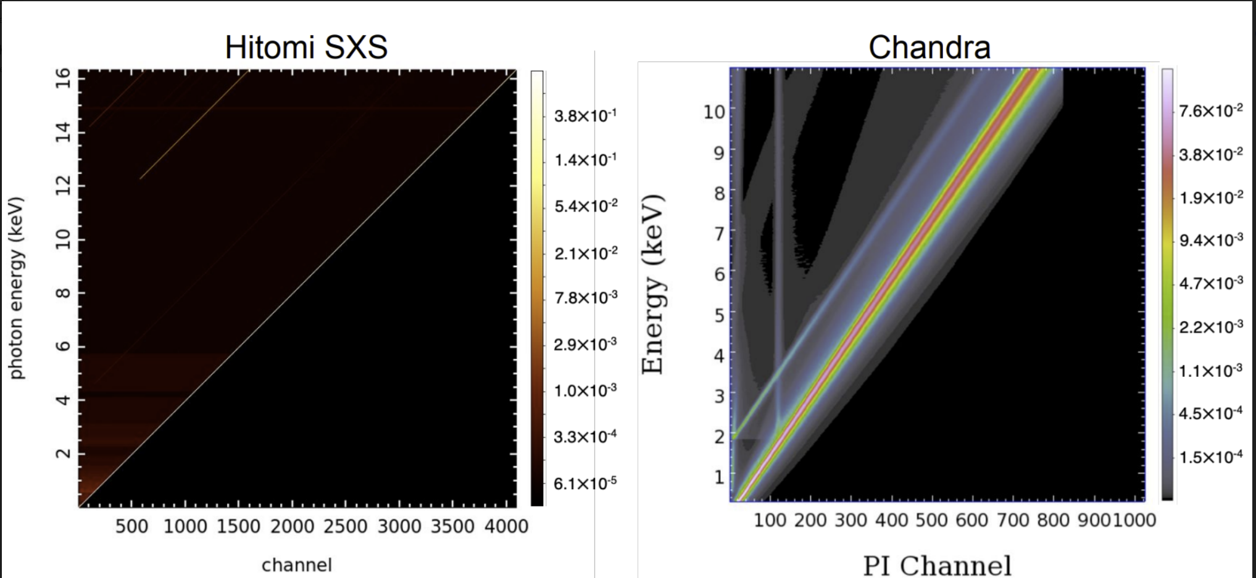
The redistribution matrix file (RMF)
Photopeak
Photopeak
Credits: Ogorzalek

Slide 9

What Response Files are Provided for Cycle1?
For both point and extended sources:
Resolve Responses
  3 RMFs
  6 ARFs
Xtend Responses
  1 RMF
  2 ARFs
XRISM Cycle 1 ARFs and RMFs will be available by early Feb
These files will be used for Webspec and Webpimms at the HEASARC web.
https://heasarc.gsfc.nasa.gov/docs/xrism/proposals/xrism_tools.html

Slide 10
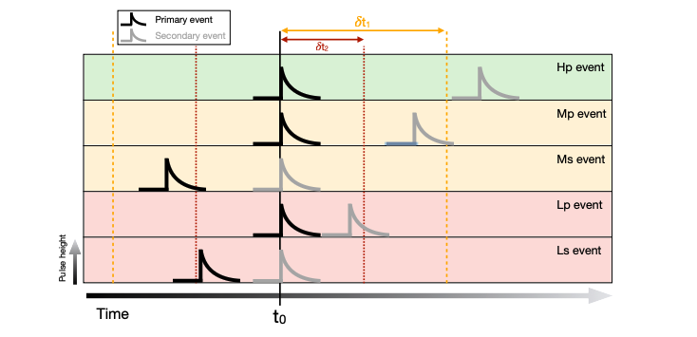
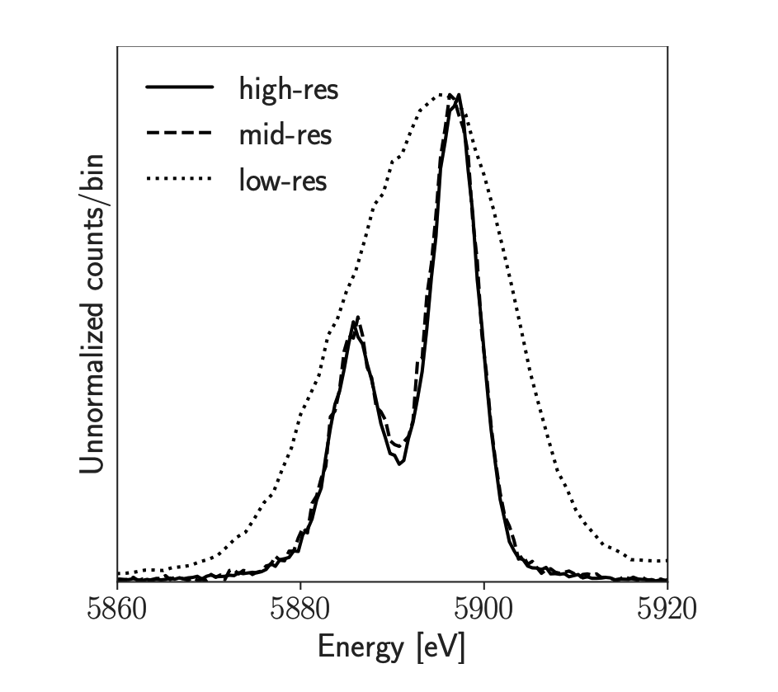
Resolve RMFs
Three event grade cases:
Pulse Height
100% of high-resolution events (Hp): rsl_Hp_5eV.rmf - FWHM of 5 eV
100% of mid-resolution events (Mp): rsl_Mp_6eV.rmf - FWHM of 6 eV
100% of low-resolution events (Lp): rsl_Lp_18eV.rmf - FWHM of 18 eV
The proportion of events in the various event grades depends on the source count rate. At low rates, most events will achieve calorimeter resolution. For faint or moderately bright sources, rsl_Hp_5eV.rmf may be safely used for simulations.

Slide 11
Resolve RMFs
Three event grade cases:
Pulse Height
100% of high-resolution events (Hp): rsl_Hp_5eV.rmf - FWHM of 5 eV
100% of mid-resolution events (Mp): rsl_Mp_6eV.rmf - FWHM of 6 eV
100% of low-resolution events (Lp): rsl_Lp_18eV.rmf - FWHM of 18 eV
But resolution is degraded for bright sources as mid-res and low-res events contribute more.
See Edmund’s talk.

Slide 12
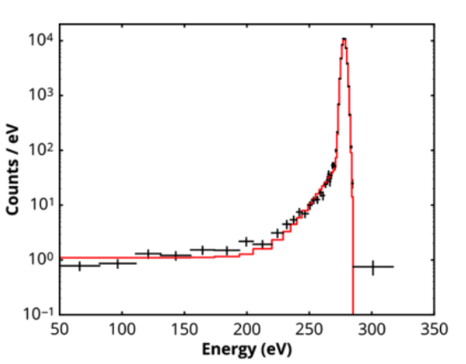
Resolve RMFs
Three event grade cases:
Pulse Height
100% of high-resolution events (Hp): rsl_Hp_5eV.rmf - FWHM of 5 eV
100% of mid-resolution events (Mp): rsl_Mp_6eV.rmf - FWHM of 6 eV
100% of low-resolution events (Lp): rsl_Lp_18eV.rmf - FWHM of 18 eV
HITOMI SXS
Electron loss
continuum
NOTE:
The electron loss continuum is not included.
All 35 pixels have the same FWHM. See Francois’s talk for creating your own RMFs.
Eckart et al. 2018

Slide 13
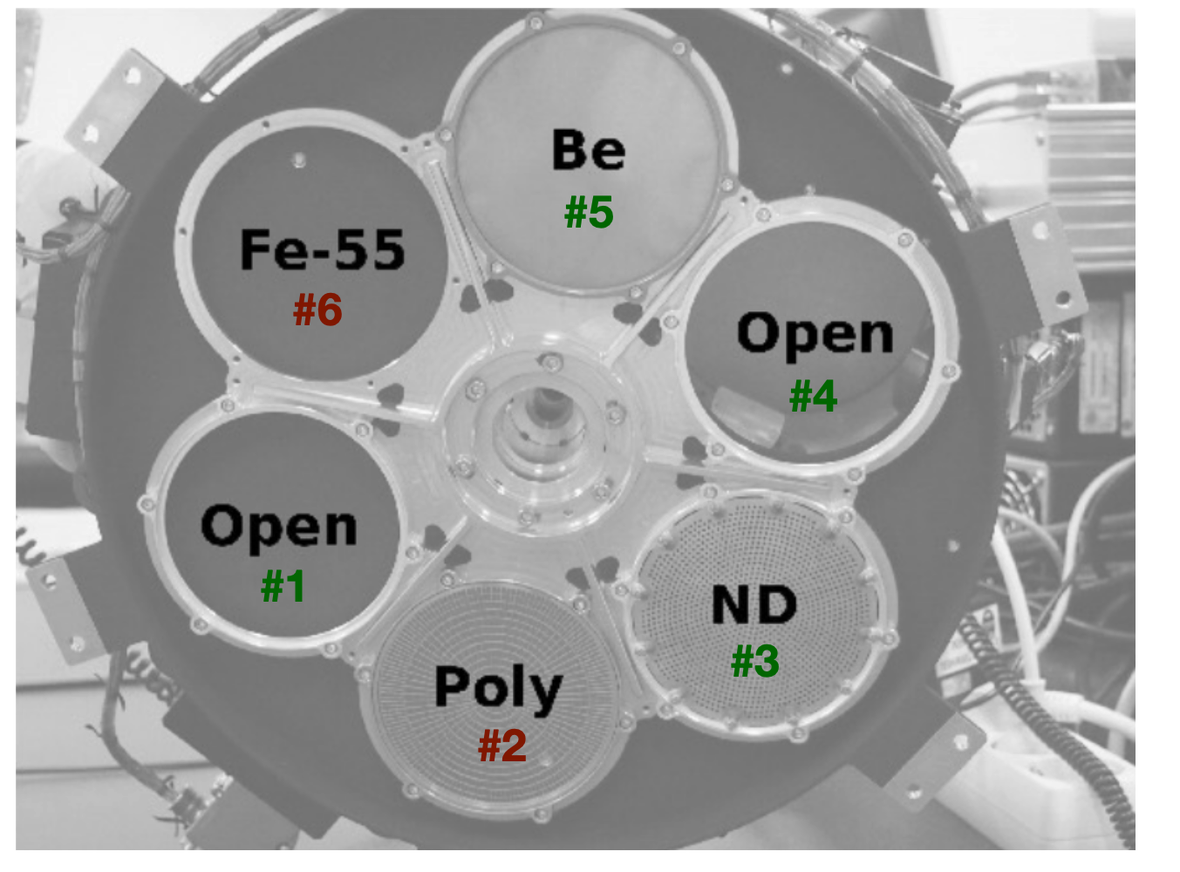
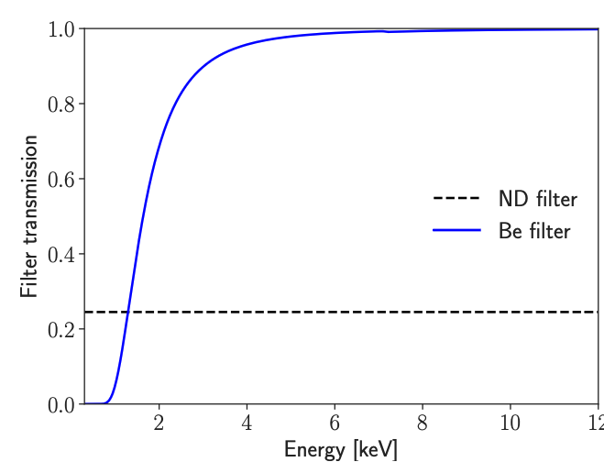
Resolve ARFs - Gate Valve Closed
Two Source Types - 4 point and 2 extended cases
A point source at the Resolve aimpoint (but 15arcsec away from the optical axis) with the filter wheel open: rsl_standard_GVclosed.arf
A point source at the Resolve aimpoint with the Be filter: rsl_pointsource_fwBe_GVclosed.arf
A point source at the Resolve aimpoint with the ND filter: rsl_pointsource_fwND_GVclosed.arf
A point source at a ~1’ away from the aimpoint with the filter wheel open: rsl_pointsource_off_GVclosed.arf

Slide 14
Resolve ARFs - Gate Valve Closed
Two Source Types - 4 point and 2 extended cases
A point source at the Resolve aimpoint (but 15arcsec away from the optical axis) with the filter wheel open: rsl_standard_GVclosed.arf
A point source at the Resolve aimpoint with the Be filter: rsl_pointsource_fwBe_GVclosed.arf
A point source at the Resolve aimpoint with the ND filter: rsl_pointsource_fwND_GVclosed.arf
A point source at a ~1’ away from the aimpoint with the filter wheel open: rsl_pointsource_off_GVclosed.arf
For bright sources:

Slide 15
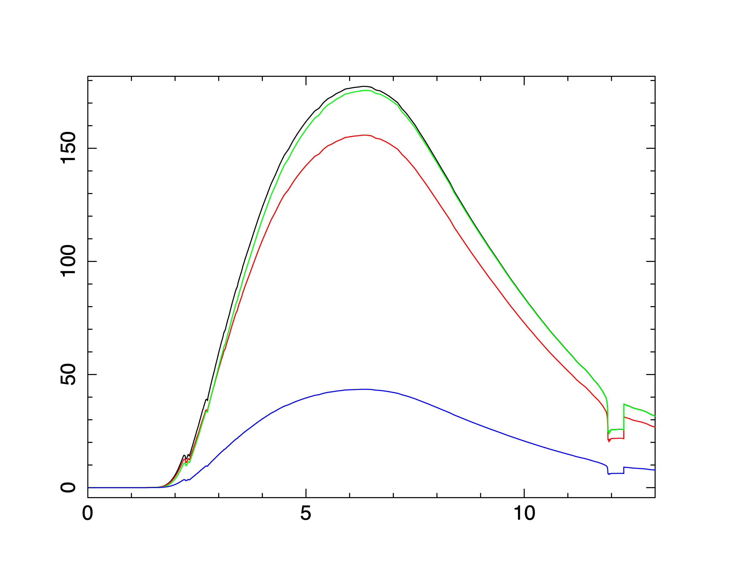
Resolve ARFs - Gate Valve Closed
Two Source Types - 4 point and 2 extended cases
Standard
1’ offset
Be Filter
Effective Area (cm²)
ND Filter
Energy (keV)

Slide 16


Resolve ARFs - Gate Valve Closed
Two Source Types - 4 point and 2 extended cases
A 5’ radius source with flat distribution: rsl_extflat_GVclosed.arf
A 5.7’ radius source using a beta-model (rc = 1.26’ and β = 0.53). rsl_extbeta_GVclosed.arf
 | The fraction of simulated photons on Resolve FoV
Point source | 0.910
Flat circle | 0.232
Beta model | 0.467
NOTE: At the aimpoint with the filter wheel open
See Francois’s talks and demos for creating your own arfs.

Slide 17
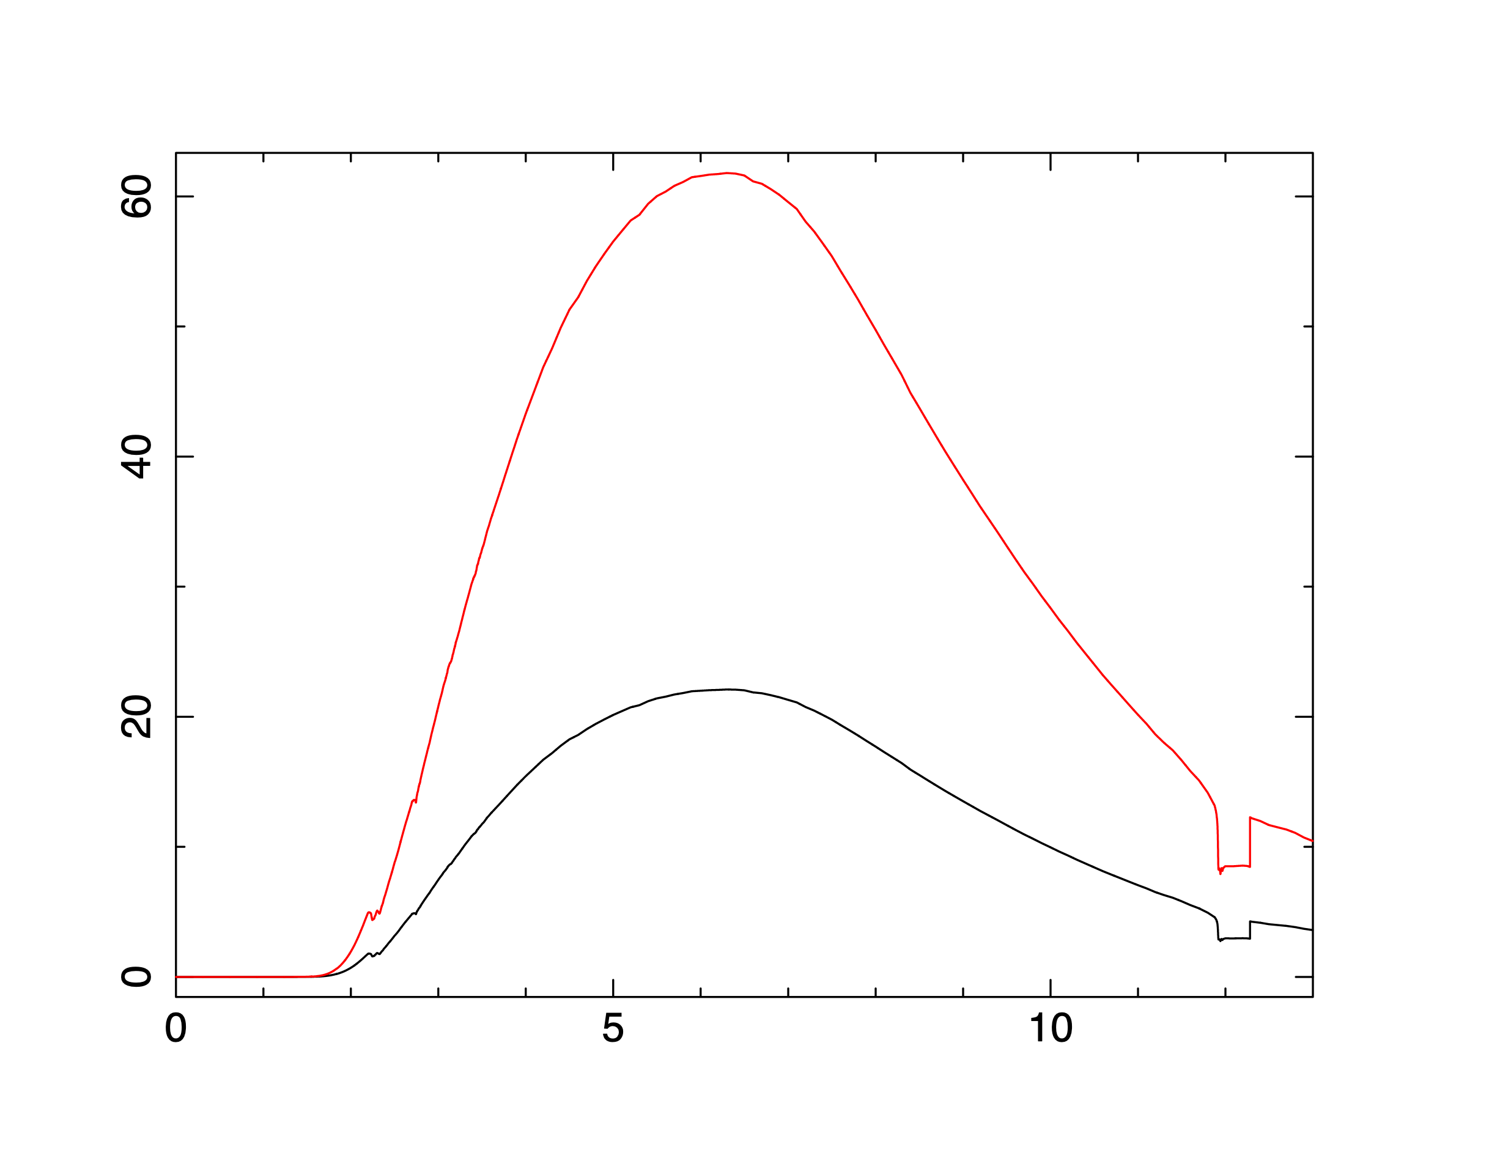
Resolve ARFs - Gate Valve Closed
Two Source Types - 4 point and 2 extended cases
At the aimpoint with the wheel filter open
Beta
Effective Area (cm²)
Flat
Energy (keV)

Slide 18
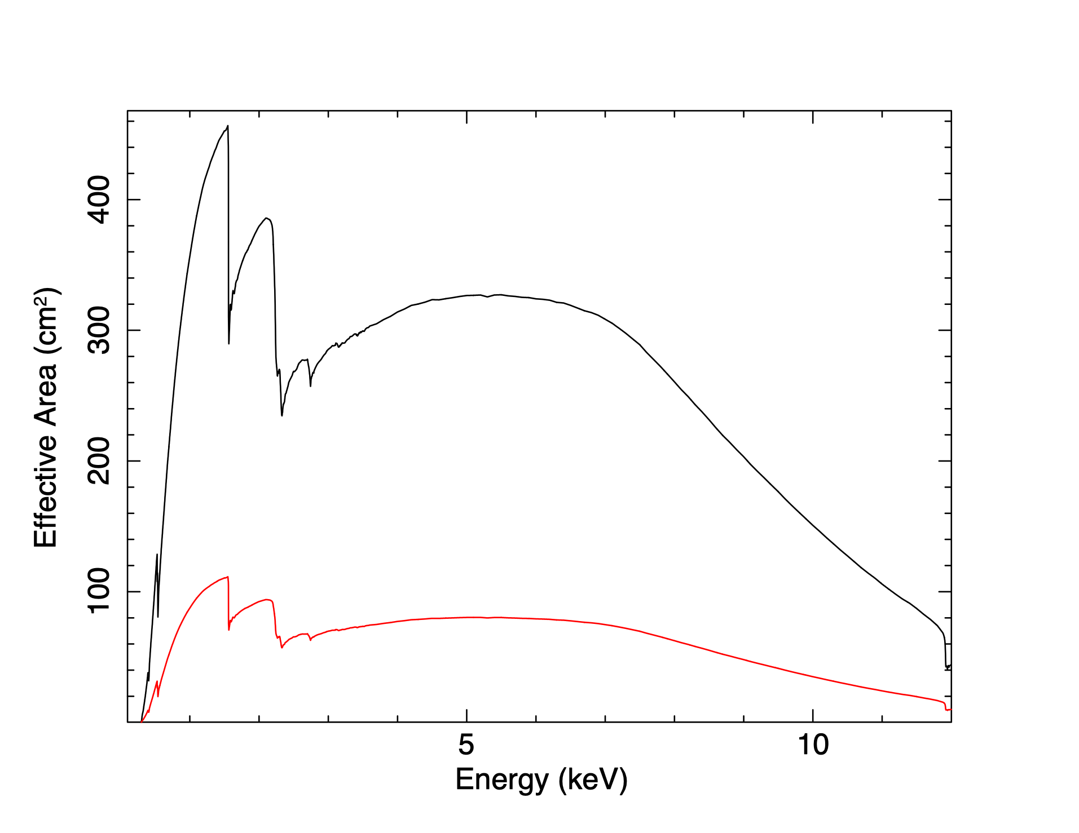
Xtend ARFs and RMF
For both point and extended sources:
Xtend RMF - xtd_standard.rmf
2 Xtend ARFs
  A point source located at the aimpoint - xtd_standard.arf
  Flat circular distribution with a 5’ radius centered at the aimpoint - xtd_extflat.arf
Xtend ARFs
Point source
This Xtend extended ARF does not reproduce the spatial / spectral complexity of any known extended source.
5’ radius source

Slide 19
These XRISM response files are:
available at the HEASARC XRISM web page: https://heasarc.gsfc.nasa.gov/docs/xrism/proposals/xrism_tools.html
adequate for spectral simulations for the Cycle 1 proposal preparations
(not for the data analysis)
Caveats:
Some adjustments may be needed for the sources with spatial and spectral complexity.
HEASIM may need extra files (e.x. PSFs and vignetting), which will be eventually available but not by Feb 2024. HEASIM may need to use the HITOMI setup/files.
Resolve ARFs with GVO shall be available, if the gate valve is open and the NRA is revised.

Slide 21
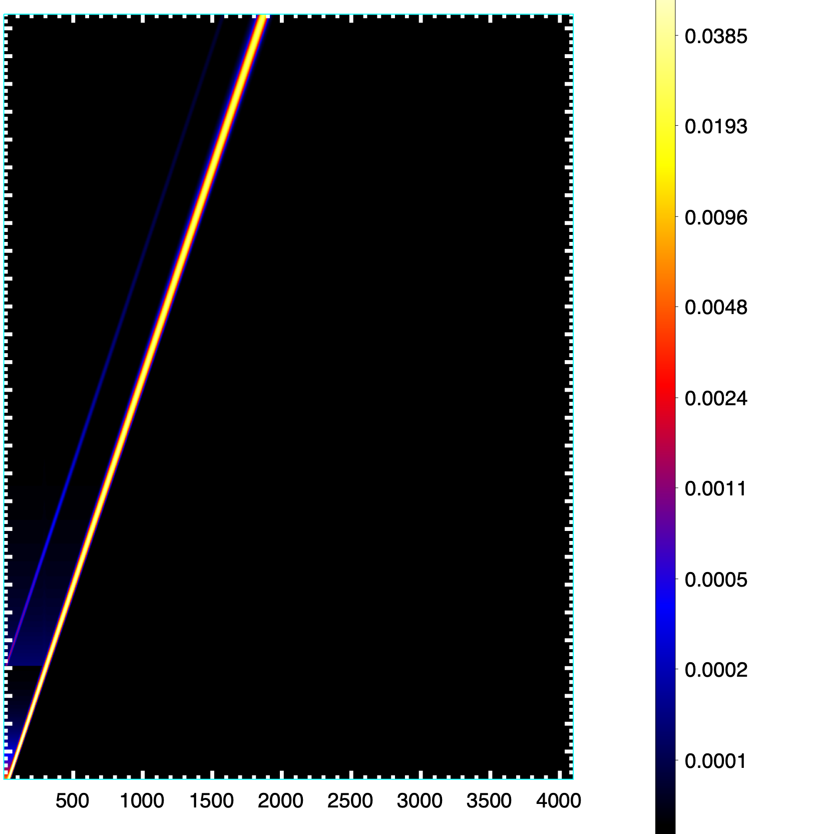
Xtend RMF
11
Xtend RMF
Photopeak
9
Photopeak
7
Photon energy (keV)
Counts/bin
2 keV
5
4 keV
3
Energy (keV)
1
Channel

