Slide 1
Is Abell 3667 an offset merger?
20 minutes(15-18 minutes talk+ 2-5 minutes question)
Yuki Omiya (Nagoya-U)
K. Nakazawa (Nagoya-U), T. Tamura (JAXA/ISAS), H. Akamatsu (QUP),
K. Matsushita (TUS), N. Okabe (Hiroshima-U), K. Sato (Saitama-U),
Y. Fujita (TMU), L. Gu, A. Simionescu (SRON), Y. Ichinohe (RIKEN),
D. Ito, K. Sakai (Nagoya-U)
The 2nd XRISM Community Workshop @ University of Maryland, 1/17-21

Slide 2
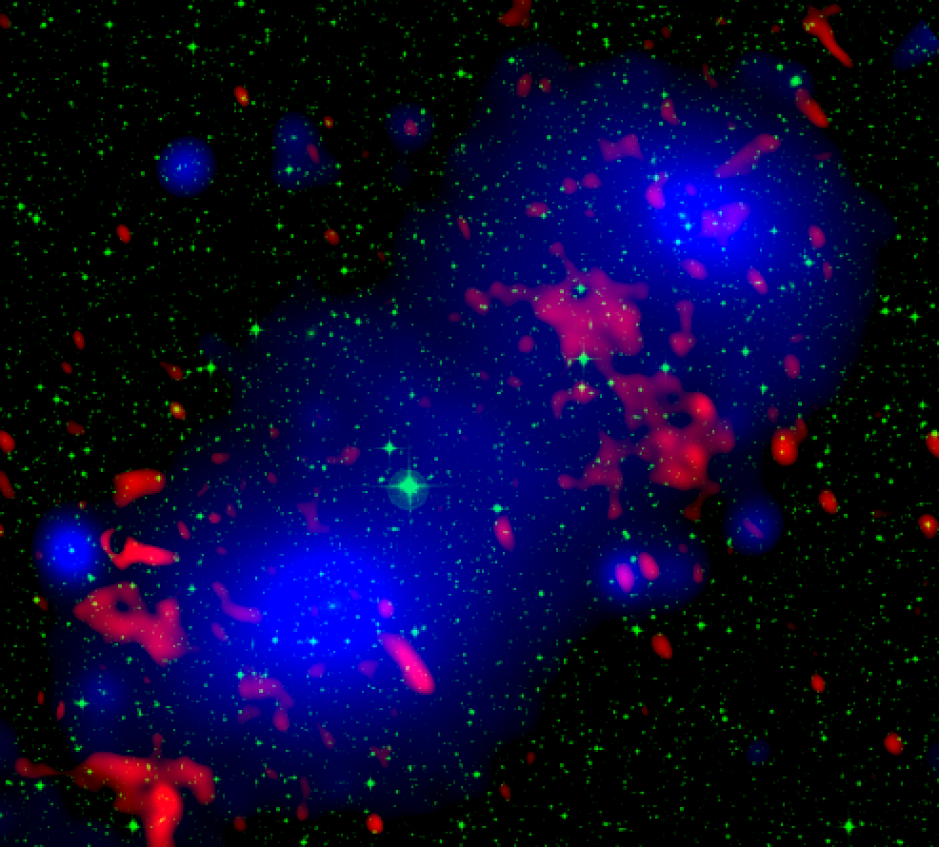
Cluster merger
1/9
Largest energy release event in the Universe (up to 10⁶⁴ erg).
Collision with a velocity of 2000-4000 km s⁻¹.
Kinetic energy of the shock is converted to thermal and non-thermal energy.
CIZA J1358.9-4750 (early phase)
Relic
Shocks
Gas heating
Collision
Particle acceleration
Shocks
magnetic amplification
Turbulence excitation
2nd
X-ray(Omiya et al. 2023)
Radio(Kurahara et al. 2023)
Optical (SDSS)
How efficient are the energy conversions?
ICM velocity measurements are essential.
Merging picture-->bulk velocity measurement
Secondarily energy conversion-->turbulent velocity measurement
The key is XRISM

Slide 3
Cluster merger
1/9
Largest energy release event in the Universe (up to 10⁶⁴ erg).
Collision with a velocity of 2000-4000 km s⁻¹.
Kinetic energy of the shock is converted to thermal and non-thermal energy.
CIZA J1358.9-4750 (early phase)
Relic
Shocks
Gas heating
Collision
Particle acceleration
10⁻⁵
Shocks
magnetic amplification
2.2×10⁴² erg s⁻¹
(Assuming face-to-face merger on the skyplane)
Turbulence excitation
2nd
X-ray(Omiya et al. 2023)
Radio(Kurahara et al. 2023)
Optical (SDSS)
How efficient are the energy conversions?
ICM velocity measurements are essential.
Merging picture-->bulk velocity measurement
Secondarily energy conversion-->turbulent velocity measurement
The key is XRISM

Slide 4
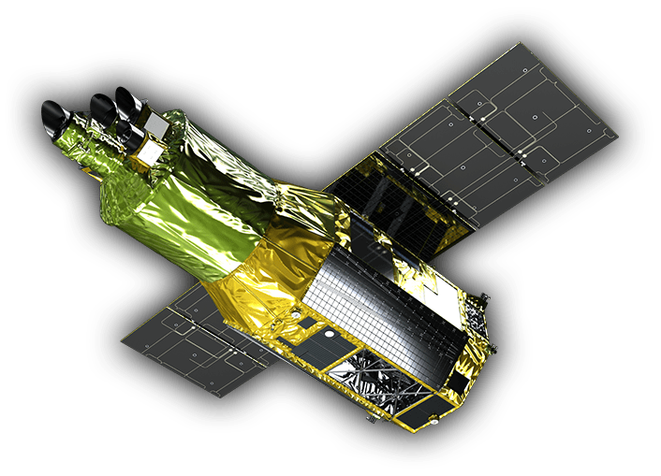
Cluster merger
1/9
Largest energy release event in the Universe (up to 10⁶⁴ erg).
Collision with a velocity of 2000-4000 km s⁻¹.
Kinetic energy of the shock is converted to thermal and non-thermal energy.
CIZA J1358.9-4750 (early phase)
But, the FoV of XRISM is relatively small.
Relic
Relic
Shocks
Gas heating
Collision
Particle acceleration
10⁻⁵
XRISM FoV
Shocks
magnetic amplification
2.2×10⁴² erg s⁻¹
(Assuming face-to-face merger on the skyplane)
Turbulence excitation
2nd
X-ray(Omiya et al. 2023)
Radio(Kurahara et al. 2023)
Optical (SDSS)
How efficient are the energy conversions?
ICM velocity measurements are essential.
Merging picture-->bulk velocity measurement
Secondarily energy conversion-->turbulent velocity measurement
The key is XRISM

Slide 5
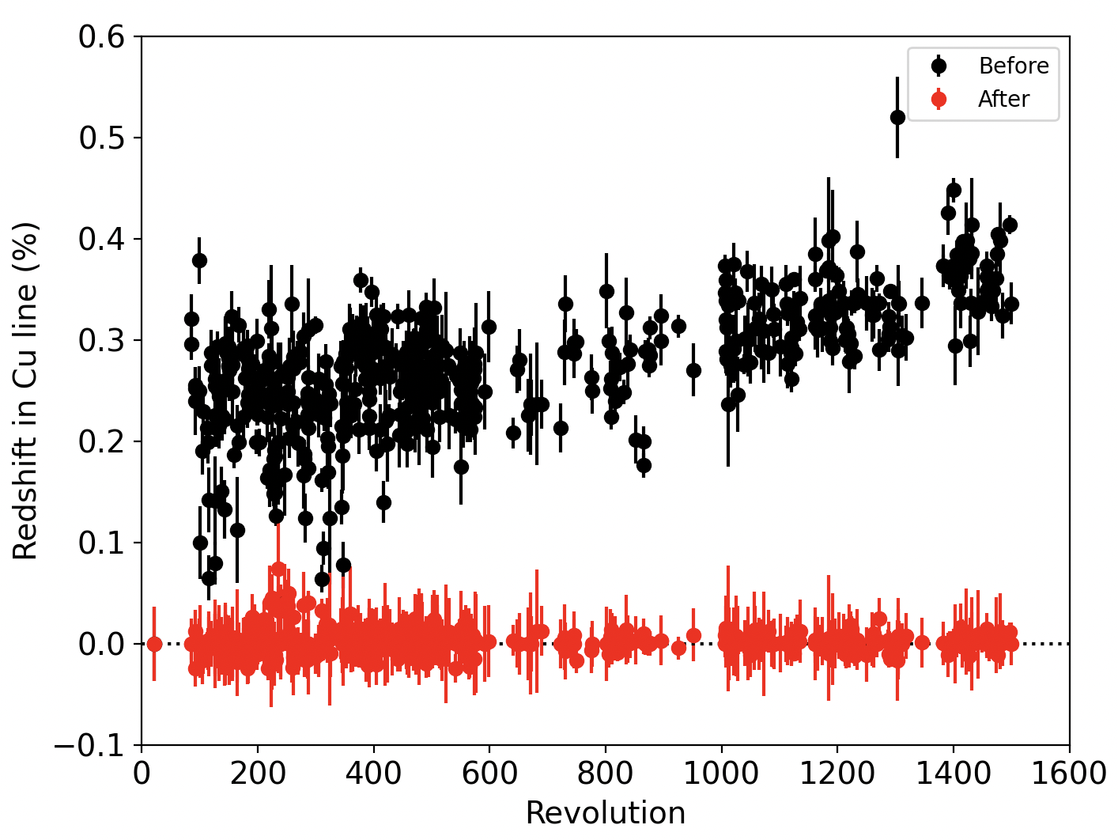
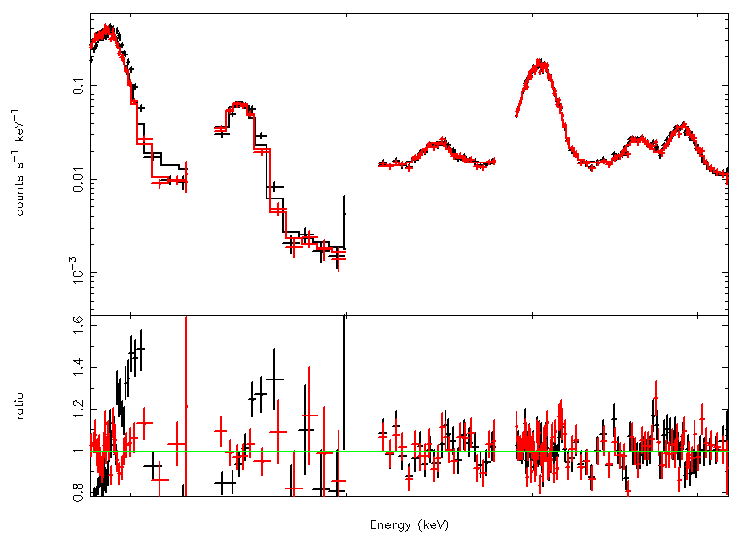

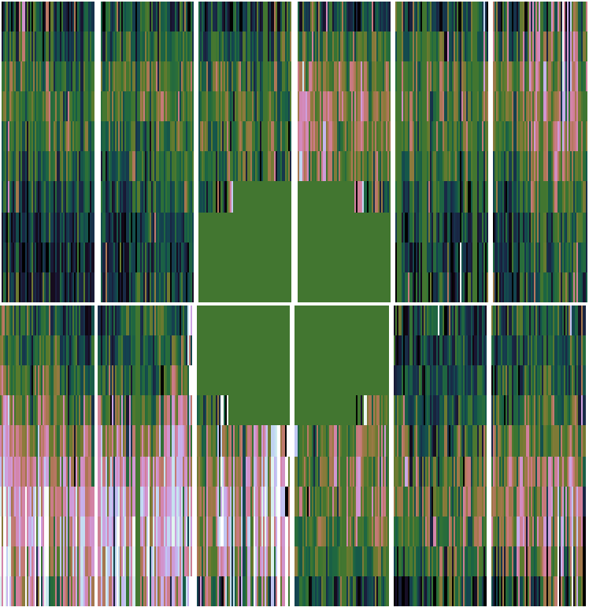

XMM recalibration method
2/9
Sanders+20 proposed a Nobel calibration technique using XMM PN data.
Improved accuracy of bulk velocity measurement 1000 km s⁻¹🡪 150 km s⁻¹
We performed a similar calibration and reproduced the Coma results of SD20.
Step1. Time dependance
Step2. Detector dependance
Step3.Scale correction
0.6
Before
All these data are EFF mode
Before
After
Mn-Kα
Cu-Kα
0.5
After
10⁻¹
Mn-Kβ
Cu-Kβ
0.4
Ni-Kα
Zn-Kα
Counts s⁻¹ keV⁻¹
10⁻²
0.3
Before
0.2
10⁻³
After
Redshift in Cu-Kα line(%)
0.1%=8eV
=300 km s⁻¹
All these data are EFF mode
0.1
1.6
Ratio
0.0
1
2000
02
04
06
08
-0.4
-0.2
0.0
0.2
0.4
0.6
0.8
0.8
year
Redshift in Cu-Kα line(%)
5.7
Energy (keV)
9.2
Can the combination of XMM-Newton and XRISM be adapted to the merging cluster?
Bulk ICM motion is measured with XMM.--> Clarify the collisional picture.
Characteristic regions are observed with XRISM. 🡪High-accuracy measurements of bulk and turbulent velocity.

Slide 6
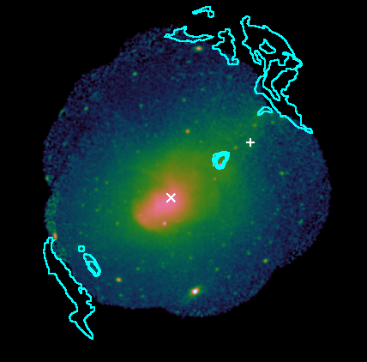
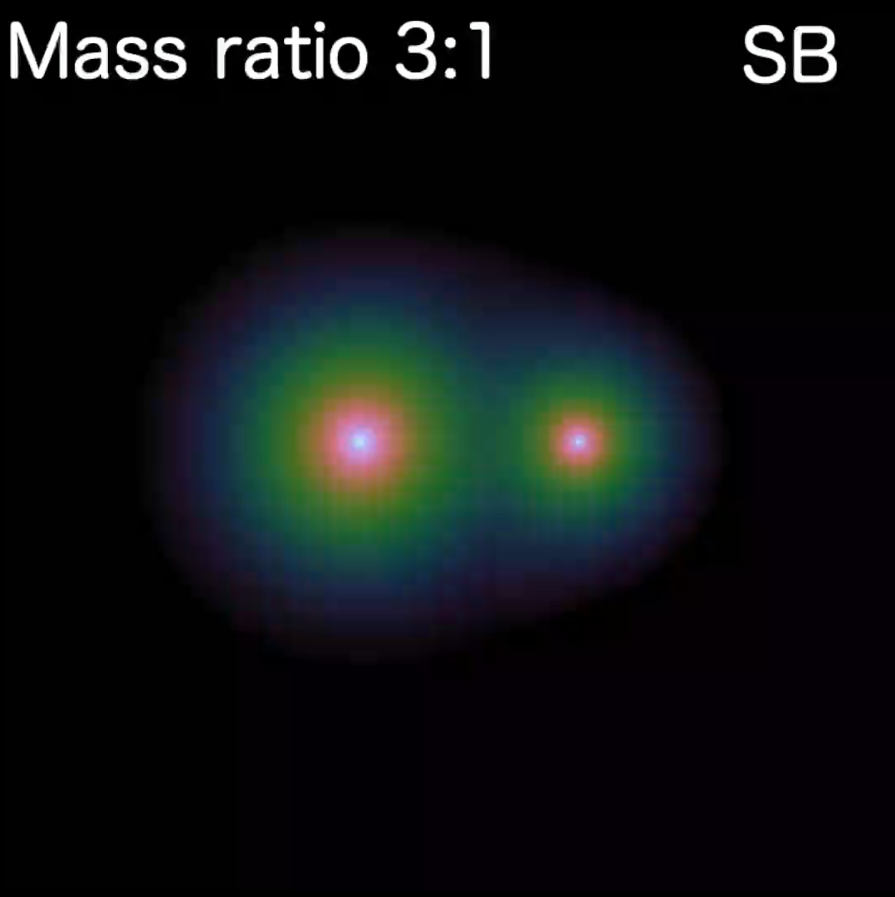
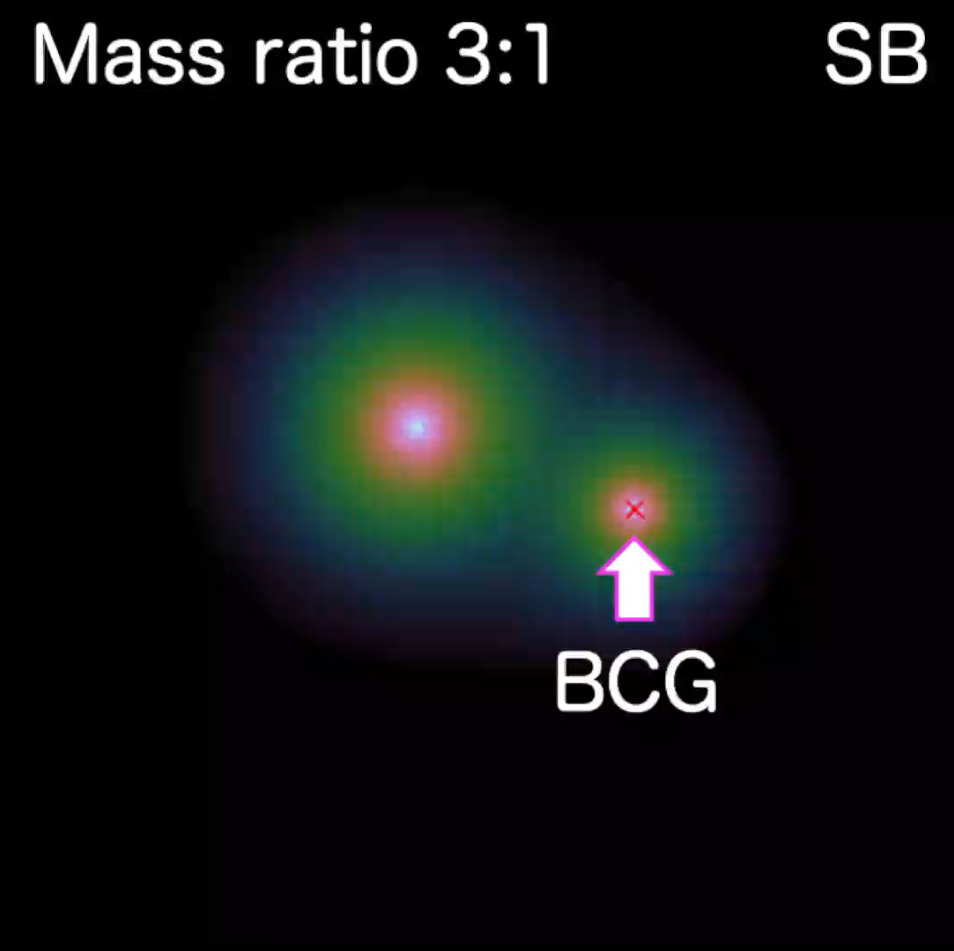
Abell 3667
3/9
Features
A pair of radio relics on cluster outskirts.
Prominent Cold Front (CF) in cluster center.
Radio halo extending to CF (de Gasperin+22).
Relic
Due to the symmetry of these structures,
it has been considered that Abell 3667 is
a major face-to-face merger on the sky plane.
Sarazin+16 proposed another scenario,
an offset merger.
2nd BCG
CF
1st BCG
Relic
Color: XMM (0.5-7.0 keV)
Contour: MeerKAT (1.28 GHz)
face-to-face merge case
offset merge case
Galaxy Cluster Merger Catalog http://gcmc.hub.yt

Slide 7
Abell 3667
3/9
Features
A pair of radio relics on cluster outskirts.
Prominent Cold Front (CF) in cluster center.
Radio halo extending to CF (de Gasperin+22).
Relic
Due to the symmetry of these structures,
it has been considered that Abell 3667 is
a major face-to-face merger on the sky plane.
Sarazin+16 proposed another scenario,
an offset merger.
mushroom
Halo
2nd BCG
CF
1st BCG
Relic
Color: XMM (0.5-7.0 keV)
Contour: MeerKAT (1.28 GHz)
face-to-face merge case
offset merge case

Slide 8
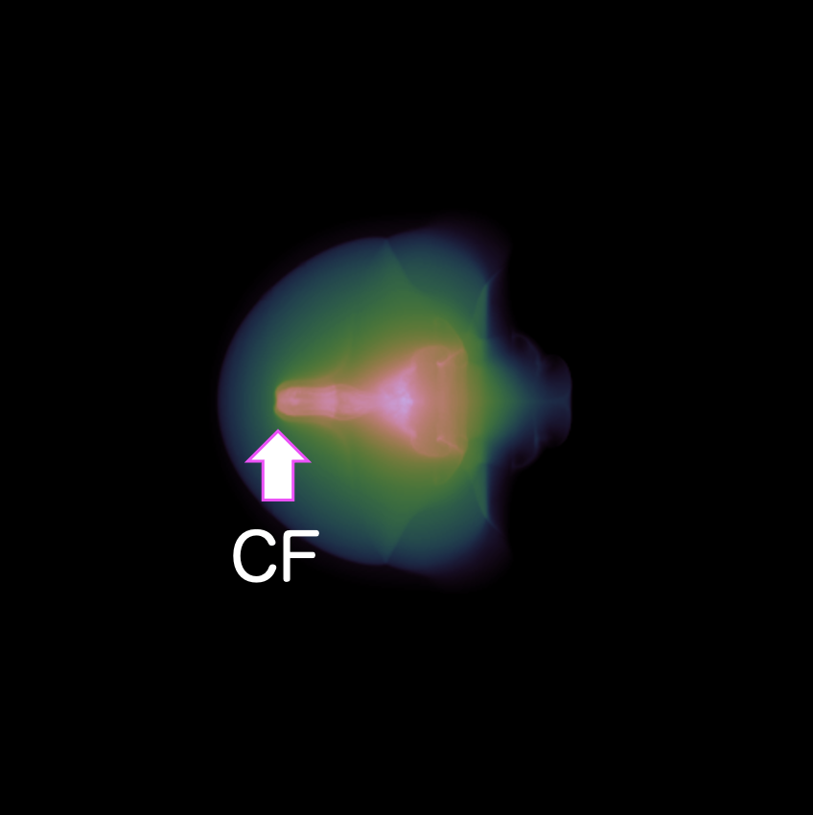
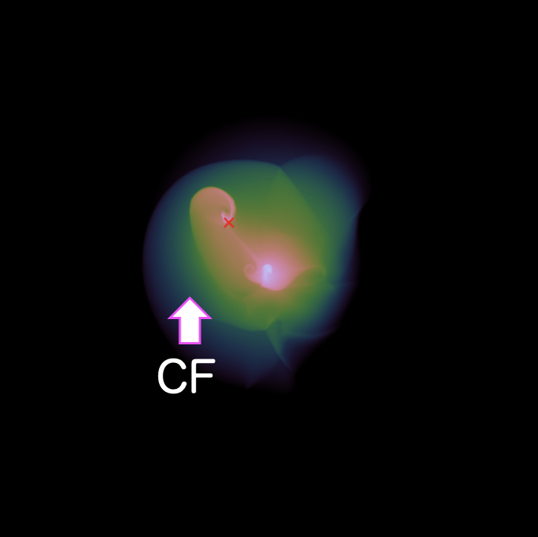
Abell 3667
3/9
Features
A pair of radio relics in cluster outskirts.
Prominent Cold Front (CF) in cluster center.
Radio halo extending to CF (de Gasperin+22).
We ①revisit the ICM distribution and ②measure the bulk ICM velocity.
In the face-to-face merger case,
① Symmetric with respect to the merge axis.
② Flat. (Consistent with the optical redshift of the BCG.)
In the offset merger case,
① Asymmetric.
② The ICM flow and its velocity gradient are observed.
Relic
Due to the symmetry of these structures,
it has been considered that Abell 3667 is
a major face-to-face merger on the sky plane.
Sarazin+16 proposed the other scenario,
an offset merger.
2nd BCG
CF
1st BCG
Relic
sky plane
sky plane
Color: XMM (0.5-7.0 keV)
Contour: MeerKAT (1.28 GHz)
face-to-face merge case
offset merge case

Slide 9
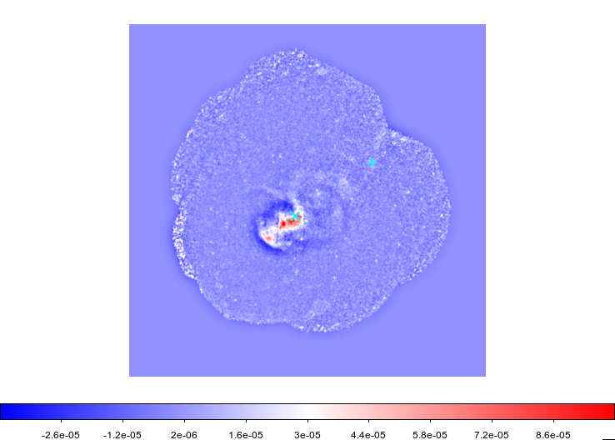

Revisiting the ICM distribution -Image analysis-
4/9
An unsharp masked image was created by subtracting the smoothed pseudo-model image from the X-ray image.
pseudo-model image
smoothed with σ=1’
Unsharp masked image
Relic
Filamentary
excess
(Vikhlinin+01)
RG1 vortex
2nd BCG
Radio Galaxy (RG)
CF
CF
1st BCG
CCW vortex?
Relic
BCG-E tail
CF-W tail
merge axis?
Color: XMM (0.5-7.0 keV)
Contour: MeerKAT (1.28 GHz)

Slide 10
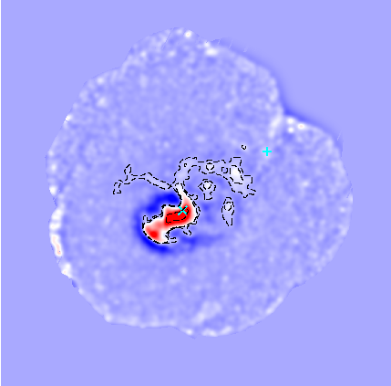
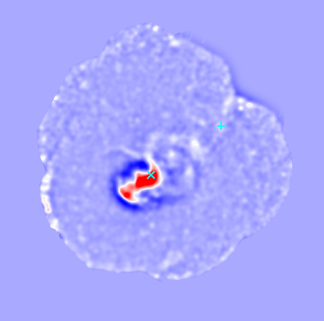
Revisiting the ICM distribution -Image analysis-
4/9
An unsharp masked image was created by subtracting the smoothed pseudo-model image from the X-ray image.
pseudo-model image
smoothed with σ=1’
Unsharp masked image
Relic
Filamentary
excess
(Vikhlinin+01)
RG1 vortex
2nd BCG
Radio Galaxy (RG)
CF
CF
1st BCG
CCW vortex?
Relic
BCG-E tail
CF-W tail
merge axis?
Color: XMM (0.5-7.0 keV)
Contour: MeerKAT (1.28 GHz)

Slide 11
Revisiting the ICM distribution -Image analysis-
4/9
An unsharp masked image was created by subtracting the smoothed pseudo-model image from the X-ray image.
Unsharp masked image
Features mentioned for the first time
CF-W tail
Tail-like enhancement extending to the west at CF boundary.
BCG-E tail
An enhancement extending from the BCG to the CF.
RG1 vortex
A clockwise vortex-like enhancement with a radius of about 250 kpc.
Filamentary
excess
(Vikhlinin+01)
RG1 vortex
Radio galaxy(RG1)
CF
CCW vortex?
BCG-E tail
CF-W tail
RG1 vortex, CF-W tail, and Filamentary excess are asymmetric with respect to the merge axis.
merge axis?
contour level: 5e-5, 5e-6, 5e-7

Slide 12
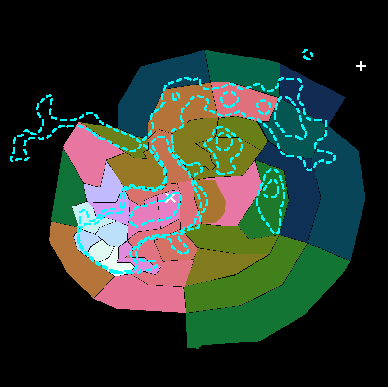
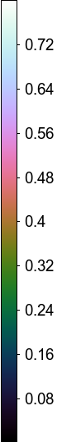
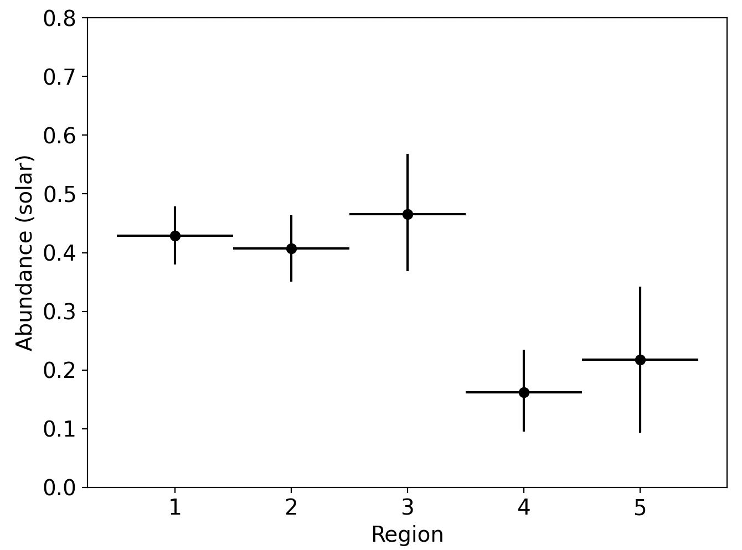
Revisiting the ICM distribution -Spectral analysis-
5/9
To check the ICM condition, we performed the spectral analysis in the cluster center.
The RG1 vortex has high abundances comparable to the central region.
Toward the outside of it, we can see a sharp drop from 0.5 solar to 0.2 solar.
🡪Remnant of cluster core ICM?
Λ
RG1 vortex
4
5
2nd BCG
2
3
1
RG1 vortex
Outside
Abundance (solar)
CF
1st BCG
1σ c.l.

Slide 13
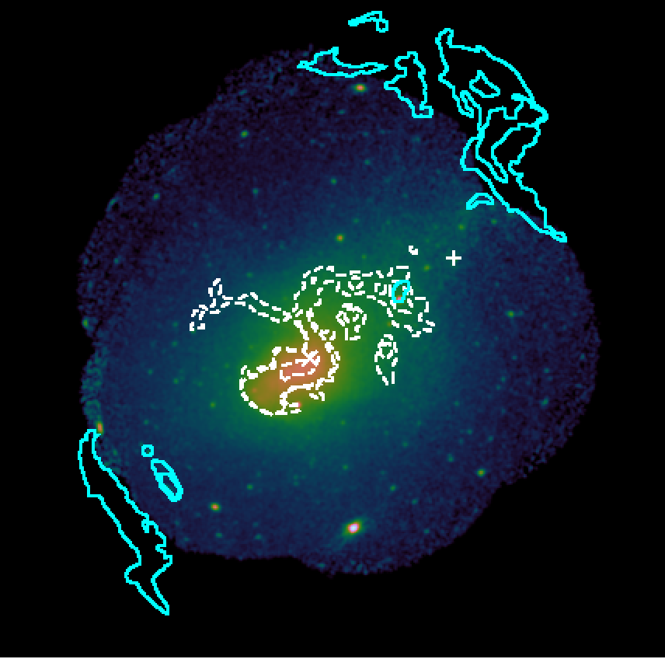
What is the RG1 vortex?
6/9
In the face-to-face merger case,
Karman vortex?
KH roll would move away from the shear layer, eventually, forming a Karman vortex.
This can happen if the moving structure is cylindrical-like shaped, but too large if the core is spherical.
Relic
2nd BCG
In the offset merger case,
It is natural that the ICM is stripped away by each other having an angular momentum in the core crossing, and producing vortex structures.
🡪Reinforce “Offset merger scenario”.
CF
1st BCG
Relic
KH roll (Ichinohe+17)
Color: XMM (0.5-7.0 keV)
Contour: MeerKAT (1.28 GHz)

Slide 14
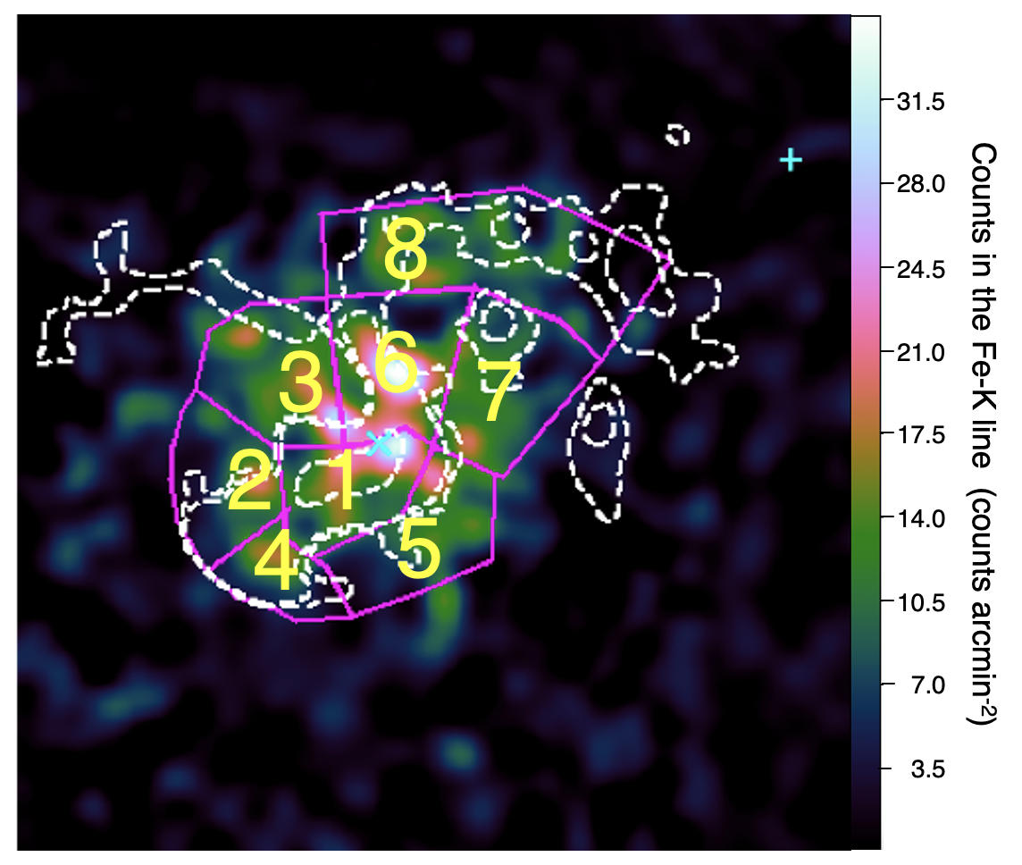
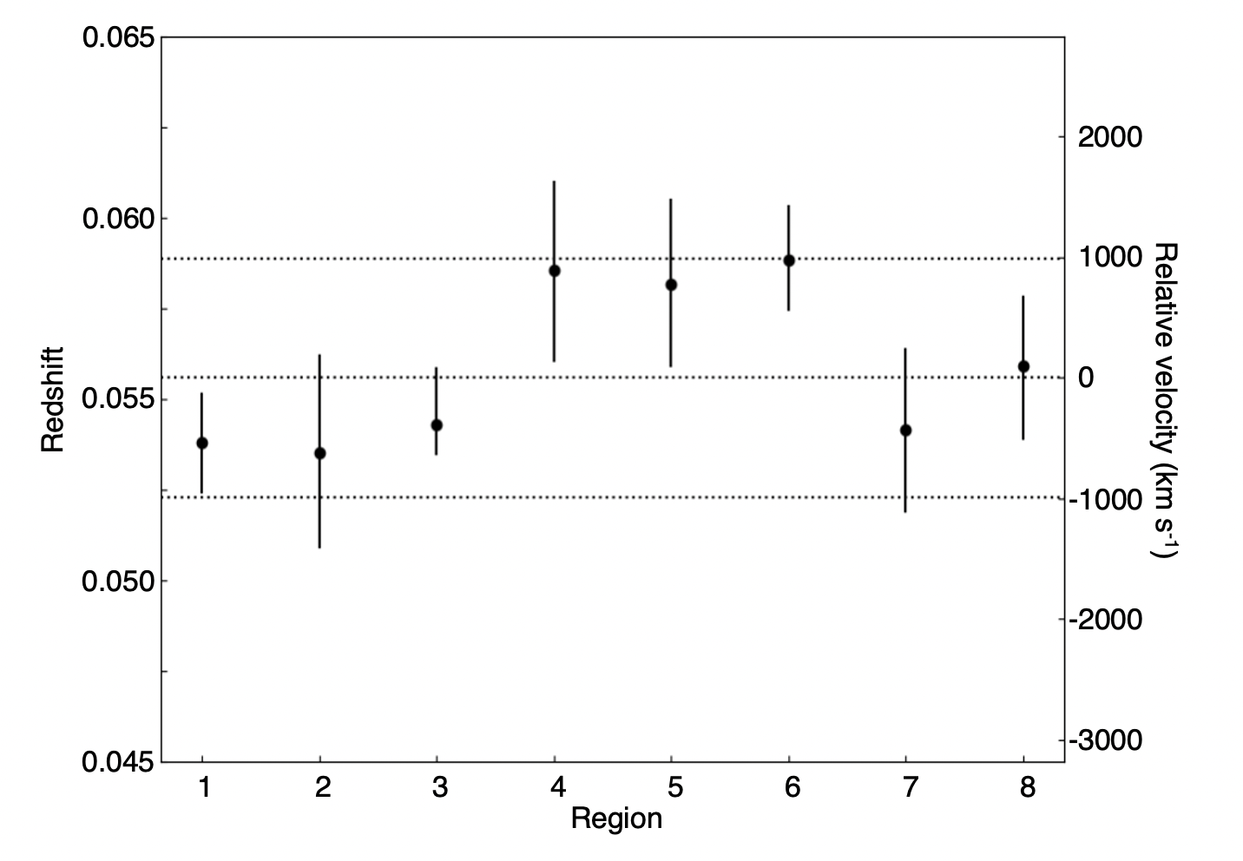
Measurement the ICM bulk velocity
7/9
Fe counts map
Bulk velocities were measured by adapting the recalibration method to the XMM PN data.
We divided into 8 regions so that the number of Fe counts is 50–200.
Fe counts map
The redshift of Reg1-5 (between the BCG and the CF) is consistent with optical that of the BCG within the 1.3-sigma error range.
Reg6, where the part near the BCG of the RG1 vortex, is red-shifted with 980±440 km s⁻¹ and differs from that of the 1st BCG at 2.3σ.
The ICM flow and its velocity gradient are observed.
🡪 Reinforce Offset merger scenario.
1σ c.l.
1000 km s⁻¹
Optical redshift of BCG
-1000 km s⁻¹

Slide 15
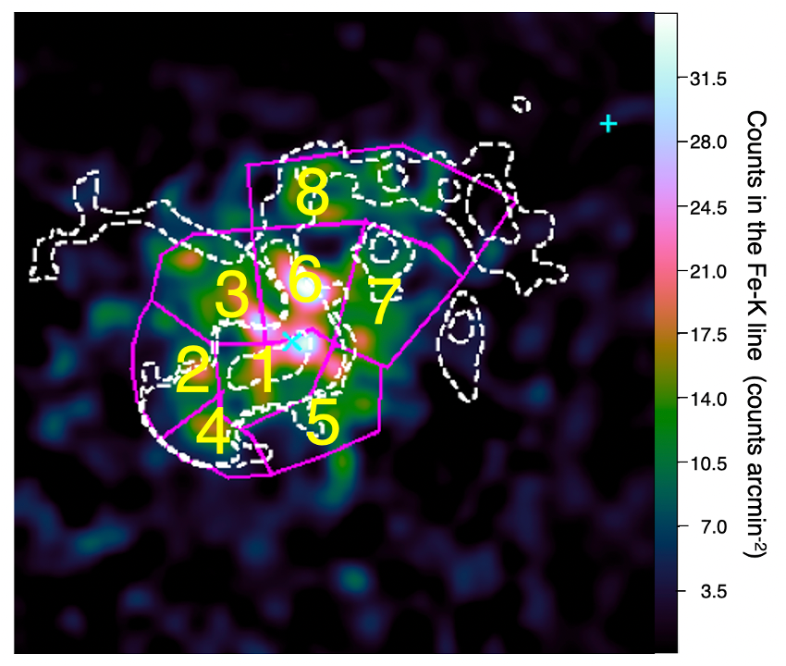
Measurement the ICM bulk velocity
7/9
Fe counts map
Bulk velocities were measured by adapting the recalibration method to the XMM PN data.
We divided into 8 regions so that the number of Fe counts is 50–200.
The redshift of Reg1-5 (between the BCG and the CF) is consistent with optical that of the BCG within the 1.3-sigma error range.
Reg6, where the part near the BCG of the RG1 vortex, is red-shifted with 980±440 km s⁻¹ and differs from that of the 1st BCG at 2.3σ.
The ICM flow and its velocity gradient are observed.
Reinforce “Offset merger scenario”.
1σ c.l.
1000 km s⁻¹
Optical redshift of BCG
-1000 km s⁻¹

Slide 16
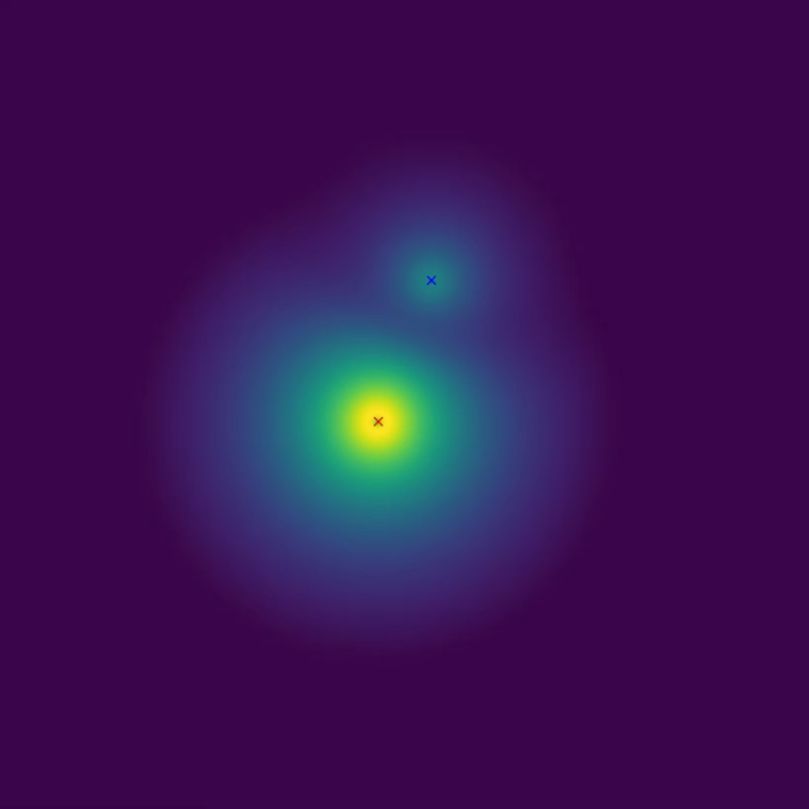
Suggestion of the offset merger scenario
8/9
If we were seeing this from the left direction,
the ICM in the region near the cold front (Reg1) would be observed to be blueshifted.
The arc-like motion of the ICM in the cluster core falling back towards the BCG (Reg6) would be observed to be redshifted.
kT
Galaxy Cluster Merger Catalog http://gcmc.hub.yt

Slide 17
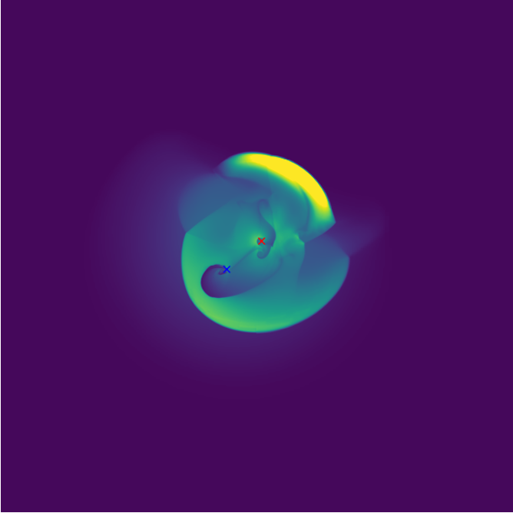
Suggestion of the offset merger scenario
8/9
If we were seeing this from the left direction,
the ICM in the region near the cold front (Reg1) would be observed to be blueshifted.
The arc-like motion of the ICM in the cluster core falling back towards the BCG (Reg6) would be observed to be redshifted.
kT
Red-shifted flow like Reg6
Cold front
Blue-shifted flow
like Reg1
Rotation of
the cluster core
Galaxy Cluster Merger Catalog http://gcmc.hub.yt

Slide 18
Summery
We ①revisit the ICM distribution and ②measure the bulk ICM velocity in Abell 3667 to distinguish two scenarios, a face-to-face merger and an offset merger.
①
②
The unsharp masked image shows some features, the CF-W tail, the BCG-E tail, and the RG1 vortex.
RG1 vortex was produced by a slight offset in core crossing?
The part near the BCG of the RG1 vortex is red-shifted with 980±440 km s⁻¹, which reinforces the offset merger scenario.
Feature work
Propose accurate bulk and turbulence velocity measurements with XRISM.
Perform additional observations with XMM. 126 ks of observation was adopted in AO23 (Priority C).
A paper on these results will be submitted in Jan-Feb on arxiv.

