Slide 1

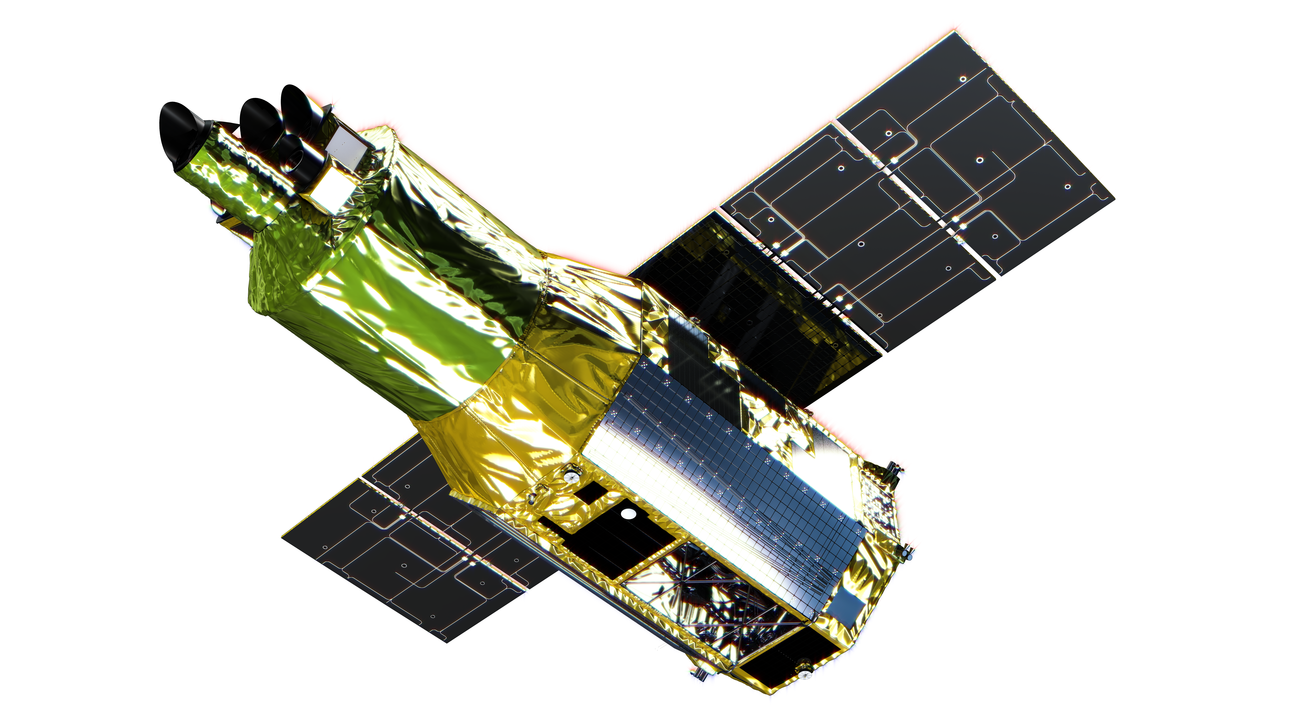
Cycle 1 Policies and Submission Procedures
Koji Mukai
NASA Goddard Space Flight Center
and University of Maryland, Baltimore County
NASA XRISM Guest Observer Facility

Slide 2
Scope of Cycle 1
XRISM observing time is open to the world-wide astronomy community via 3 parallel solicitations.
During Cycle 1 (~August 1, 2024 – July 31, 2025), 15% of available time will be reserved to complete any priority A PV observations that could not be carried out during the 6-month PV phase, and 10% will be Director’s reserve for on-going calibration and real-time target of opportunity observations.
Assuming a 45% observing efficiency, the total GO time for Cycle1 is ~10.6 Ms - that’s about 130 observations of 80 ks each.
Cycle 1 proposals are limited to observations 10-200 ks per pointing. Multiple pointings of a single target (at different binary phases, different positions within an extended objects) may total >200 ks.
Cycle 1 proposals must not exceed 600 ks per proposal.
There is no mechanism within Cycle 1 to grant coordinated observing time of other observatories; there are no current solicitations by other observatories that can grant coordinated observing time on XRISM.
As of this writing, Cycle 1 proposals must assume the Gate Valve-closed configuration for Resolve.

Slide 3
Who May Propose ... and where
The institutional affiliation of the PI determines the agency to which proposals should be submitted. There are no restrictions on the affiliations of the co-Is.
NASA solicitation for researchers based in the US and Canada (https://heasarc.gsfc.nasa.gov/docs/xrism/proposals/propthread.html) - 44% of total GO time, proposal deadline of 4:30 pm EDT on April 4, 2024, proposals must be written in English and be dual-anonymous. See also “Type 2 proposal” for US-based researchers.
ESA solicitation for researchers based in ESA member countries and cooperating states (https://www.cosmos.esa.int/web/xrism/announcements-of-opportunity) – 8% of total GO time, proposal deadline of 12:30 p.m. Central European Time on April 4, 2024, not dual anonymous.
JAXA solicitation for researchers in Japan and the rest of the world (https://xrism.isas.jaxa.jp/research/proposer/announcement/index.html) – 48% of total GO time, of which up to 4% will be made available to PIs outside Japan proposal deadline of 4:30 pm JST on April 4, 2024, not dual-anonymous.
International teams should not submit identical/strongly overlapping proposals on the same targets with the same scientific objective to multiple agencies.

Slide 4
Target Prioirty
Accepted targets will be classified into three priority categories – while target priority is expected to be correlated with proposal rankin, there is no requirement for a strinct linkage – for example, a highly ranked proposal might be awarded one priority A and one priority C target).
Priority A targets (comprising 50% of available GO time) are guaranteed to be observed, with highest priority for observation scheduling.50% of available time. Time-critical or TOO targets must be Priority A. If not carried out during Cycle 1, Non-TOO Priority A targets will be automatically retained in the target list for observation during future cycles (unless the time-critical condition makes it impossible). If unforeseen issues with the observatory, downlink station etc. reduce the achieved exposure time, Priority A observations will not be considered complete unless 90% of approved exposure time is achieved; in such cases, supplementary observations will be automatically scheduled.
Priority B targets (40% of available time) are guaranteed to be observed. If unobserved during Cycle 1, Priority B targets will be automatically retained for future cycles. Priority B observations will be considered complete if 70% of approved exposure time is achieved.
Priority C targets (50% of available time) will be used as scheduling fillers, with the expectation that ~20% (in terms of exposure time) will be observed. Unobserved Priority C targets will not be carried over to subsequent cycles, and incomplete observations will not result in supplementary observations.

Slide 5
Exposure Time, Target Priority and Related Issues
Proposals must specify the total good on-source time of the observation after standard GTI-based data screening (Earth occultation, SAA passages etc.) but not for dead-time.
Observations will be scheduled to achieve the approved exposure time plus a small margin, often (but not always) in a single visit.
Time-critical observations (for coordination with another observatory, monitoring observations, observations for specific binary phases, roll-constrained observation, and any other reasons) are allowed but must be approved at priority A.
TOO observations (of specific targets, remember) must be approved at priority A.
If approved exposure time was not achieved (interruption by TOO, spacecraft or downlink issues), supplementary observations will be scheduled.
Priority C targets are schedule fillers – if not observed within the cycle for which they were approved, they will not be carried over to the next cycle.
Priority A & B targets will be carried over to subsequent cycles if necessary, except (1) untriggered TOO targets; and (2) time critical observations whose constraints can no longer be met.

Slide 6
Proposal Review and Merging
Agency Reviews: each agency (JAXA, NASA and ESA) performs its own peer review to select best proposals for potential implementation. But they do not make the final decision.
International Merging: Three observing lists will be combined into a single observing program.
If a target is common among multiple (provisionally) accepted proposals, the merging committee shall consider if they are true overlaps or if significant differences exist.
Merging: such overlaps may be resolved by awarding a single observation to both teams, who are strongly encouraged to collaborate, with one person designated as the principal PI (PPI).
In some cases (e.g., proposer preference not to merge), one of the proposals may be dropped.
Such merging will be performed on a target-by-target (not proposal-by-proposal) basis.
Non-merged targets may be affected – priority might change, some may get dropped.
Final Program: 50 percent of available time for priority A targets, 40 percent for priority B, and 50 percent for priority), and with appropriate balance among agencies.

Slide 7
Events after the Merging Meeting
For Cycle 1, the Merging Meeting will likely take place in early July, 2024. After some additional checks, the final target list will be published on the web and results (including possible mergers) are communicated back to the three agencies.
For US-based proposers with accepted proposals, there is a phase 2 process to request funding.
Next steps: Long-term and short-term observing schedules will be developed.
Some PIs with accepted time-critical proposals may be contacted if there are questions.
Note that some long pointings may have to be broken up into multiple pieces for operational reasons.
When an observation is put in the short-term schedule, the PI will be contacted to double-check the parameters. If there is significant change in the instrument performance or our understanding of the instrument performance, this will be communicated at this stage or before.
Small (<~Resolve FOV) adjustments in the pointing direction is possible at this stage, particularly ones that depend on the actual roll angle of the actual observation. This could allow for, e.g., better tiling of extended sources, or an offset pointing of a bright point-like source. Larger adjustments, particularly those based solely on science, may be rejected.

Slide 8
Three different installations of ARK/RPS
ARK/RPS has been developed and maintained at NASA for many Goddard-supported missions – currently used for NuSTAR, NICER, IXPE, Swift, Fermi, and TESS.
NB, for XRISM, there are three parallel solicitations using three different installations of ARK/RPS. We expect to open all three version by the end of January. For security reasons, ARK account information is not shared among the three versions.
First action: If you have never used ARK/RPS, or if you are submitting a XRISM proposal to JAXA or to ESA, create an ARK account on the right installation of ARK/RPS, and join the XRISM group; PIs in US or Canada with an existing ARK/RPS account can simply join the XRISM group. Note that we only have a mechanism to prevent submission of XRISM proposals to the wrong ARK/RPS, we do not have a mechanism to prevent you from joining the XRISM group in the wrong version of ARK/RPS (e.g., researcher in Germany can create an account and join XRISM group in the JAXA version of ARK/RPS, but they will be prevented from submitting a proposal to the JAXA ARK/RPS.)
Then familiarize yourself with ARK/RPS in general and the XRISM proposal form in particular.
See https://heasarc.gsfc.nasa.gov/ark/xrism/help.html (already public).

Slide 9
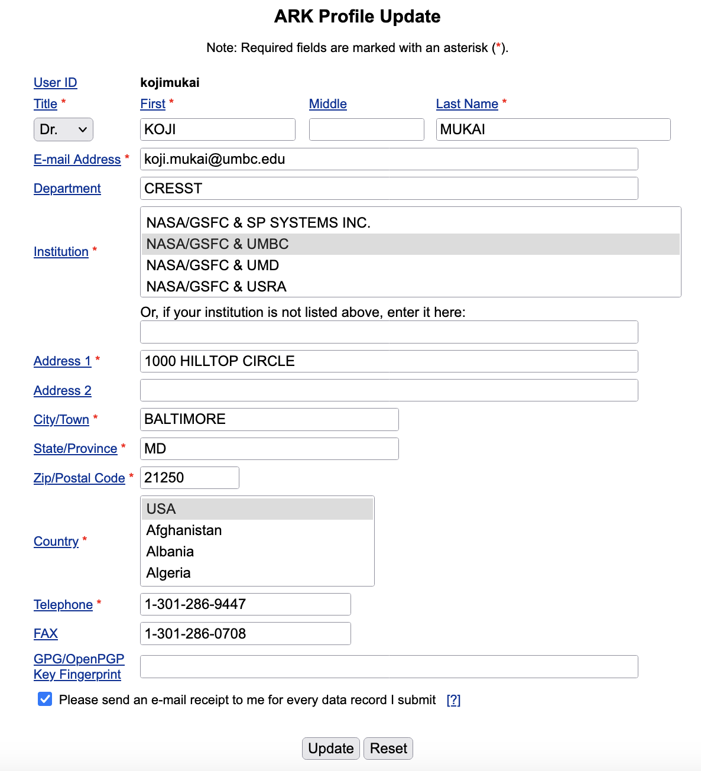
ARK User Profile
Your ARK Profile contains name, affiliation, institutional address (including country) that will be used to automatically fill the PI filed of any proposals you create and/or submit.
If you move to a different institution, you can update your ARK Profile (as long as you known your ARK user ID and password.
Note the last tick box – this is the mechanism to specify whether you want e-mail confirmation when you’ve submitted a proposal.

Slide 10
Basic Steps
Fill all the compulsory & desired fields of the RPS form
Verify – checks all the compulsory fields are filled, and that all the entries are within the allowed limits. If your form fails, you must modify accordingly.
Submit – this button will only appear if your form has been successfully verified.
Upload – when you submit, you will be invited to upload the scientific justification as a PDF file (and a second PDF for NASA, see later) – this can be done later.
You can use the “Show all proposals” link to see your proposals – you can discard or modify the forms, or (re)upload PDF files to keep working on the proposals up until the deadline.
We recommend keeping a PDF copy of your submitted forms for your own record.
When your ARK/RPS session times out, your form in progress will be lost – you can save and reload forms in progress before Verify/Submit as a safeguard.

Slide 11
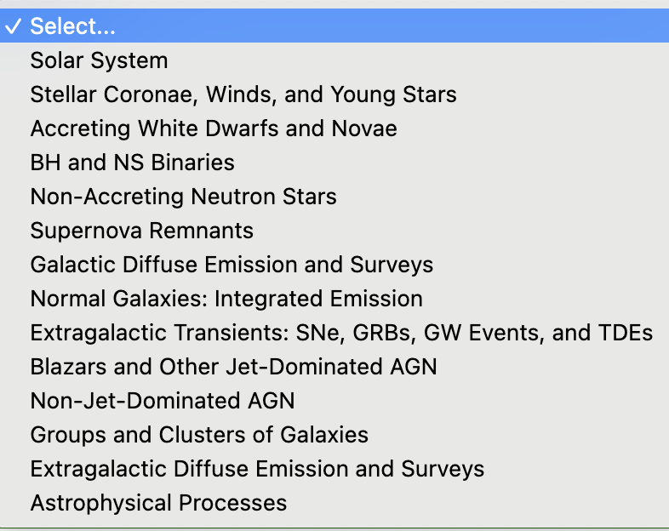
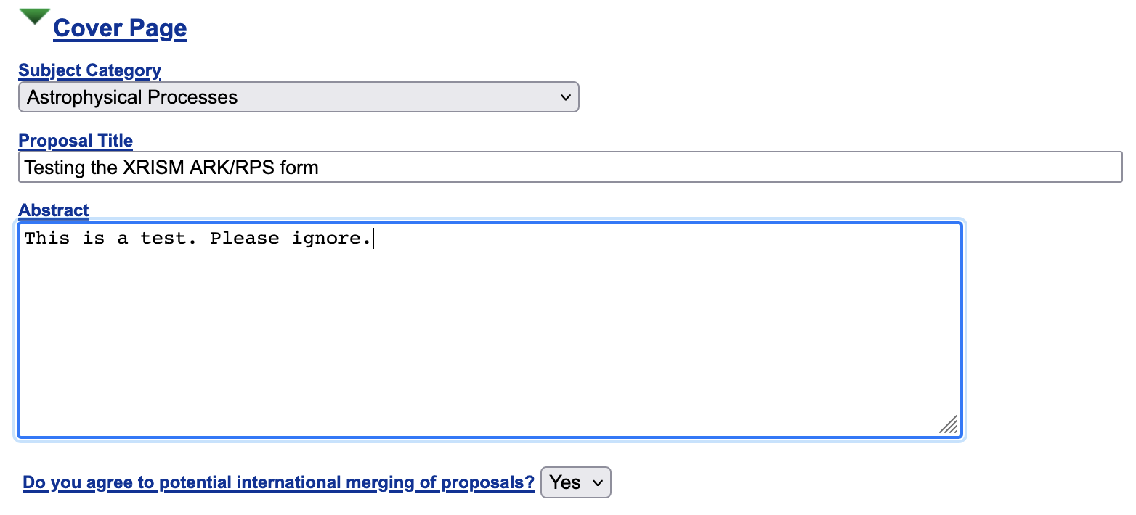
Cover Page
On the cover page, pick the appropriate “Subject Category”, type in proposal title and abstract (without LaTeX etc. mark-ups).
Subject category (when correctly chosen) help us select the right expertise to review the proposal.
You can opt out of potential merging.

Slide 12
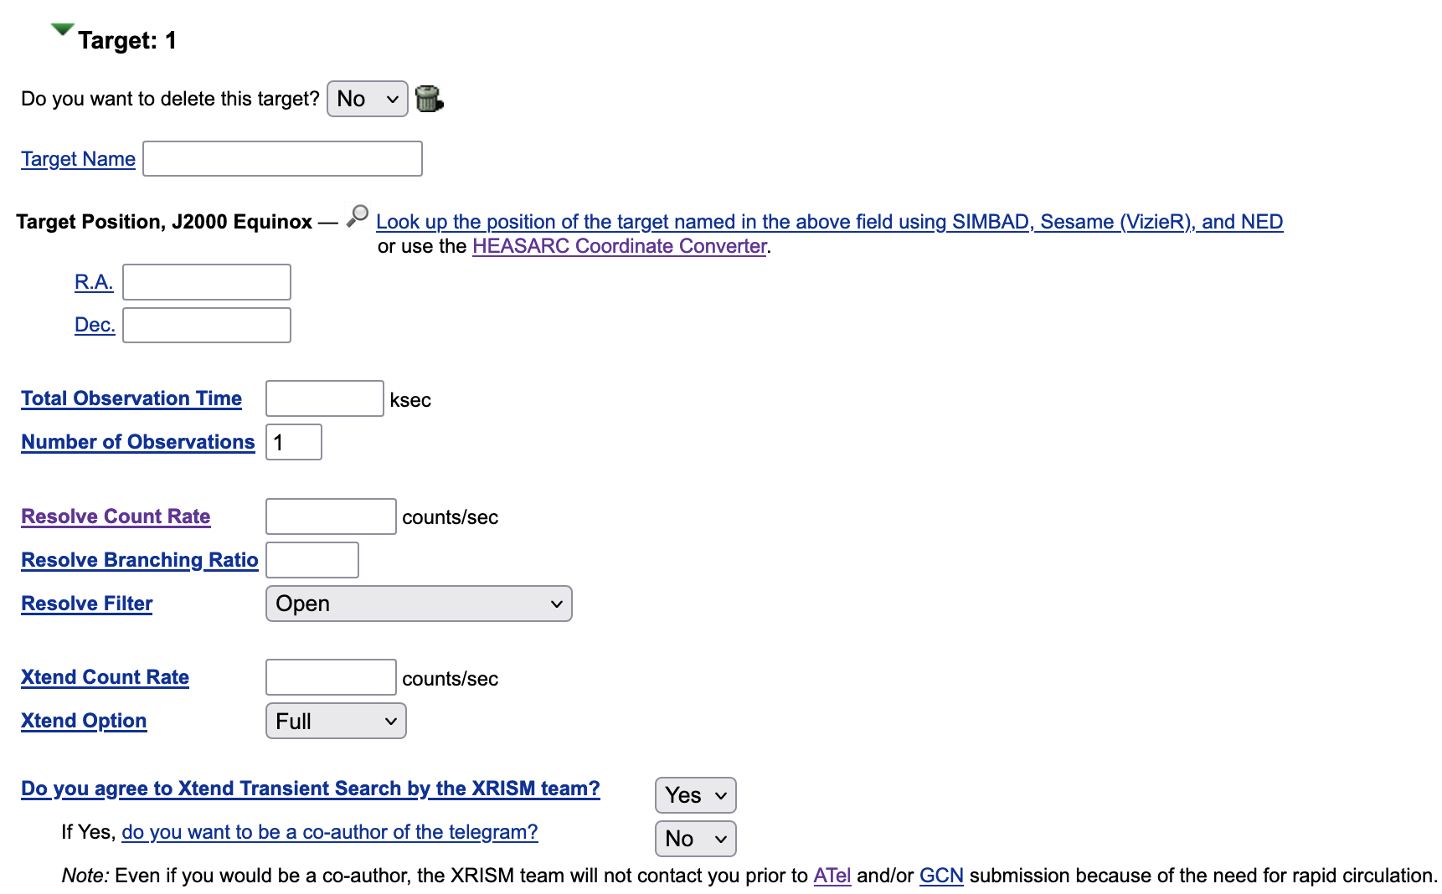
Target Form
You start by clicking on “Add Target” button to reveal the Target Form (you can subsequently add or delete targets).
Target name, RA and Dec, total time (10-200 ks), and estimated count rates are obvious.
You can use “number of observations” of >1 to divide your total exposure into n equal-length sub-pointings (for monitoring observations)
Resolve branching ratio: estimated fraction of H+Mp events from, e.g., WebPIMMS.
Finally, agree (or not) to Xtend transient search outside the Resolve FOV.

Slide 13
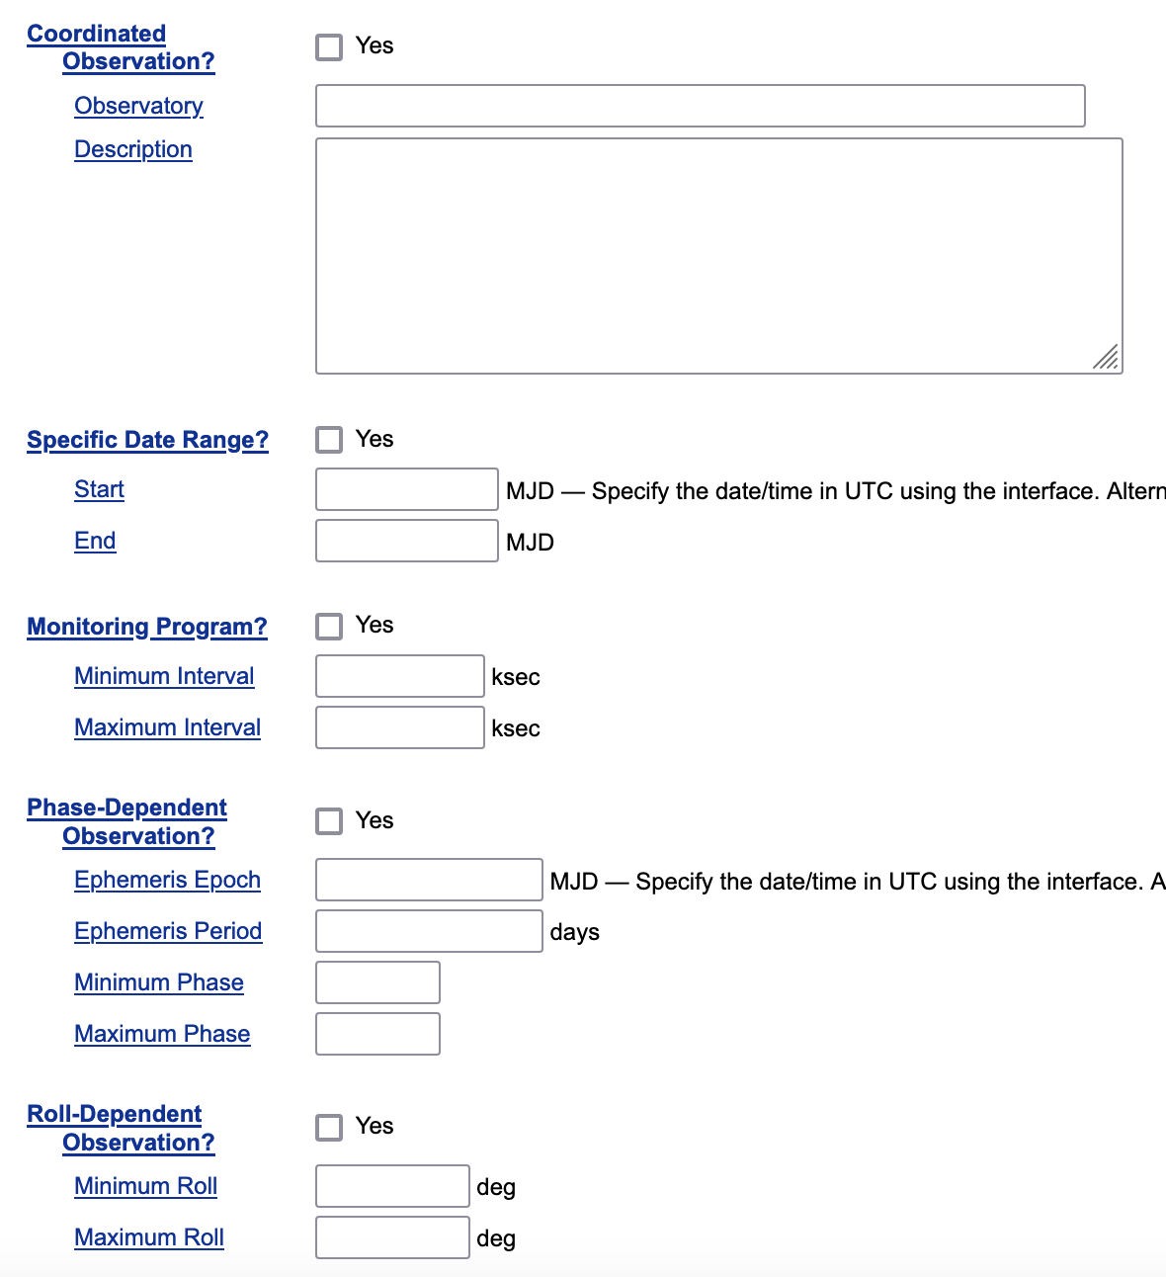
Target Form (continued)
The RPS form for XRISM recognizes 5 different ways in which XRISM observations can be time-constrained.
Coordinated – remember, the time on partner observatory must be secured separately this cycle.
Specific date range – catch-all category.
Monitoring – if you want to divide your “pointing” into multiple pointings to probe variability. Specify number of observations >1 and specify the desired interval.
Phase dependent – relevant to binaries with orbital period substantially longer than the duration of observation.
Roll dependent – if you want Resolve FOV in certain orientation, this (if possible) translates to a time constraint.

Slide 14
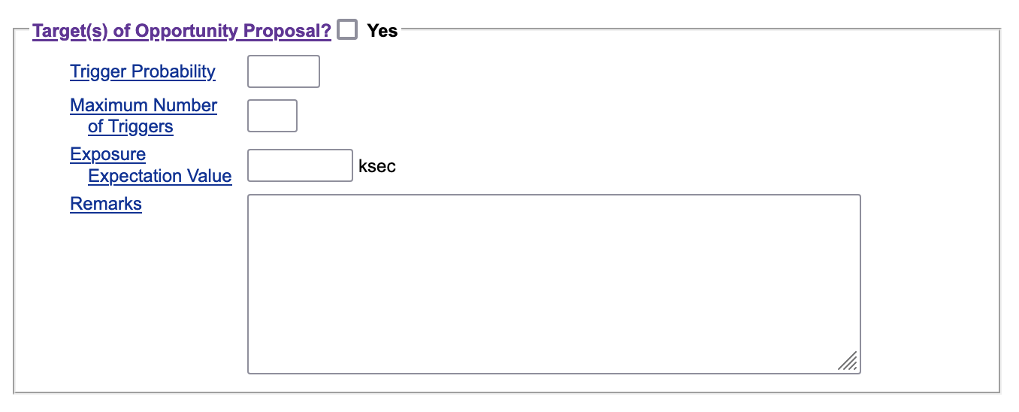
Target of Opportunity Proposals
You cannot mix TOO and non-TOO observations in a single proposal, so this tick box is on the cover page.
TOO proposals for a specific target or a list of specific targets are allowed, but not a generic (“nearby supernova”) TOO proposals on unknown targets.
Triggering criteria must be clearly specified and estimated trigger probability (for the entire proposal, not on a target-by-target basis) must be provided.
Up to 10 candidate targets can be specified. Multi-candidate TOO proposals can request observation of any or all of the targets that satisfy the triggering criterion – as long as the total exposure time does not exceed 600 ks.
It’s okay to have 10 candidates of 150 ks per target, if ”maximum number of triggers” is 4 or fewer.

Slide 15
TOO Proposals (continued) – Exposure Expectation Value
How much time should we put aside for TOO proposals? We use probability-weighted time.
In the general case, it’s very tricky to calculate – but it’s less difficult for the proposal PI than for the GOF staff or reviewers, so we ask you to estimate this number and enter into “exposure expectation value” field.
Simplest case - a single target, exposure time of T, trigger probability of P – enter T times P.
Next simplest case – n candidates, all same exposure. Just remember you can’t sum the probability, you have to do something like 1-(1-p)^{n} as the proposal-level trigger probability, required by the form.
If you request ”max trigger”>1, then you have to add “probability of triggering once” times T, probability of triggering twice times 2T etc.
We do not recommend – although we do allow – n-candidate, multi-trigger (<n) TOO proposals with different exposure times for different targets.
This would mean that the order in which these targets trigger matters. This might depend not only on individual trigger probability but how the XRISM visibility windows are ordered.
Good news – exposure expectation values need not be highly accurate – a difference of 5 ks may not be important when allocating 10 Ms of observing time.

Slide 16
For US-based investigators only
(Also for Canadians): The form and the scientific justification should be written anonymously, and a second, non-anonymized document describing team “expertise and resources” must also be uploaded.
US-based PIs will be eligible to receive funding from NASA
Eligible PIs will be contacted to submit Stage 2 (budget) proposals.
Supporting Atomic Physics (SAP) proposals
Interpretation of XRISM/Resolve data may require an improved knowledge of atomic physics.
Proposals for (up to) 3 year funding of either theoretical or experimental investigation will be solicited at the same time as AO-1 observing proposals
Such proposals must be explicitly tied to expected XRISM science.

Slide 17
Future Cycles
Future announcements are anticipated annually.
No more time for the Science Team – GOs get 90% of total time, with 10% being reserved for ongoing calibration, unanticipated TOOs and other director’s discretionary observations.
We will consider introducing Key Projects category or similar to allow large projects.
Joint proposals with several missions (e.g., NuSTAR, NICER, XMM-Newton, Swift) will likely be allowed, subject to successful negotiations. This allows proposers to secure time on multiple missions by submitting a single proposal.
This was considered too complicated for implementation during Cycle 1, given the various uncertainties of a mission yet-to-launch. Proposers are free to arrange joint observations by submitting proposals to XRISM and other missions.
Reminder: Resolve and Xtend are co-aligned and always operate simultaneously.

