Slide 1
PCA Energy Calibration – Lessons for the future
Remember to be alert: the data might answer questions you didn’t ask
Keith Jahoda
29 March 2012

Slide 2
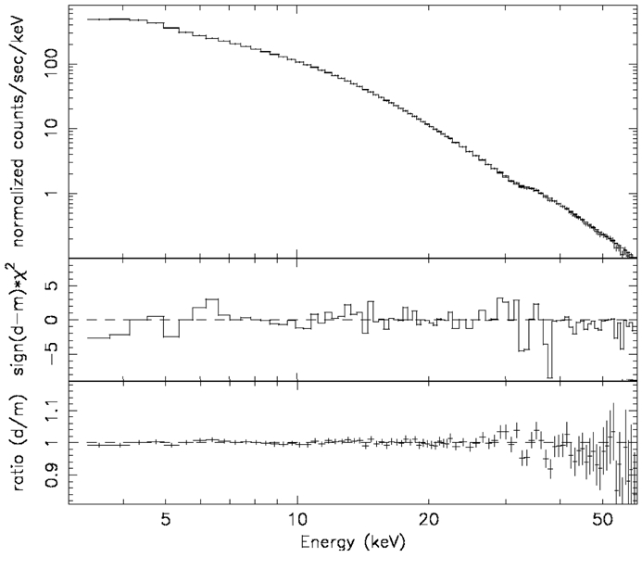
PCA Energy Calibration - status
Current (final) calibration is described in Shaposhnikov et al. “Advances in the RXTE PCA Calibration: Nearing the Statistical Limit” (in preparation)
Example shows Crab data with 7 x 10⁶ counts and χ² ~ 96 (84 degrees of freedom)
Success relies on detailed physical model … and time.
M. C. Weisskopf et al. 2010 ApJ 713 912

Slide 3
Atomic Edges complicate the response
PCA response matrix includes 3 discontinuities at the Xe-L edges (4.78, 5.10, 5.45 keV)
  Jumps in the energy to channel relationship
  Changes in the quantum efficiency
  Changes in the redistribution
Large residuals in early matrices are evidence of the difficulty in separating the three effects
Deliberate calibration lines are continually present at energies ≥ 13 keV

Slide 4
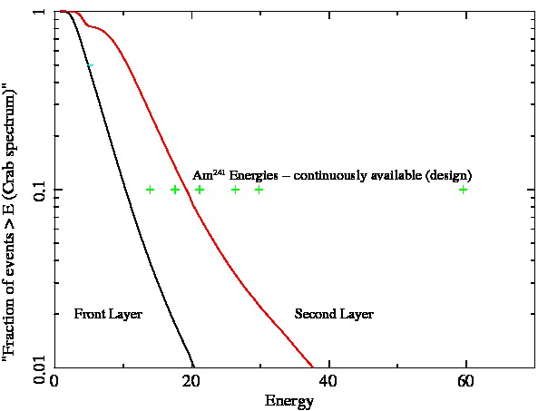
The PCA count rate from the Crab is ~2800 ct/s (total) with overall with ~2500 ct/s in the front layer; > 95% of photons in the front layer (and >90% of all detected photons) have energy lower than all of the Am²⁴¹ calibration lines.

Slide 5
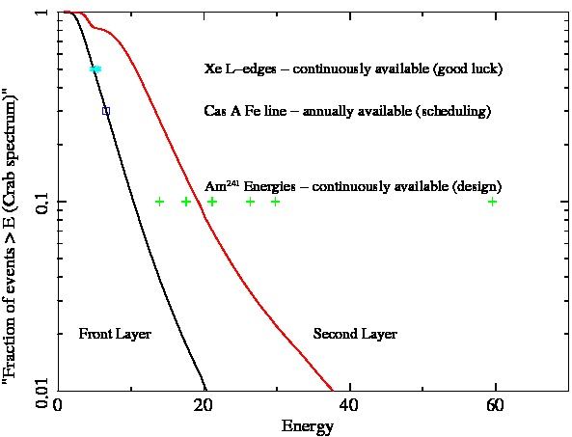
Cosmic lines, and a design flaw/feature fill in the gap

Slide 6
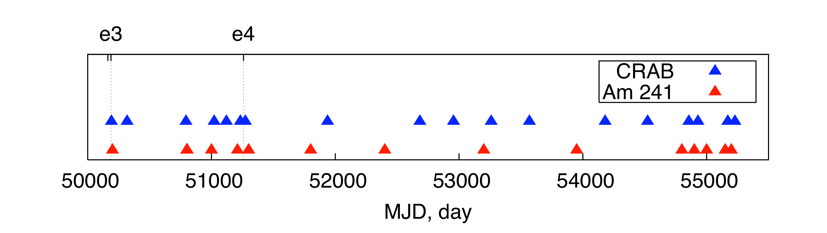
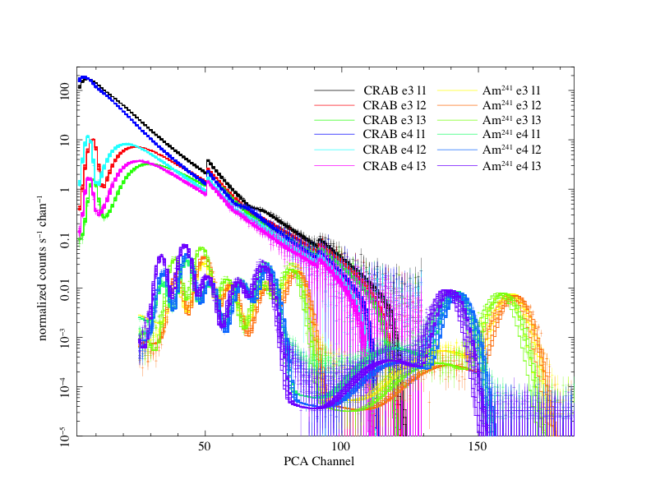
Simultaneous fitting of many Crab and Am²⁴¹ observations breaks the degeneracies, largely because the quantum efficiency is time dependent.
Non physics based parts of the model
  Time dependent Quadratic charge-to-channel relationship

Slide 7
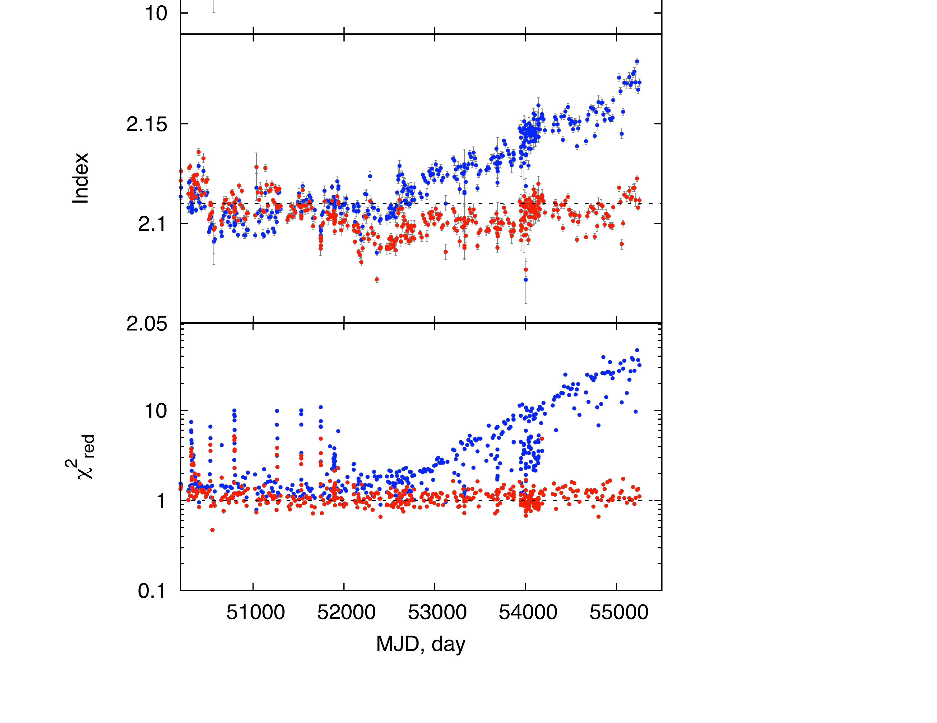
Current model provides a single parameterization that gives consistent results and good fits over many years.
Figure shows results for single PCU fits to Crab (1996-2010)
What else should we have been paying attention to?
N. Shaposhnikov et al. 2010 IACHEC

Slide 8
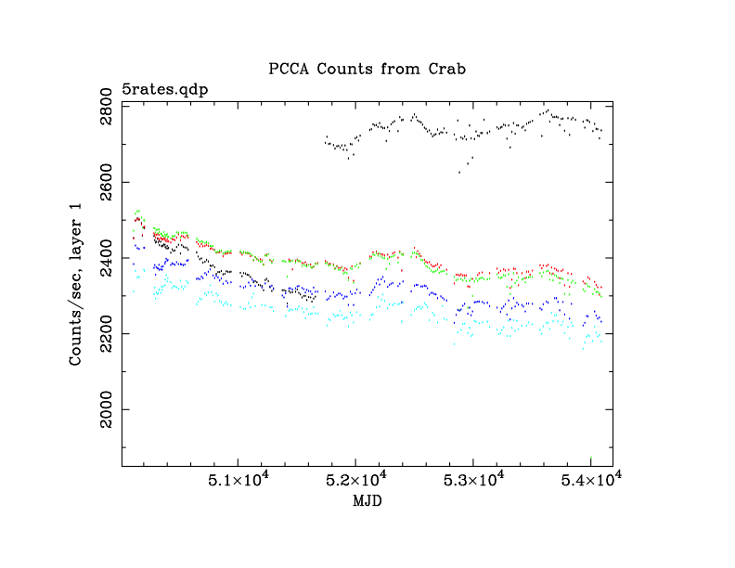
E-mail attachment 2/23/2007
Raw count rate shows
  loss of propane layer in pcu 0
  gradual decline in counting rate
    channel boundary shifts
    accumulation of Xenon in propane layer
  unexplained bump centered on MJD 52300

Slide 9
Text from the same e-mail
“….
So, re your offer,
If it is easy for a student to examine the HEXTE fluxes and compare to the PCA, I would be grateful. The student would either (a) become a co-author on a paper about long term variability in the Crab integrated flux or (b) contribute in an important way to tracking down a previously unknown PCA instrument signature. I hope for (a) and expect (b). ….”
It turned out not to be easy (HEXTE was not rocking for most of these observations in order to increase timing sensitivity). The bump was first forgotten, then explained by others

Slide 10
Conclusions / Advice
Develop a physics based detector model
Calibrate in the middle of the band
  and on both sides of atomic edges
Do (many) more calibration observations than you (think you) need

