Slide 1
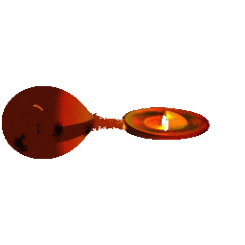
RXTE Observations of Cataclysmic Variables and Symbiotic Stars
Koji Mukai
NASA/GSFC/CRESST and UMBC

Slide 2
How RXTE matches up with WDs
Luminosity: up to ~a few x 10³⁴ erg s⁻¹ for symbiotic stars, ~a few x 10³³ erg s⁻¹ for typical intermediate polars, ~a few x 10³² erg s⁻¹ for hard X-ray bright polars, and 10²⁹-10³¹ erg s⁻¹ for dwarf novae – a few dozen systems are good targets for RXTE.
If optically thin, shock temperature is 20-60 keV for magnetic systems (strong shock from free-fall), <10-30 keV for most non-magnetic systems (from Keplerian flow)
Timescales:
Orbital period from a few minutes to a few days (CVs) and ~1 year to decades (symbiotic stars)
Eclipse transitions from ~2 s to ~2 min
Spin period from ~10 s to ~1 hr
Dwarf nova outbursts last from a few days to a few months
Nova outbursts create shocked X-rays for first 100-1000 days
CVs and symbiotic stars are unpredictable

Slide 3
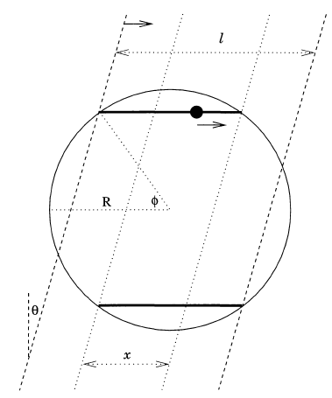
Eclipses in the IP, XY Ari
Sharp (<2 s) eclipse transitions whose timings wander as a function of spin phase allowed Hellier (1997) to put tight constraints on system parameters.
Since XY Ari is the only deeply eclipsing IP
Known, this work still provides the best constraints on the accretion spot size in IPs.

Slide 4
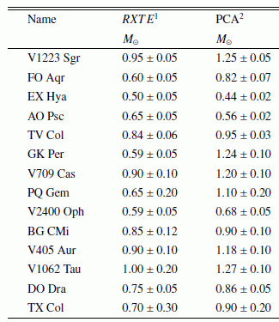
WD Mass in IPs
kTmax is best determined using high energy data, particularly because IPs suffer complex absorption below 5 keV.
Suleimanov et al. (2005) used PCA+HEXTE data to estimate the white dwarf mass (via kTmax) in 14 IPs, often revising previous estimates downward.

Slide 5
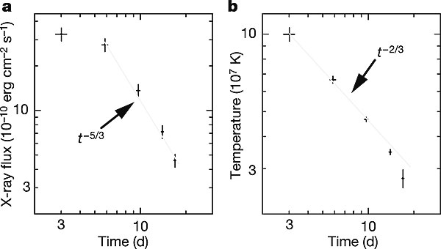
Ejecta Mass of RS Oph (2006)
Novae (thermonuclear runaway) eject a large fraction of the accreted envelope – internal shocks (novae in CVs) or shocks against the red giant wind (Symbiotic systems) generate early hard X-rays.
Sokoloski et al. (2006) used the evolution of X-ray spectrum to estimate the ejecta mass in RS Oph.

Slide 6
Dwarf Nova Outbursts
Dwarf nova outbursts are explained as due to disk instability.
What do X-rays tell us about the changes in the boundary layer?
What do X-rays tell us about the continued accretion during quiescence?
High luminosity
Eclipse shape
Intra-quiescence evolution
We expect the boundary layer to be completely optically thin during quiescence, but (mostly) optically thick in outburst (Patterson & Raymond 1985)

Slide 7
SS Cyg: The Paradigm or Outlier?
In SS Cyg,
Hard X-rays rise with a delay
Sudden drop in hard X-rays, with simultaneous turn-on of soft X-rays
Hard component weaker and softer during outburst peak than in quiescence
Another hard X-ray enhancement during outburst decay
(Wheatley, Mauche & Mattei 2003)
Is this generally true of all dwarf novae, and do we have a model that can explain these behavior?

Slide 8
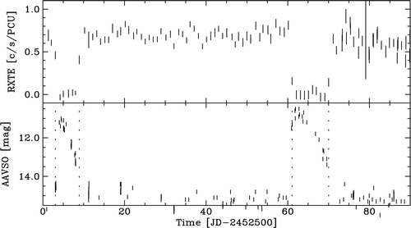
Other Dwarf Novae
Hard X-ray suppression during outburst is often observed (e.g., WW Cet, above) but not always (U Gem, left).
The early and late hard X-ray enhancement has so far only been seen in SS Cyg, despite RXTE campaigns on other systems capable of detecting them.

Slide 9
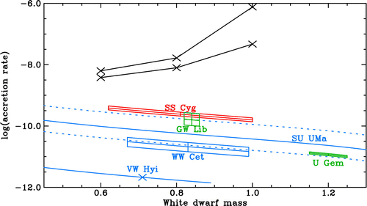
Transition and Softening
The accretion rates at which the boundary layer transitions from optically thin to thick are different from system to system, and from theory.
Softening: separate origin of outburst hard X-rays, or Compton cooling?

Slide 10
Trend during quiescence
Collins & Whately (2010) found a slow decline in hard X-ray luminosity during quiescence in SU UMa. This is another phenomenon that the standard Disk Instability Model (DIM) cannot explain.
DIM does not provide a good description of observations in quiescent dwarf novae – and in other quiescent systems.

Slide 11
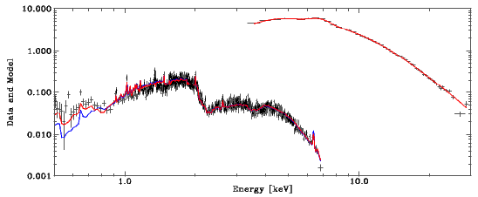
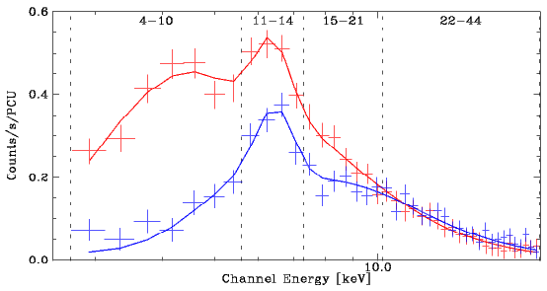
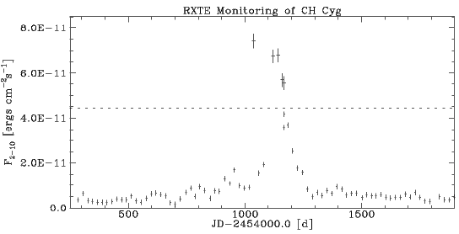
We Are Not Done Yet

